Slide 1

Notes:
Welcome
Recognize who the hosts for today’s webinar are
Housekeeping
Thank you for joining us. This is one of three CCRG Reporting TA sessions hosted by INCCRRA
We have lots of people on the line today – so you are all muted throughout the webinar.
Encourage you to put questions in the chat – they will be added to the FAQ under a Reporting Section to be added soon.
PPT along with other CCRG resources are available at www.inccrra.org for your reference once the reporting forms are released
Again, INCCRRA continues to provide TA throughout the life of the CCRG via email and/or the call-center.

Slide 2

Agenda
Webinar Purpose and Goals
Overview of the first round of the CCRG awards
Review of the structure and rules governing the CCRG
Brief review of reporting expectations
Step-by-step review of the reporting process and forms
Timeline
Notes:
Run through the agenda quickly

Slide 3
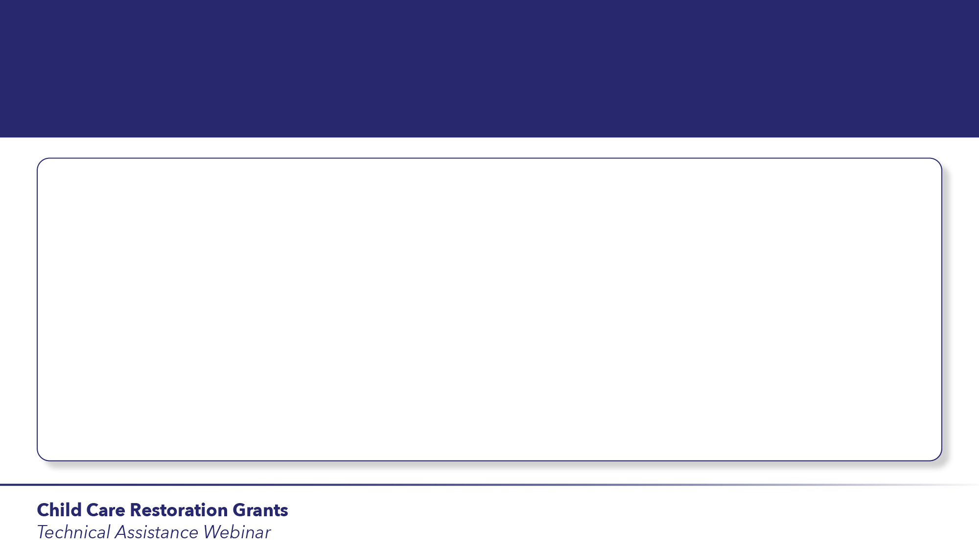
Purpose and Goals
Notes:
Today’s webinar is primarily designed to prepare you for the reporting requirements for the CCRG.
First, I will go over a few ‘high-level’ items related to the first round of the CCRG and then the staff at INCCRRA will walk you through the reporting expectations.
Much like our first webinar that introduced you to the application portal and process, we are providing this TA session BEFORE we actually release the budget reporting forms – so you know what to expect. Joellyn will talk about the timeline during her presentation.
As true for this entire process, INCCRRA staff will continue to be available to you throughout the entirety of the reporting process to answer your questions in ‘real –time’. Today’s webinar is just to prepare you on what to expect.

Slide 4

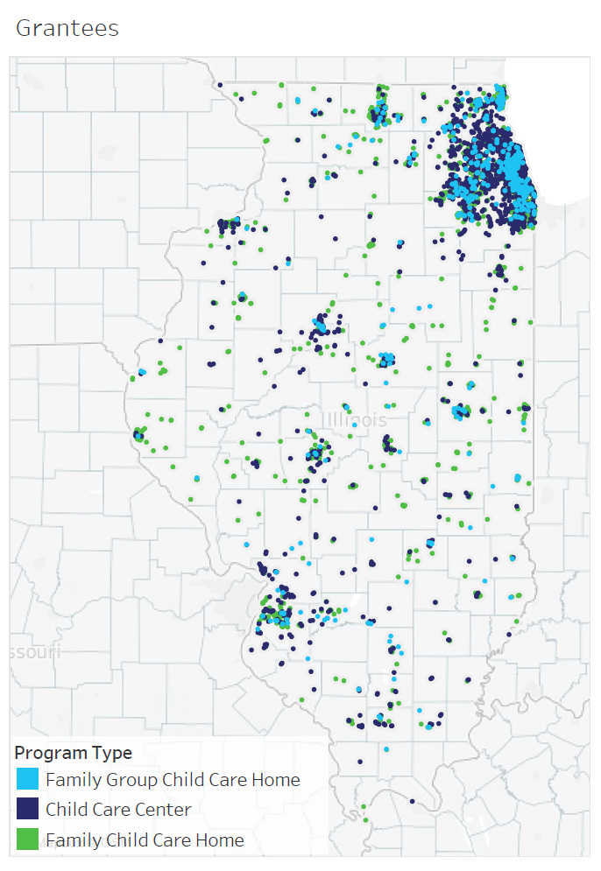
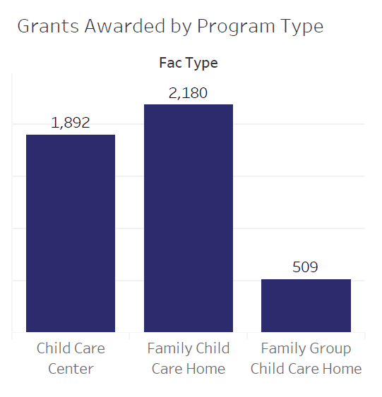
Notes:
94 counties have providers who have received an award
4,581 grants have been awarded; 1,892 centers, 2,180 family child care providers and 509 group family child care providers
Awards total $149.2 million
Another 145 programs are pending totaling another estimated $2.2 million
44 have been found ineligible for an award.

Slide 5
Rules and Structure of the CCRG
Federal CARES relief funds
Grants vs. the usual ‘fee for service’ child care dollars
Funds flow through the Department of Commerce and Economic Opportunity
Financial information beyond the amount of your grant
Notes:
These funds must be spent by December 30th – so we are working hard to get these dollars into the hand of child care providers
Because these funds originate as ‘business interruption’ – they flow through DCEO and follow specific rules and requirements either because of the federal funding source or because of the state policies that regulate DCEO funds.
Also, it is important to note that these funds are grants and not a fee for service funding arrangement. As such, the funds are subject to the rules and requirements laid out by the Illinois Grant Accountability and Transparency Act.
To both of these points, there are a few things to note:
DCEO posts all names of awardees along with the amount of their grant on their website for transparency.
This is not unlike all state salaries are public and posted on the comptrollers website \
As was true for the application process, requirements for information needed is defined by federal or state law and policy
For example, it is a federal requirement all applicants must have a DUNS number
For federal auditing purposes – you must keep all receipts and records of your award for five years. The state may ask to review those records at any time.
Finally, you will notice on the budget reporting form that you will be asked to report on funding and expenses beyond the CCRG. The amount of your grant has been calculated to help make-up the loss experienced due to the reduced capacity/group size mandated due to COVID-19. in order for us to fully understand the use of the CCRG dollars, we must understand the full picture of your monthly expenses and revenue.

Slide 6
Brief Review of the Reporting Requirements & Process
Receipt of Approval form must be signed and returned
Monthly reports; first one due September 15th
Exceptions
When will you receive the reporting forms
Reconciliation
September 15th
Notes:
The first report is due on Sept. 15th ; this will cover the months July and August. Each month must be reported separately.
September report will be due on October 15th.
If you have not received your check in the mail by the time your report is due INCCRRA will automatically extend your monthly reporting deadline. – we know that and will expect your report once your check has been received. However, you know what your award amount will be so there is no reason you do not prepare your report, but we understand if you do not want to submit it until the check is in the bank.
You will be required to fill out two separate ‘forms’ for your monthly report. You will receive an email next week with a PDF attached that you must sign and return. This form simply acknowledges that you received the check in the amount stated in the form. Joellyn will go over how you can sign and upload this document.
Also in the email is a link to access a budget reporting worksheet along with an instruction sheet to accompany the budget reporting worksheet. In the direction sheet are some examples of what to enter into that line and some scenarios of what is and what is NOT allowed under that category. These instructions are meant to be helpful and clarify any part of the form that might raise the question ‘is this what they are looking for in this line?’ We encourage you to download, print and complete the budget worksheet to make adding the information online easier.
Again, the form must be filled out for each month of the three-month period covered by the first round of CCRG (July, August and September). This is an on-line form so there is nothing to download or print – you can fill it out on-line. At the end of the three-month grant period, we will reconcile your monthly reports against your award amount.
On September 8th you will be able to access an area of the Director Portal for monthly restoration grant reporting. In the portal you will be able to upload your PDF letter, complete your monthly reporting (using your worksheet) and access a link to a narrative report. This narrative report is in the form of a survey-monkey questionnaire. We have tried to make it as simple and strait forward as possible and while providing us with important information, it should not take you long to complete the survey.
SPEND THE MONEY. We know the future is unclear and you might be tempted to try to ‘make it last longer’. It won’t work that way. You need to spend it in the period for which the funds were granted. Otherwise, you will either be asked to return the unused amount or they will impact your award in the second round of the CCRG. The state must be in full-receipt of your reports in order for you to be considered for a second round of CCRG grants – if funding allow for a further disbursement.
Again, the reports are due September 15th (and then again on October 15th).
Now. Joellyn is going to walk us through the process from nuts to bolts – including the email you will receive, where the links will take you, and then walk you through the actual form.

Slide 7
Report Walk-Through

Slide 8
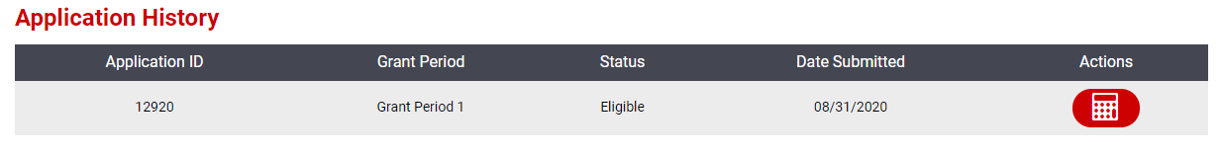
How to Access CCRG Reporting
Log in to Gateways Registry
Enter the Director Portal for your program
Go into the CCRG Application section
Click the calculator icon by your eligible application

Slide 9
Components of Reporting Process
Receipt of Approval Letter (one-time upload)
Budget Report
Narrative Report

Slide 10
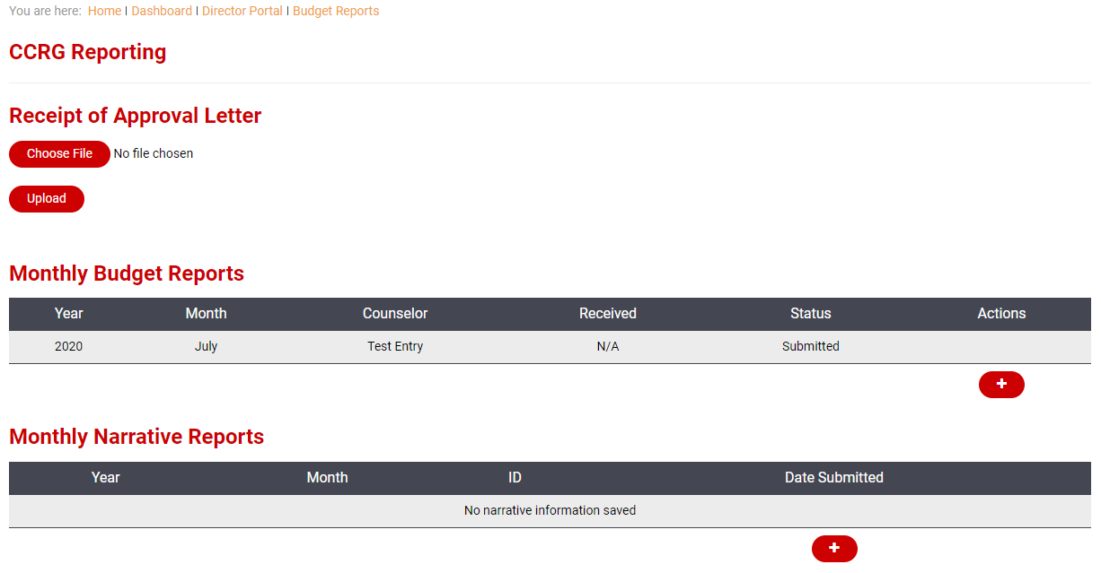
1
2
3

Slide 11
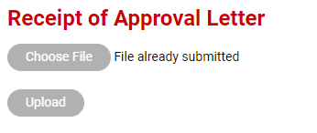
1. Upload signed Receipt of Approval letter
You need only do this one time
Click Choose File
Locate the file on your computer
Click Upload
The upload is successful if the text changes to “File already submitted” and both buttons turn grey

Slide 12


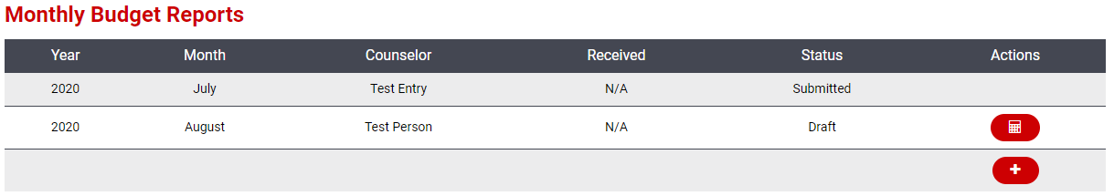
2. Complete Budget Report
Complete one budget report per month (July, August, September)
Click to add a new budget report
Click to edit your budget report

Slide 13
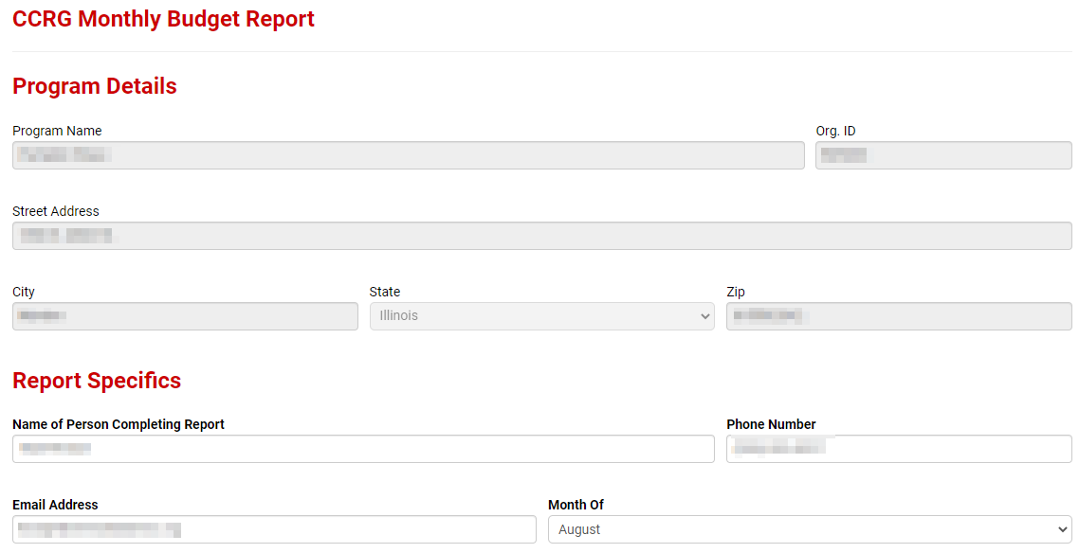
Leave Program Details section as-is;
Meant just as a double check to ensure you’re reporting for the right program
Under Report Specifics, enter the name, phone number, and email address of the person completing the report. Select the month you are reporting on.

Slide 14
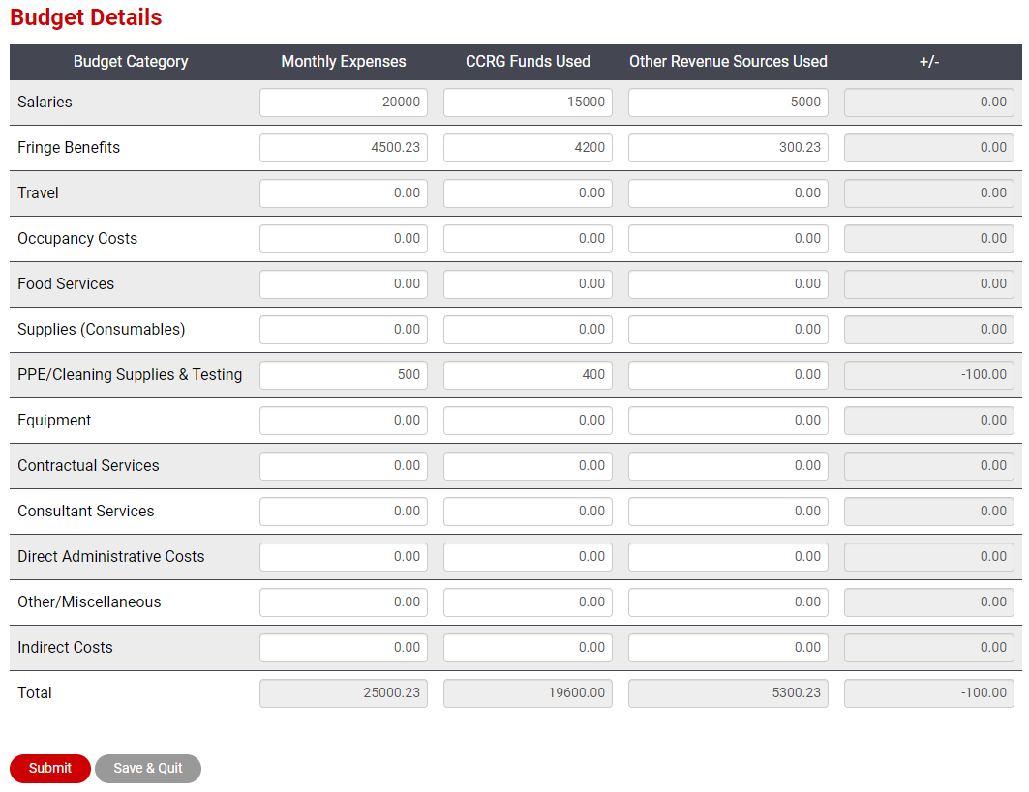
Enter monthly expenses, CCRG funds used, and other revenue sources used for each category (no dollar sign, no commas)
The system will automatically calculate the +/- and totals
Click Save & Quit if you want to save and finish later
Click Submit to submit the budget report

Slide 15
Revenue Sources
CCRG Funds
Other Revenue Sources
Funds from private pay fees, parent co-payments, CCAP, Head Start, PreK, CACFP, etc. normally used to pay expenses

Slide 16
Expense Categories
Salaries – all agency staff salaries for the report period
Fringe Benefits – amount paid on behalf of employees
Travel – travel-related expenses such as mileage, parking for staff, or student-related transportation costs
Occupancy Costs – rent, utilities
Food Services – food and food supplies
Supplies (Consumables) – educational and office supplies

Slide 17
Expense Categories (cont.)
PPE/Cleaning Supplies & Testing – maintenance supplies, detergent, PPE, cleaning supplies; COVID testing for staff
Equipment –equipment, cots, chairs, toys, etc.
To be claimed against the grant, purchases must be related to COVID. Examples: portable partitions to enforce social distancing or hand washing stations.
Contractual Services – contractual services such as janitorial or cleaning services, trainers for staff, etc.

Slide 18
Expense Categories (cont.)
Consultant (Professional Services) – consultant services such as nurse consultant, social services consultant, etc.
Direct Administrative Costs – costs such as postage, printing, bookkeeping services, etc.
Other/Miscellaneous – costs not capture in other categories
Indirect Costs – agency indirect costs may be listed here but you may not use CCRG funds for indirect costs

Slide 19
Budget Report Status Definitions
Draft – you started the report and saved, but have not yet submitted
Submitted – you submitted the report and it is awaiting review
Information Required – some additional information is needed, check email and re-submit
Accepted – report has been reviewed and accepted

Slide 20
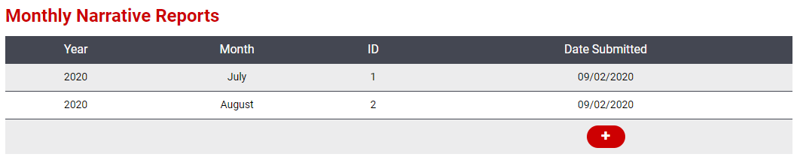
3. Complete Narrative Report
Complete one narrative report per month (July, August, September)
Click to add a new narrative report
Narrative reports cannot be edited once submitted!
A copy of the survey questions will be available for you to review and prepare your response

Slide 21
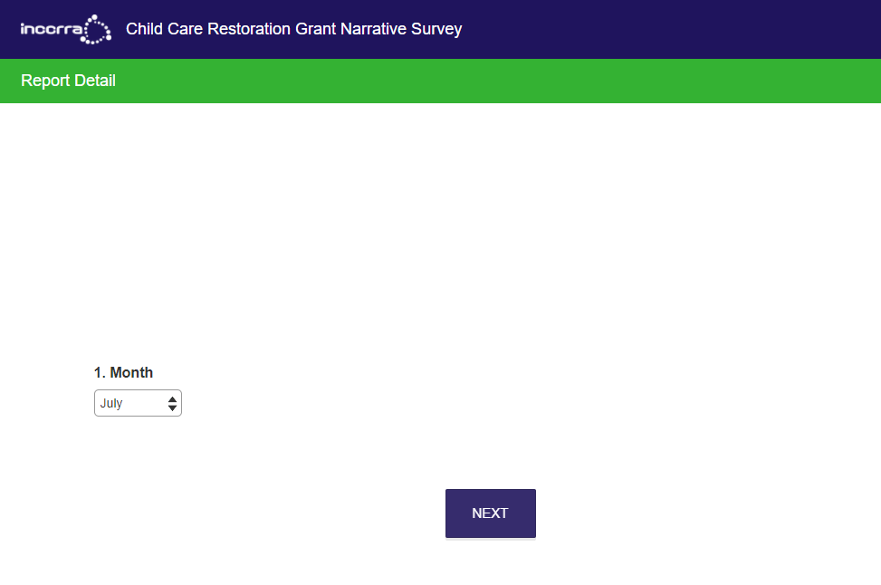
The monthly narrative report is a SurveyMonkey survey that is tied back to your grant application.
ONLY access the survey through the Director Portal > CCRG Application > Reporting screen
Do not copy your survey link and send it to others or use it for other programs

Slide 22
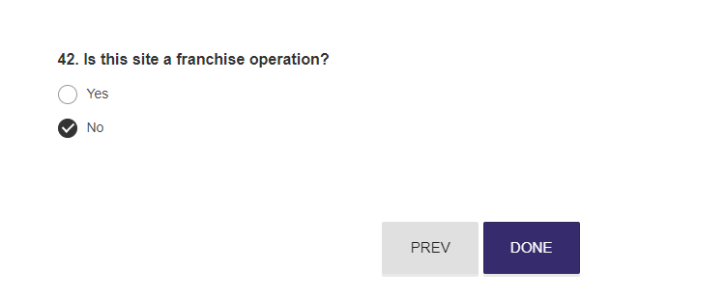
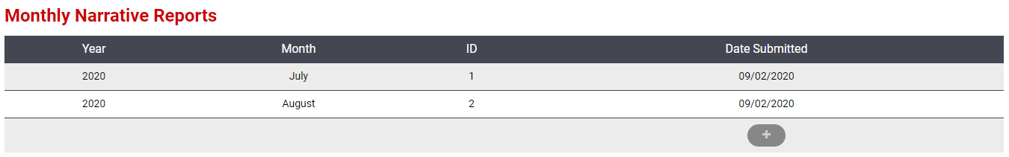
Be sure to click the final DONE button to submit your monthly narrative report
Your submitted narrative report may not appear in the listing immediately
Please allow 48 hours for your report to appear
Do not complete a survey for the same month again unless you are asked to do so

Slide 23
Getting Help
Our CCRG Help Desk team is available M-F, 8:00am – 4:00pm
Call toll-free 1-855-939-4858
Email us at ccrg@inccrra.org

Slide 24

Notes:
As always. Thank you for what you do each and every day.

