Slide 1


Slide 2

WELCOME!
Flexibility: requisite skillset
What’s the plan for today?
Who is in the audience?
Where are materials/information posted?

Slide 3

Agenda
Forum Agenda for Thursday, April 16, 2020
10:00AM Welcome Joni Scritchlow, Senior Program Director INCCRRA
Keynote Albert Wat, Alliance for Early Success
Advancing the ECE Profession: Where Do We Go From Here?
State Panel Presentations:
Dr. Stephanie Bernoteit, Illinois Board of Higher Education, Executive Deputy Director
Dr. Jamilah R. Jor’dan, Governor’s Office of Early Childhood Development, Acting Executive Director
Q &A facilitated by Albert Wat

Slide 4

Who’s participating?
Faculty Fellows
Faculty & Deans representing the majority of our Gateways Credential Entitled Institutions
State Agency & Advocacy representatives
State Competency Leadership Team

Slide 6

Materials/Information
Gateways to Opportunity Forum Agenda
State Panel Bios
Entitled Institution Maps
Credentials and Competency Timeline
College Cohort Report
Faculty Fellows Report
FAQ: Modularization
Guidance Regarding Illinois Articulation Initiative document
Guidance on Applying Pass/Fail Grades document
Dual Credit Guidance link to document
Dual Credit FAQ link to document
COVID-19: Illinois’ Early Childhood Care and Education Response document

Slide 7

Critical Role of Faculty
Develop & Implement Gateways Credentials
Advocate for higher compensation and more supports for students taking EC coursework
Create & design cohorts for student success
Drove Faculty Fellows Project Success
Partnered w NLU in LOI for Illinois Early Childhood Investment Collaborative Grant
Moved courses to virtual platforms/COVID-19

Slide 8
Gateways Credentials

Slide 9
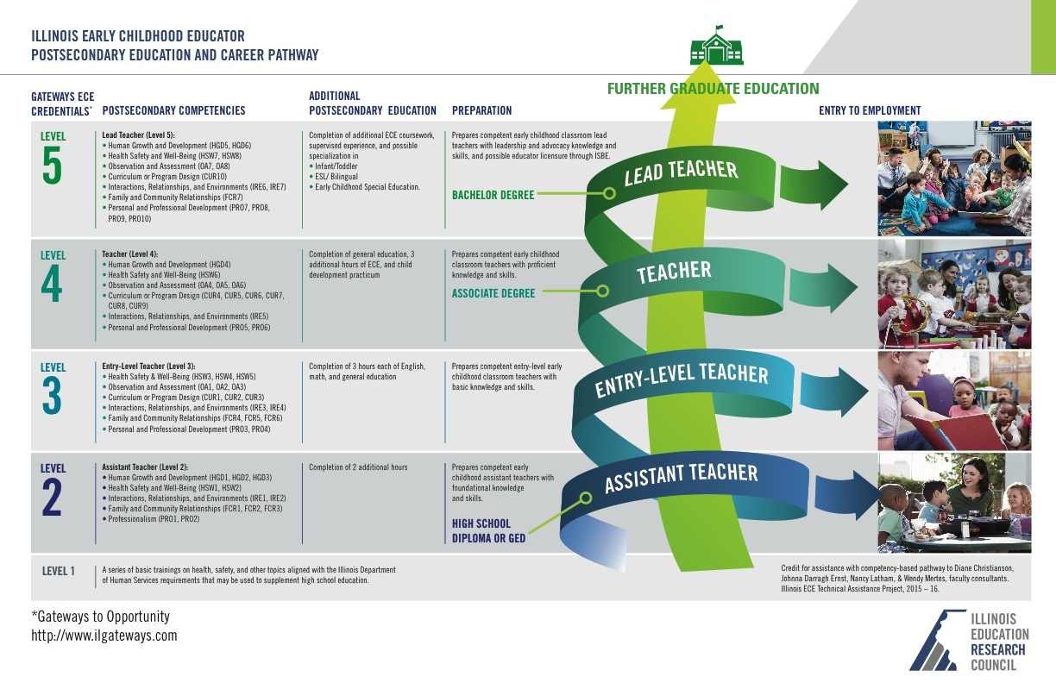

Slide 10


Slide 11


Slide 12
Faculty Stepped up to Plate and hit a HOME RUN!
How many courses were redesigned to utilize virtual platforms to ensure students are able to complete this semester?
How many additional hours/days/weeks have been spent to ensure the COVID-19 crisis does not derail your students?
Faculty deserve a standing ovation!

Slide 13
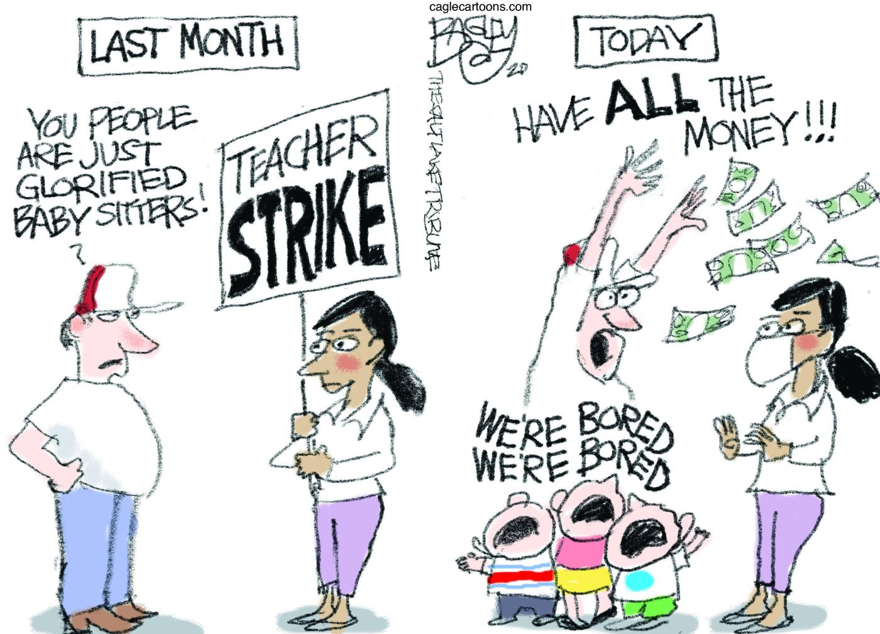

Slide 14
Reminder
Please type questions for presenters into the chat box. Start with which agency or presenter the question is directed to!
Morning Session Q & A will begin around 11:30AM

Slide 15
Welcome
Albert Wat,
Alliance for Early Success

Slide 16

Advancing the ECE Profession: Where Do We Go From Here?
Gateways to Opportunity Higher Education Forum| April 16, 2020

Slide 17
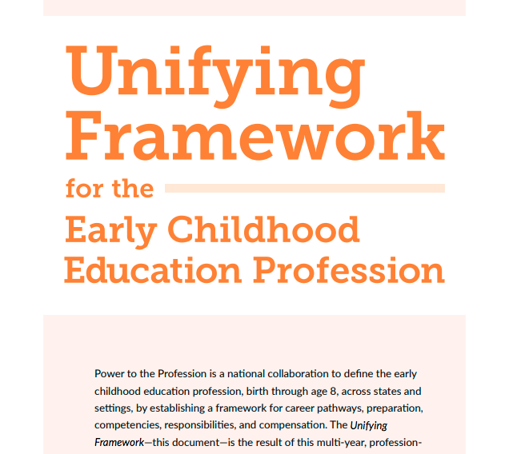
Where were we before COVID-19
Since the Transforming the Workforce report . . .
Statewide strategic plans
Early Educators Investment Collaborative
Power to the Profession
Compensation strategies/initiatives
Equity and diversity

Slide 18
Opportunities and Challenges in Higher Ed
Opportunity
Success stories
Focus on “non-traditional” students
Challenge
Disparate “system”
Sphere(s) of influence
Scaling and policy solutions
UNCF-MEMBER INSTITUTION TALLADEGA COLLEGE

Slide 19
Promising Progress in IL
Enabling Conditions for Innovations
Support and leadership from state government
Collaboration across IHEs
Promising Strategies
Articulation and stackable credentials
Evidence-based supports for students (e.g., guided pathways, responsive advising)
Competency-based strategies
Focus on compensation

Slide 20
Next Steps
Respond – Protect – Build
Play offense: Double-down on our vision
Create political will
Partner with non-ECE advocates – business, women’s rights, workforce development, economic justice
Challenges
Depleted budgets
Playing defense
Opportunities
Potential federal relief/stimulus (e.g., ARRA, RTTT-ELC)
COVID-19 as an inflection point

Slide 21

Contact Information
Albert Wat
Senior Policy Director
awat@earlysuccess.org

Slide 22

www.earlysuccess.org

Slide 23
Questions
Please type your questions for Albert or Alliance for Early Success into the chat box!

Slide 24
Welcome
Dr. Stephanie Bernoteit,
Illinois Board of Higher Education

Slide 25

Stephanie Bernoteit, Ed.D.| April 16, 2020

Slide 26
Thank You!
Support for your learners
Support for children and families
Support for educators
https://learnaway.education.illinois.edu/

Slide 27


Slide 28
Thank You!
Donate PPE
Provide material and labs to manufacture items needed for COVID-19 testing
Provide modeling expertise
Research and develop solutions
Provide medical care at university hospitals and clinics
Provide alternative emergency housing

Slide 29
IBHE Efforts – COVID-19
Coordinate communication with our state’s 450 postsecondary institutions (208 degree-granting institutions and 242 private business and vocational schools)
Support access to federal CARES dollars
Provide flexibility to IBHE-administered programs and grants
Student Emergency Fund
Coordinate with other state agencies
Licensure of postsecondary graduates
Guidance for transfer, P/F, and dual credit

Slide 30
Joint Guidance – Education Agencies
Dual Credit – ICCB, ISBE, and IBHE
ISBE “Act of God” and remote learning days
Advising
Options for completion
Illinois Articulation Initiative – IBHE and ICCB
Courses for labs and speech/communication
Pass/Fail grading
Course transfer – General Education and major
Advising

Slide 31

Looking Ahead – New Credentialing Landscape
https://luminafoundation.org/our-work/unlocking-the-nations-potential/

Slide 32
Looking Ahead – National Landscape
Strada Education Network – April 2, 2020
Public Viewpoint: COVID-19 Work and Education Survey
One-third (33%) believe that if they lose their jobs, they will need additional education and new skills to find a comparable one.
If Americans could choose where to receive education and training, their top preferences would be online colleges and universities (26%), apprenticeships or internships with a local employer (18%), or online community colleges (17%).
Notes:
Nationally representative survey of 1,000 people – designed to track the impact of the pandemic on Americans’ lives, work, and education

Slide 33
Looking Ahead – Illinois Landscape
Illinois insights from the Education Consumer Survey
Conducted by Strada Education Network and Gallup with the Education Commission of the States
Education Consumer Survey
340,000+ responses to date
350 daily | 10,000 monthly | 122,500 annually
All demographics | All states & D.C. | Largest 50 metro areas
Major survey content areas
Demographic, Education, & Employment
Ratings of quality, value, and relevance
Motivations & Barriers to Enrollment
Need for additional education
Illinois sample
10,683 respondents reside in Illinois / 7,537 attended an institution in Illinois

Slide 34
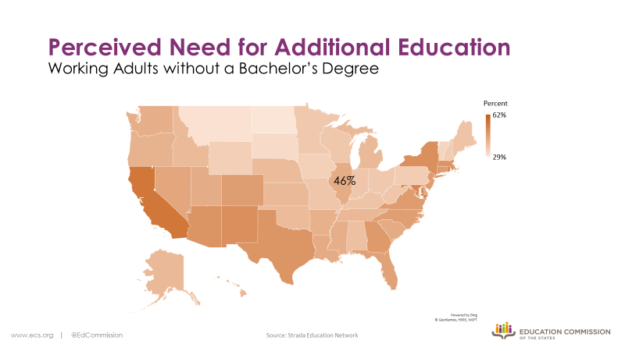

Slide 35
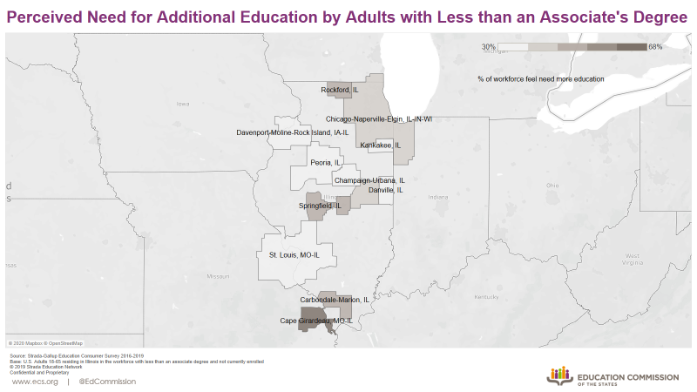

Slide 36
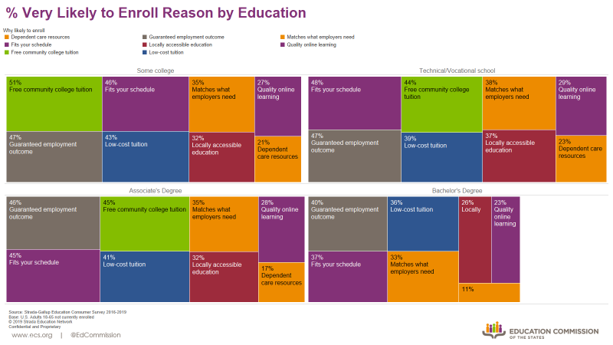

Slide 37
Looking Ahead – RFP for Early Childhood Credential Completion Cohort (EC4) Grants
$1.3M in funds from Illinois PDGB-5 initiative
RFP released May 1, 2020
Applications due June 1, 2020
Work beginning July 1, 2020
Opportunity for at least four grants for cohorts of 20-40
Eligibility:
Illinois institutions of higher education
Accredited by the Higher Learning Commission
Entitled by Illinois Gateways

Slide 38
Questions
Please type your questions for IBHE into the chat box. Preface questions with the agency or person they are directed to.

Slide 39
Welcome
Dr. Jamilah R. Jor’dan,
Governor’s Office of Early Childhood Development

Slide 40
Gateways to Opportunity Higher Education Forum State Panel April 16, 2020 Jamilah R. Jor’dan, Ph.D. Acting Executive Director

Slide 41
About GOECD
The Governor’s Office of Early Childhood Development (GOECD) leads the state’s initiatives to create an integrated system of quality, early learning and development programs to help give all Illinois children a strong educational foundation before they begin kindergarten.

Slide 42
2020 Higher Education Forum
COVID-19 Illinois’ Early Childhood Care and Education Response
Preschool Development Grant Birth-5 Renewal Grant
Early Childhood Educator Workforce Development Project
Prenatal to Three Policy Agenda
Illinois Pyramid Model Pilot Evaluation

Slide 43
COVID-19 Illinois’ Early Childhood Care and Education Response

Slide 44
GOECD AND STATE PARTNERS * GOECD COVID-19 for Early Childhood webpage * COVID-19 Emergency Child Care for Communities & Providers webpage

Slide 45
GOECD AND STATE PARTNERS * Guidance for Child Care Centers, Child Care Homes, and Early Education Programs * FAQs * GOV.OECD@Illinois.gov

Slide 46
PRESCHOOL DEVELOPMENT GRANT BIRTH-5 RENEWAL GRANT

Slide 47
PDG-B5 Renewal Grant * 20 states and territories awarded three-year renewal grants * Illinois awarded $13,414,500 * 6 Activities and Bonus Sections * 34 Projects

Slide 48
PDG B-5 Renewal Grant Activity 1: Needs Assessment * Address Data Gaps * Increase understanding about how families engage with the ECCE system * Strategies to meet family needs

Slide 49
PDG B-5 Renewal Grant Activity 2: Strategic Plan * Organized into four goal areas: 1. Access 2. Coordination 3. Quality 4. Workforce Support

Slide 50
PDG B-5 Renewal Grant Activity 2: Strategic Plan * Organized into four goal areas: 1. Access 2. Coordination 3. Quality 4. Workforce Support

Slide 51
PDG B-5 Renewal Grant Activity 3: Family Engagement * Family engagement focus * Families voice in policy development through representation on the Family Advisory Committee of the Early Learning Council * Parent Cafes

Slide 52
PDG B-5 Renewal Grant Activity 4: Professional Development (Sharing Best Practices) * Alignment across PD systems *Expand practice-based coaching/evidence-based programs * Workforce development supports

Slide 53
PDG B-5 Renewal Grant Activity 5: Quality * Expansion of high-quality early learning opportunities * Support for Continuous Quality Improvement (CQI) * Focus on rural communities and programs serving infants and toddlers

Slide 54
PDG B-5 Renewal Grant Activity 6: Data * Data to inform cross-agency decision making * Standardize ECCE data across systems * Unduplicated count of children served within public-funded systems

Slide 55
PDG B-5 Renewal Grant Bonus Sections * Coordinated Intake Pilot * Infant Toddler Emphasis * Kindergarten Transition Pilot

Slide 56
Early Childhood Educator Workforce Development Project Illinois’ ECE Workforce

Slide 57
Early Childhood Educator Workforce Development Project * Transitioned into different format * Published Consensus Statement on Early Childhood Educator Compensation

Slide 58
Early Childhood Educator Workforce Development Project *Published materials for high schools and postsecondary advisors and counselors on ECE pathways and opportunities. Materials were vetted by ECE faculty.

Slide 59
Early Childhood Educator Workforce Development PDG B-5 *Workforce questions in Needs Assessment * Workforce goals/strategies in Strategic Plan * Funds for credential fees and debt relief

Slide 60
Early Childhood Educator Workforce Development PDG B-5 *Postsecondary cohorts * Course modularization via competencies * Home visitor and I/ECMHC workforce development * Tiered QRIS/Tiered Funding Pilot

Slide 61
Early Childhood Educator Workforce Development PDG B-5 Partners * IBHE * ICCB * ISBE * INCCRRA * Institutions of higher education (2 and 4-year) * Home visitor and I/ECMHC workforce development * Tiered QRIS/Tiered Funding Pilot

Slide 62
Illinois Prenatal to Three Policy Agenda

Slide 63
PN3 Policy Agenda * Aligned with Pritzker Children’s Initiative * Goal was to develop a plan to expand services to an additional 50% of the total number of lower-income infants and toddlers by 2025

Slide 64
PN3 Policy Agenda Illinois Benchmarks * By 2023, 25% increase in access or quality= 50,250 infants/toddlers * By 2025, 50% increase in access or quality= 100,500

Slide 65
PN3 Policy Agenda Coalition * Over 100 stakeholders * Broad public/private representation from diverse sectors * Convened by GOECD and Ounce of Prevention with support from Irving Harris, McCormick and Stone Foundations

Slide 66
PN3 Policy Agenda Opportunities for Engagement * Higher education is a critical partner in developing pathways, training and ongoing supports for a well-qualified, compensated and competent workforce. * Invite you to participate in the Implementation Coalition

Slide 67
PN3 Policy Agenda Opportunities for Engagement * Anticipated Coalition launch date May/June 2020 *Send an email to Karen Berman at kberman@ounceofprevention.org to express interest, ask questions and request survey about agenda priorities.

Slide 68
Illinois Preschool Development Grant-Expansion (PDG-E) Pyramid Model Pilot Evaluation
Promoting Social-Emotional Competence in Illinois’ Infants and Young Children

Slide 69
Pyramid Model Pilot Evaluation * 26 PDG-E Programs * 22 began spring 2018 * 4 began spring 2019 * Evaluation Focus: Participation in PD, gains in knowledge, skills, strategies, implementation, challenges, benefits for children and families, next steps

Slide 70
Pyramid Model Pilot Evaluation Summary of Findings * Program personnel gained new skills to support children’s social emotional development * Create learning environments that are culturally responsive, address equity, inclusive settings, family relationships * 4 began spring 2019 * Evaluation Focus: Participation in PD, gains in knowledge, skills, strategies, implementation, challenges, benefits for children and families, next steps

Slide 71
Pyramid Model Pilot Evaluation Summary of Findings * Substantial growth toward program-wide implementation. * Growth: Program expectations, staff buy-in and family engagement * Development Needed: Collecting and using data

Slide 72
Pyramid Model Pilot Evaluation Summary of Findings * Fidelity of Implementation: At or near 80% in several key practice areas * Highest rated: Collaborative teaming, connecting with families, supportive conversations with children

Slide 73
Pyramid Model Pilot Evaluation Summary of Findings * Areas for growth: Teaching behavior expectations, social emotional skills, problem solving, and others.

Slide 74
Pyramid Model Pilot Evaluation Summary of Findings Perceived Benefits * 60% noted decreased rates of suspension * 48% noted decreased rates of expulsion

Slide 75
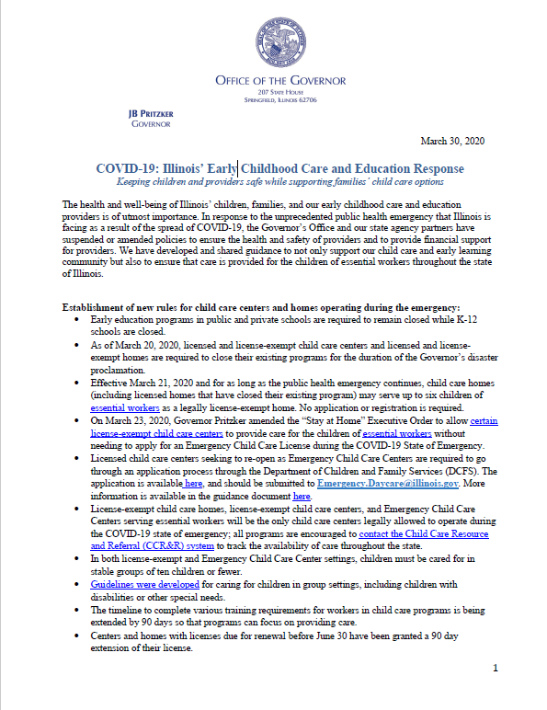
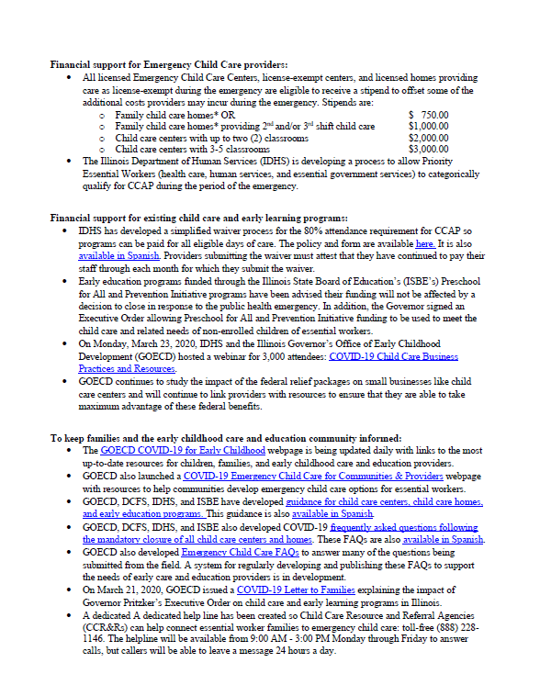

Slide 76
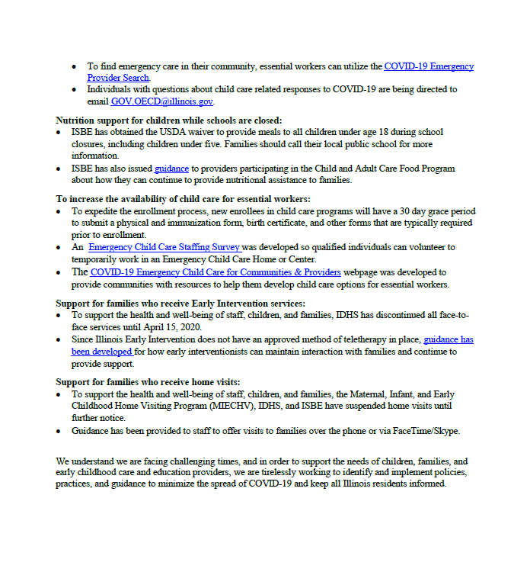

Slide 77
Thank You!
Contact Information:
Jamilah.R.Jordan@Illinois.gov

Slide 78
Q & A BEGINS
Morning Session Questions
Please type your questions into the chat box starting with agency or person they are directed to:
Albert Wat, Alliance for Early Success
Stephanie Bernoteit, Illinois Board of Higher Education
Jamilah R. Jor’dan, Governor’s Office of Early Childhood Development

Slide 79

Break
The Webinar will re-open at 12:30PM

Slide 80
WELCOME BACK!
Please type questions for the afternoon State Panel Presenters into the chat box. Preface the question with the agency or person they are directed to!

Slide 81
Agenda
12:25PM Welcome Back
State Panel Presentations:
Dr. Marcus Brown, Illinois Community College Board, Senior Director for Academic Affairs and Student Services
Dr. Jason Helfer, Illinois State Board of Education, Deputy Officer for Instructional Education
Dr. Eric Lichtenberger, Illinois Board of Education, Deputy Director for Information Management and Research
Q &A facilitated by Albert Wat
Wrap-Up/Closing Thoughts
2:30PM Adjourn

Slide 82
Welcome
Dr. Marcus Brown,
Illinois Community College Board

Slide 83
Illinois Community College Board Update
Gateways to Opportunity
Higher Education Forum 2020
April 16, 2020
Dr. Marcus Brown
ICCB Senior Director for Academic Affairs and Student Services

Slide 84
Responding to Community Needs
Shifting to respond to COVID-19
State of programs in community colleges
Equity
Dual Credit Opportunities
Program Need
Competency-based Technology Grant

Slide 85
COVID-19 Response
All Community colleges shifted to remote, online or alternate formats as did the ICCB.
ICCB providing ongoing information on our website including FAQ. https://www.iccb.org/iccb/coronavirus-guidance-resources/
Issued joint guidance on system-wide issues
Continue to work through Career and technical issues including programs like Early Childhood and reduced or no access to clinical, labs or observation spaces.

Slide 86

What does Enrollment in Illinois Look Like?

Slide 87
With an Eye Toward Equity
Building the college-going future and creating an effective college experience for all students
Who are we serving?
Where is learning taking place?
How are we building the college experience?
How are we building the professional experience?
What credentials can we provide to students?

Slide 88
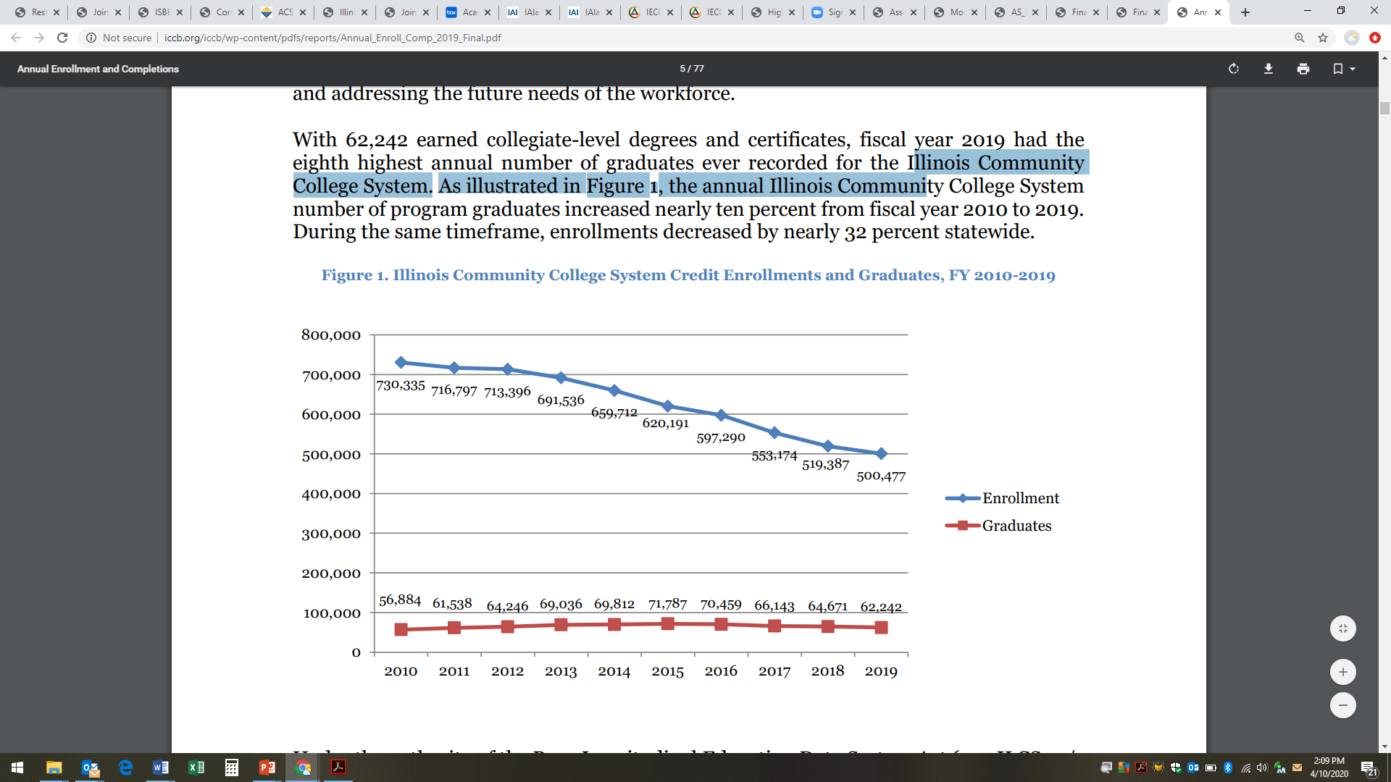
Enrollment in the Community College System

Slide 89
Continuing to Grow Dual Credit Opportunities
Create seamless pathways for all students
Opportunities for Dual Credit – eye toward completion of industry recognized certifications.
Significant effort on advising and reaching families, school counselors and support systems about early childhood opportunities.

Slide 90
Comparison of Annual Dual Credit Enrollments in Illinois Public Community Colleges Fiscal Years 2014-2018
 | FY 2014 | FY 2015 | FY 2016 | FY 2017 | FY 2018
Headcount | 50,091 | 51,718 | 54,871 | 57,897 | 59,039
% Change | 0.7% | 3.2% | 6.1% | 5.5% | 2.0%
Gender | Number | Percent
Male | 28,344 | 48.0%
Female | 30,695 | 52.0%
Total | 59,039 | 100.0%

Slide 91
Comparison of Annual Dual Credit Enrollments in Illinois Public Community Colleges Fiscal Years 2014-2018

Slide 92
Race/Ethnicity of High School Students Taking Dual Credit Courses in Fiscal Year 2018

Slide 93
Programs in the State
System parameters – who, when and where programs are offered
Program decisions are driven by
Local workforce and educational need
Access provided at the local level
Enrollment/Interest
helps determine program offerings
Location/Site
Faculty and staff needs

Slide 94
Programs in the State
System parameters – who, when and where programs are offered
Program decisions are driven by
Stackable
Industry Recognized Credentials
Specialized Accreditation or Licensure
The CAREER Agreement
Expands access to programs not offered in the home district

Slide 95
Technology Opportunity
More than ever, we can see the impact that technology can have on educating and training out students
Building on the competency-based model
Enhancing opportunities to ensure students are ready when they move out into the field.
Grant details forthcoming

Slide 96
Questions
Please type your questions for ICCB into the chat box. Preface questions with the agency or person they are directed to.

Slide 97
Welcome
Dr. Jason Helfer,
Illinois State Board of Education

Slide 98
Early Childhood and Educator Effectiveness Updates
April 16, 2020
Jason Helfer Ph.D.
Deputy Instructional Education Officer
Equity ● Quality ● Collaboration ● Community

Slide 99
Agenda
Rule Updates
Part 25
Teacher Recruitment
EC Teacher Recruitment Brochure
Align with ISBE “Elevate the Profession”
FY21 Recruitment Grants
Multi-Faceted Alignment Efforts
Curriculum & Standards
IL Professional Teaching Standards (IPTS) to IL Professional Educator Competencies (IPEC)
Social Emotional Development
Assessment
Teacher Retention
Professional Development
FY21 Retention Grants
Equity ● Quality ● Collaboration ● Community

Slide 100
Rule Updates

Slide 101
Why the change in Part 25:
Feedback from higher education faculty;
National and State Teacher shortage;
Districts looking for “maximum flexibility;”
A PEL is considered the foundational license, unlike the former “certificate” structure.
Educators seeking additional endorsements can now expand grade range.

Slide 102
Part 25 Updates
Effective December 2019:
25.100- Subsequent Endorsements: 18 SH content Coursework + Content Test
Specific areas have coursework distributions: Early Childhood, Elementary Education, Middle Grade, Reading Specialist, and Safety and Drivers Education
Alternative Programs: Preschool for All classrooms
Must be assigned a Mentor or equivalent
Must be assessed by a Principal or equivalent.

Slide 103
Teacher Recruitment

Slide 104

Teacher Recruitment Efforts
Developed in collaboration with GOECD and our Illinois Early Childhood Partners.
Assists in describing the EC careers available at different educational and salary levels.
In alignment with ISBE strategies in “Elevating Educators.”
https://www2.illinois.gov/sites/OECD/Documents/ECE%20Messaging%20Brief%20191218.pdf

Slide 105
Recruitment Strategies
ISBE Goal - Elevating Educators: Illinois’ diverse student population will have educators who are prepared through multiple pathways and are supported in and recognized for their efforts to provide each and every child an education that meets their needs.
“Grow Your own” – Teachers are more representative of the student populations they work with.
Recruit & support the educational development of those individuals already part of the environment (nutrition, aides…).
Early Childhood teachers represented in “Teacher of the Year.”

Slide 106
FY21 Recruitment Grants
Golden Apple
Educators Rising
Supporting Future Teachers
Diverse and Learner Ready Teachers
Teach for America
Total: $14.5 Million

Slide 107
Alignment Efforts

Slide 108
Multi-faceted Alignment Efforts
Curriculum: Building a specific K–3 math curriculum with an aligned preK curriculum;
Standards: Expanding the state’s English Language Arts (ELA) standards, which begin at kindergarten, so they can be used in preschool;
Assessment: Adopting a common assessment for preK and TK aligned with kindergarten Common Core State Standards; and
Professional development: Engaging preK, kindergarten, first-, and second grade teachers to align expectations for teacher professional development.

Slide 109


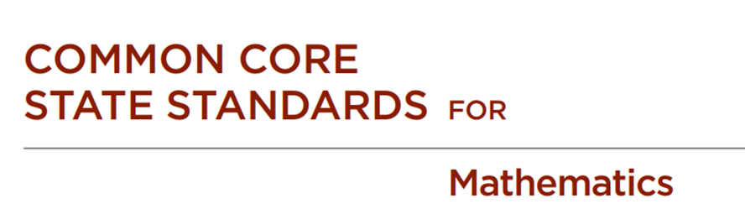
Alignment of Curriculum & Standards
Adherence to Current Standards & Common Core;
Incorporate Social Emotional Development beyond Preschool;
Change Educational Norms to Include Early Childhood;

Slide 110
IL Professional Teaching Standards to IL Professional Educator Competencies
Led by 30 IPEC Steering Committee representatives from all professional organizations
Phase 1: (June 2019-May 2020) Competency Statement Development
Phase II: (June 2020-May 2021) Competency Measurements, Assessments, and Connections to Specific Areas of Licensure
Phase III: (June 2021-June 2022) Competency Embedding and Implementation in Systems
September 2022- Program alignment to IPEC

Slide 111
Children’s social and emotional health affects overall development and learning
Children with strong social emotional skills…
Children who exhibit social and emotional difficulties…
…tend to be happier, show greater motivation to learn, have a more positive attitude toward school, more eagerly participate in class activities, and demonstrate higher academic performance than less mentally healthy peers.
(Hyson 2004; Kostelnik et al. 2015)
…tend to have trouble following directions and participating in learning activities. Compared with healthier peers, they may be more likely to suffer rejection by classmates, have low self-esteem, do poorly in school, and be suspended.
(Hyson 2004; Kostelnik et al. 2015).

Slide 112
Change Educational Norms to Include Early Childhood
“…for too many K-12 leaders, early learning is ‘other’ – something they are in favor of even if it’s not really their job to do something about it. And the data are quite clear: the things that it is “their job to do” will never happen properly without a stronger connection between the early years and what comes after them.”
Elliot Regenstein | Foresight Law + Policy
WHY THE K-12 WORLD HASN’T EMBRACED EARLY LEARNING
Proficiency is a critical metric of school performance
If a cohort of students is not proficient it is hard to catch up
A lot of students are behind by 3rd grade
Catching up is less correlated to income than starting out behind
We have to start at the beginning

Slide 113
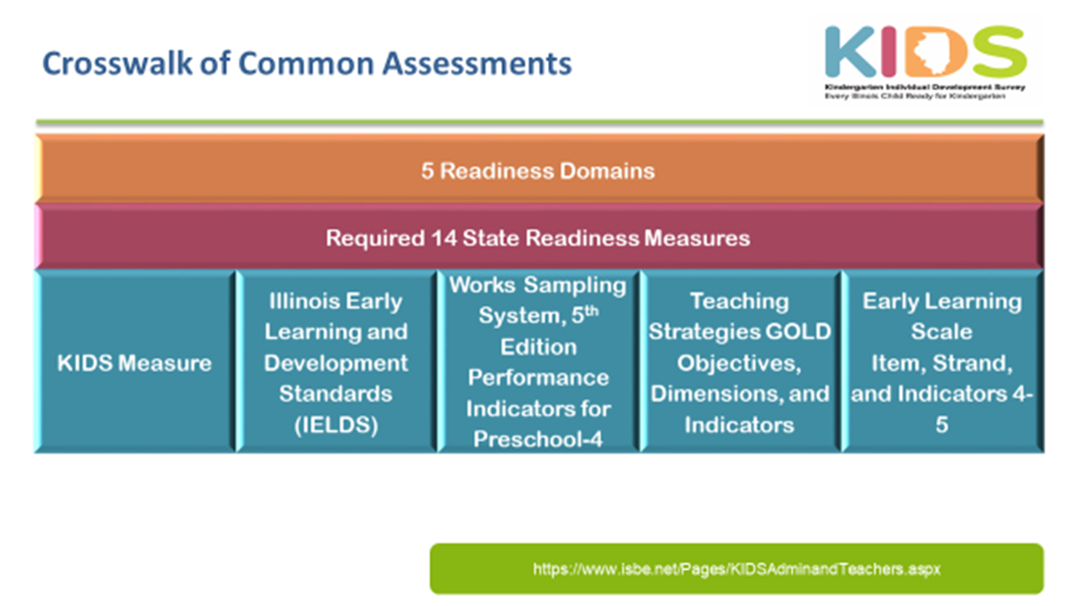
Aligned Assessment
ISBE GOAL: Develop and support an aligned PreK-12 student learning system within four years that enables every student to accurately demonstrate their ability.
KIDS - Aligned to common PreK Assessments;
Explore expansion of Authentic/Observational through 2nd Grade.

Slide 114
Teacher Retention

Slide 115
Professional Learning
Through:
Increased opportunities for understanding, communication and cooperation.
Identifying areas of disconnect and provide peer-to-peer feedback.
Enhancing the effectiveness and efficiency of preK–3 alignment.
In a variety of forms:
Classroom Observations
Transition Planning
Common Coach
ISBE Strategy: Retain educators by providing coaching and mentoring, teacher leadership opportunities, principal preparation support, and access to high-quality professional learning.

Slide 116
FY21 Retention Grants
New Teacher Mentoring
New Principal Mentoring
National Board for Professional Teaching Standards
Total: $4.5 Million

Slide 117
Contact Information
Jason Helfer Ph.D.
Deputy Instructional Education Officer
jhelfer@isbe.net
217-782-4123

Slide 118
Welcome
Dr. Eric Lichtenberger,
Illinois Board of Higher Education

Slide 119
Questions
Please type your questions for ISBE into the chat box. Preface questions with the agency or person they are directed to.

Slide 120

Higher Education Update
Eric Lichtenberger| April 16th, 2020

Slide 121

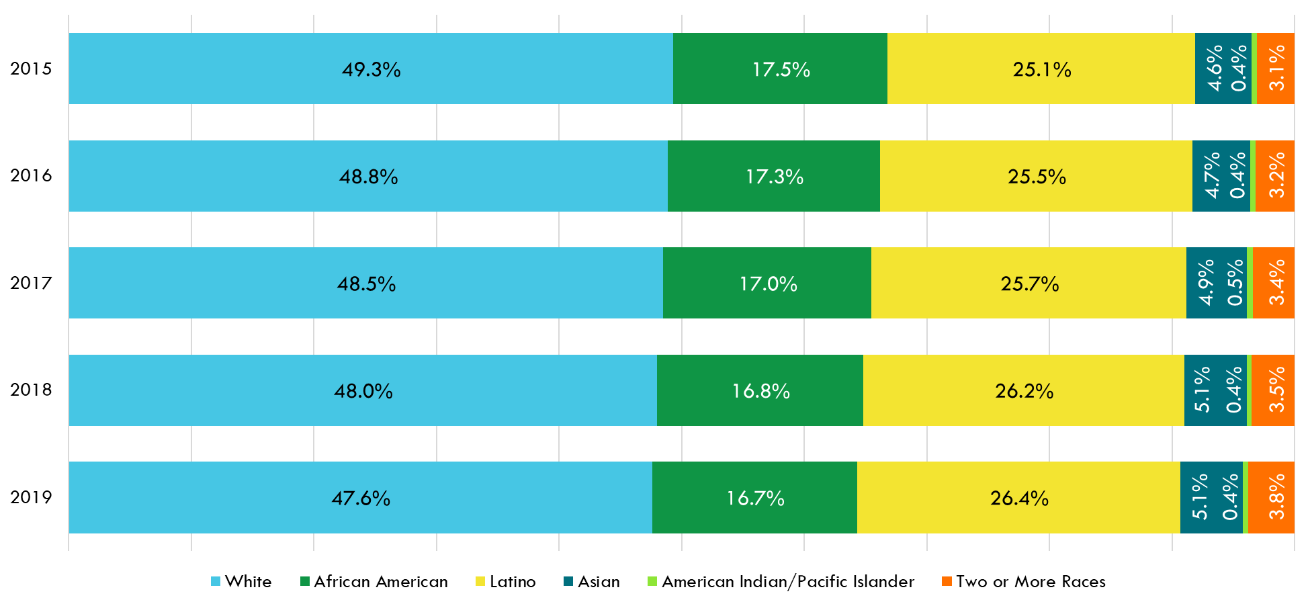
Illinois is rapidly becoming more and more diverse.
Public school students (all grades). Source: ISBE Report Card

Slide 122
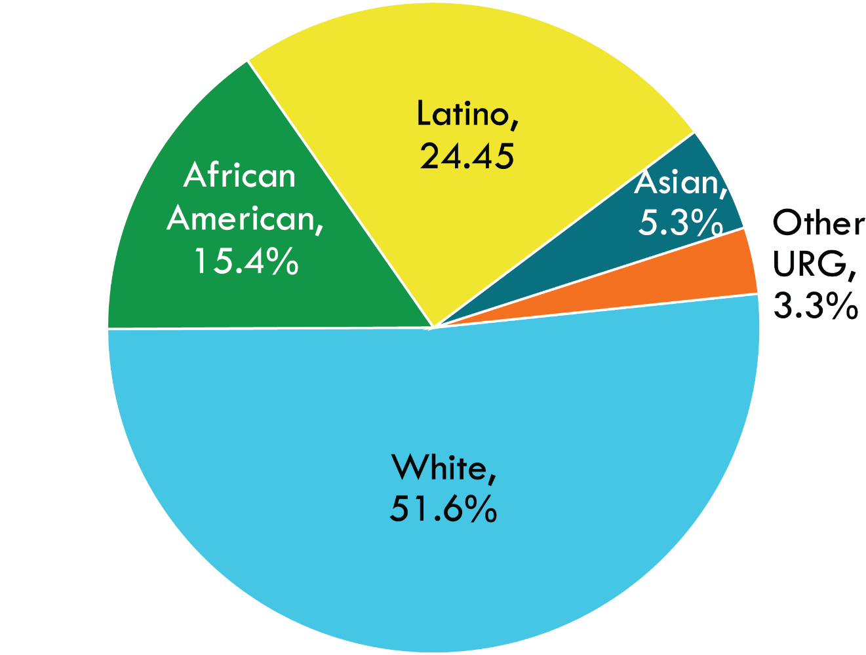
Race/Ethnicity Distribution of Recent Illinois Public High School Graduates
Source: Illinois State Board of Education

Slide 123
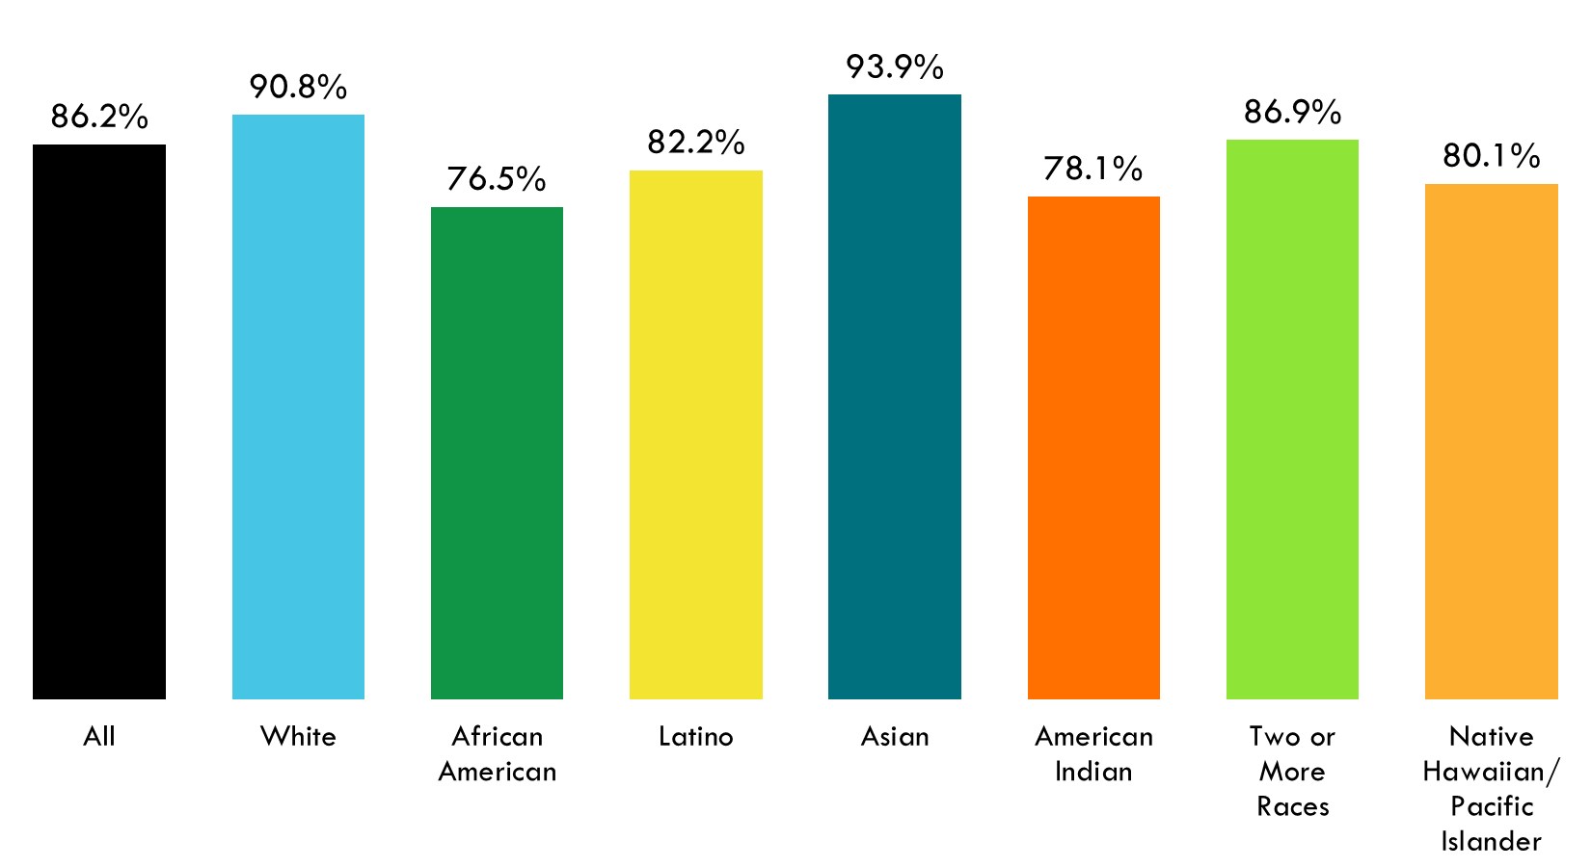
2019 High School Graduation Rates by Race/Ethnicity

Slide 124
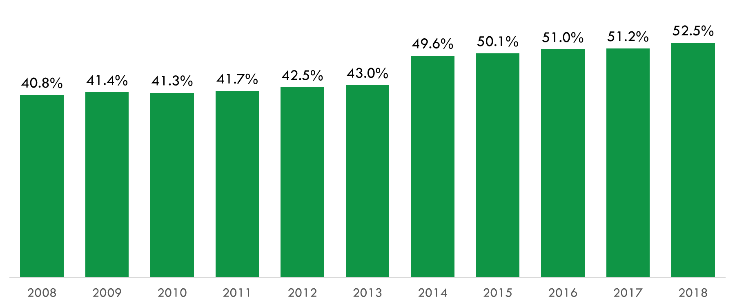
Overall Education Attainment Rate for Working Age Adults in Illinois
52.2%
Source: Lumina Foundation’s Stronger Nation Report (2020)
Note: Staring in 2014 estimates for high quality sub-associate’s degrees credential were added.

Slide 125
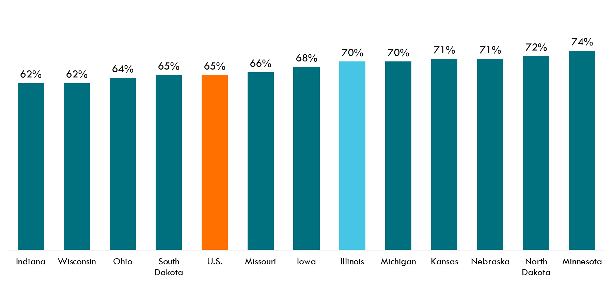
Percentage of Jobs in 2020 that Will Require a Postsecondary Education
Source: the Georgetown University Center on Education and the Workforce. (2013). Recovery: Job growth and education requirements through 2020.

Slide 126
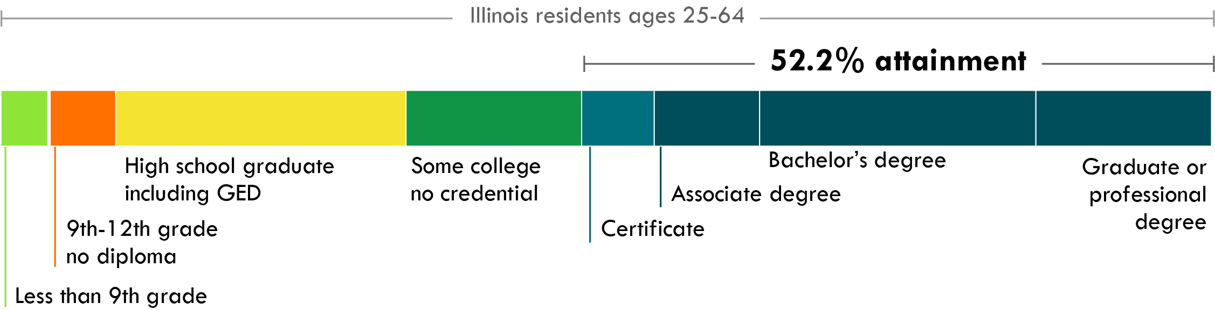
Educational Attainment in Illinois – 2018

Slide 127
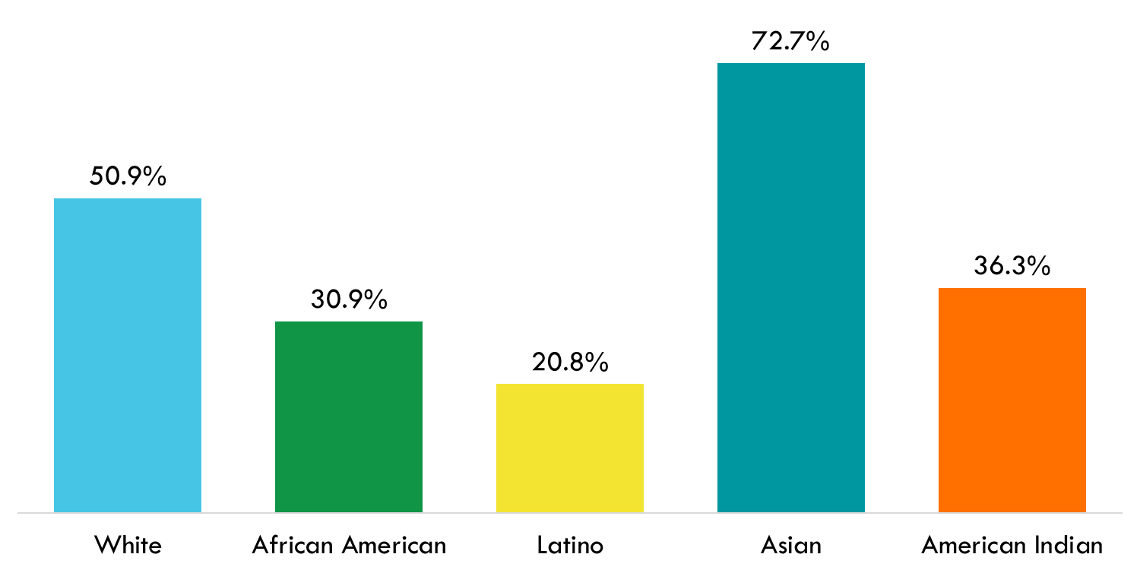
Degree-attainment rates among Illinois adults (ages 25-64) by Race/Ethnicity
Percentage with an associate degree or higher. Source: American Community Survey

Slide 128
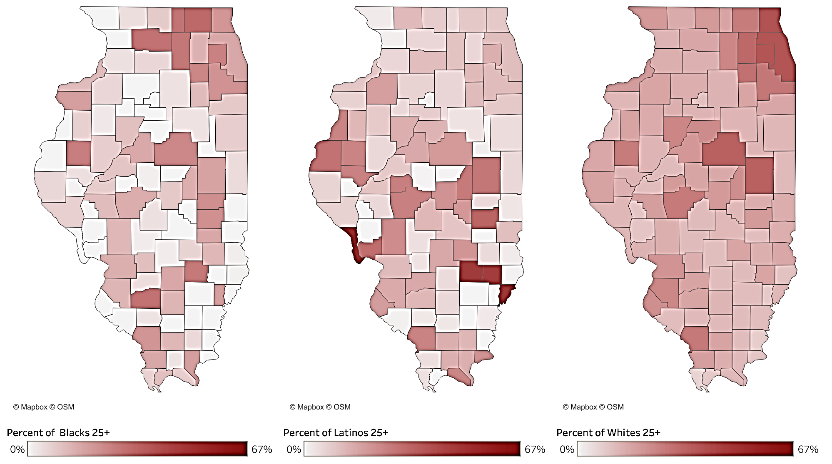
Bachelor’s Degree or Higher Attainment by Race and County

Slide 129
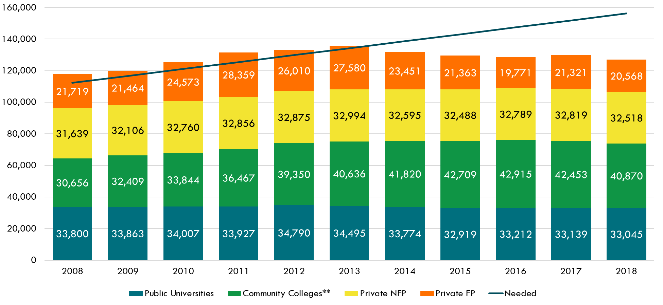
Credential Production by Sector Compared to Projected Need to Reach 60% Goal

Slide 130
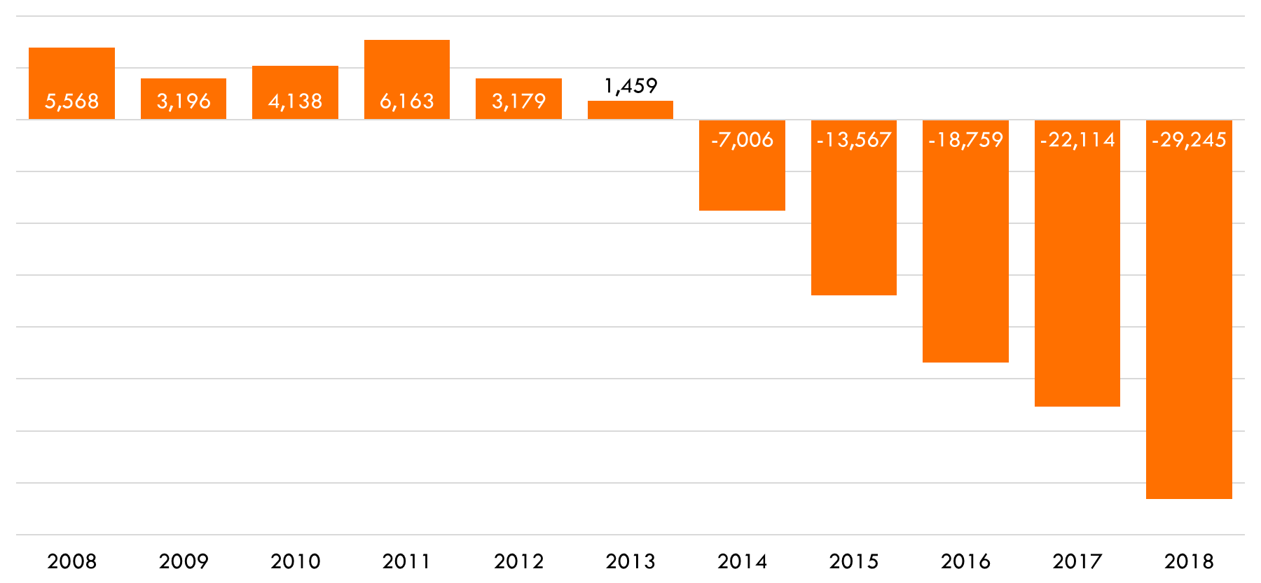
Difference between Actual Credential Production and Projected Need

Slide 131
Rate of Out-of-State Enrollment among Illinois Public High School
Graduates Enrolling at Four-Year Colleges from 2013 to 2017

Slide 132
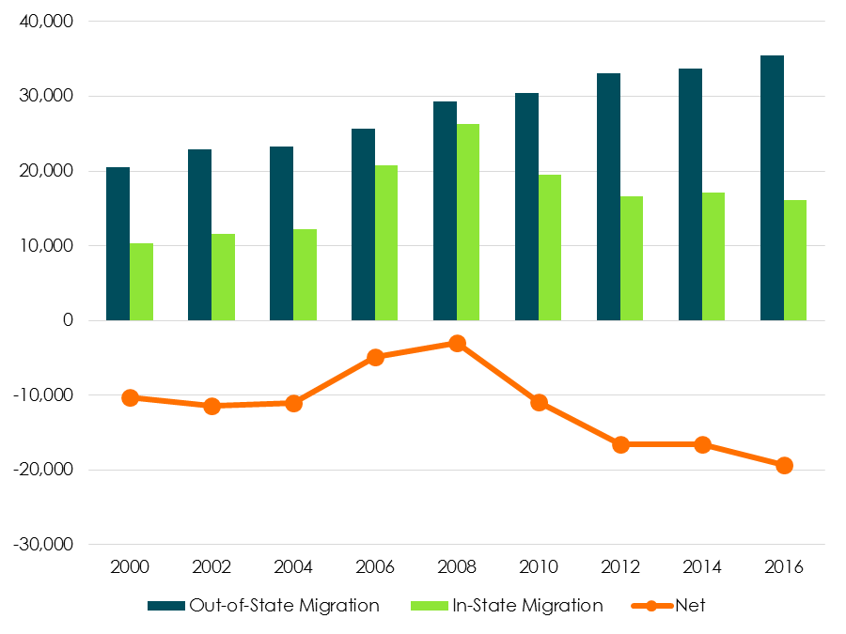
Residence and Migration of Freshmen Students into and from Illinois (2000-2016)

Slide 133
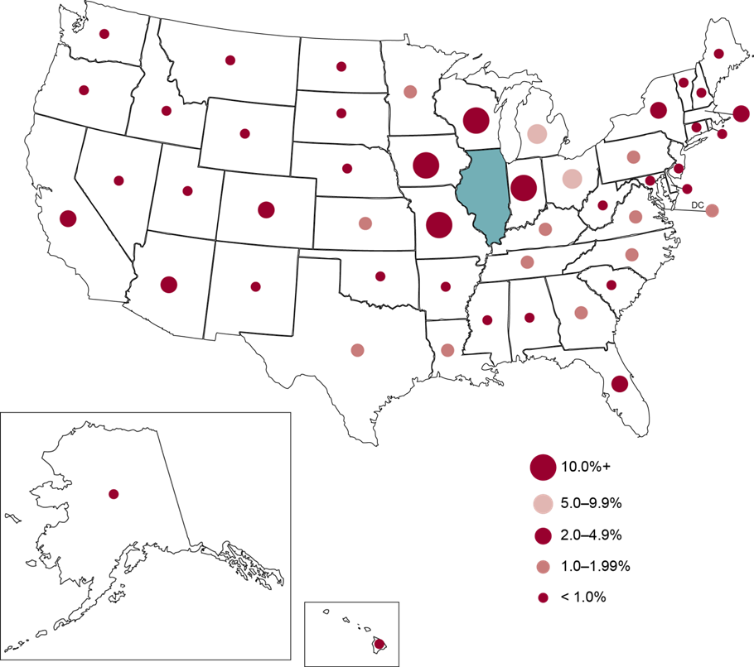
Where are Illinois outmigrants enrolling?
Lichtenberger, E. J., & Dietrich, C. (2014). Outmigration and Human Capital: Homeward Bound or Gone for Good? Policy Research: IERC 2014-1. Illinois Education Research Council.

Slide 134
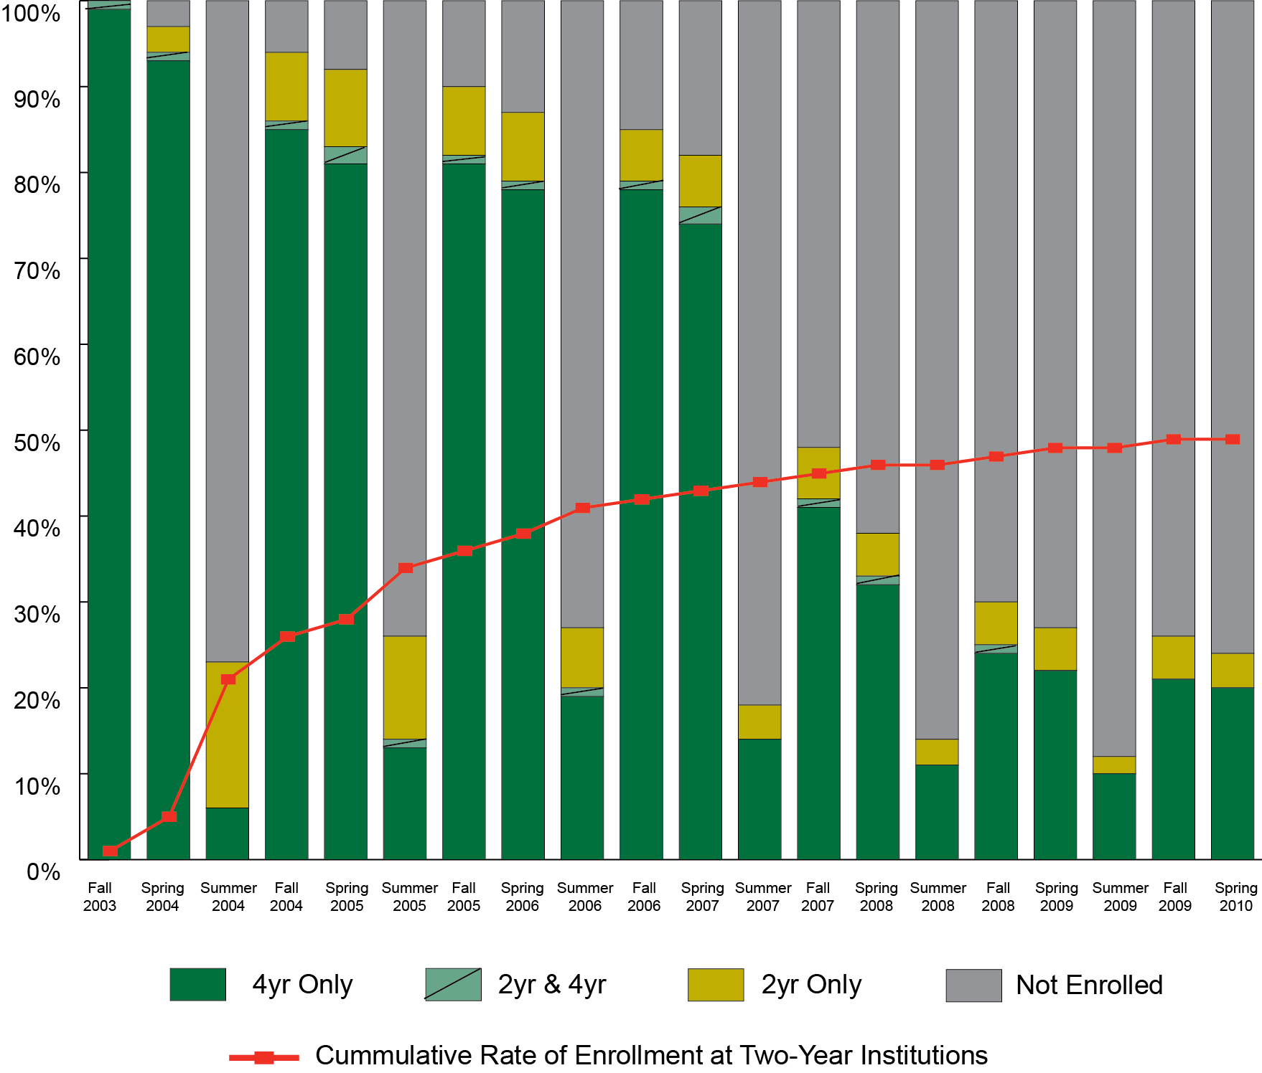
Enrollment Trends for Direct Four-Year College Entrants

Slide 135
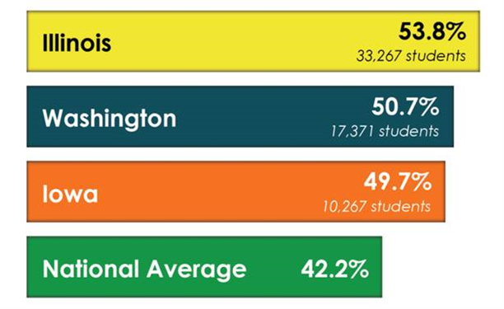
Illinois is #1 in the NATION!
According to the National Student Clearinghouse, Illinois now leads the nation in bachelor’s degree completion rates among community college students who transfer to four-year institutions.
IL was ranked #3 in the nation two years ago
With the latest 2010 cohort, IL has surpassed both Iowa and Washington by a noticeable margin:

Slide 136
Higher Education Context in Leading States
State-wide Comparison of Illinois, Washington, and Iowa
 | Illinois | Washington | Iowa
Community Colleges | 48 | 33 | 14
Community College Cohort | 33,267 | 17,371 | 10,267
Rate of Transfer-Out | 35.0% | 27.8% | 30.5%
Public Universities | 12 | 6 | 3
Transfer-in Students | 6,233 | 3,600 | 1,845
Private Nonprofit Colleges | 58 | 15 | 30
Transfer-in Students | 4,072 | 514 | 1,158

Slide 137
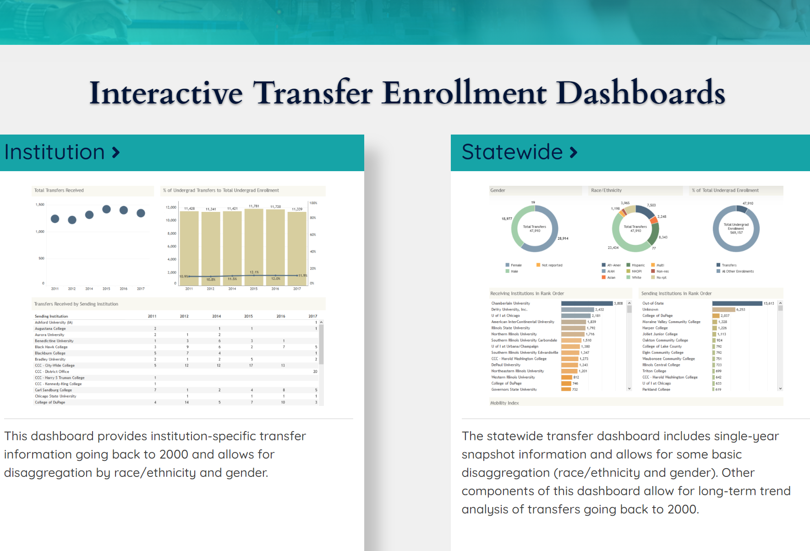
https://www.ibhe.org/transfers/

Slide 138
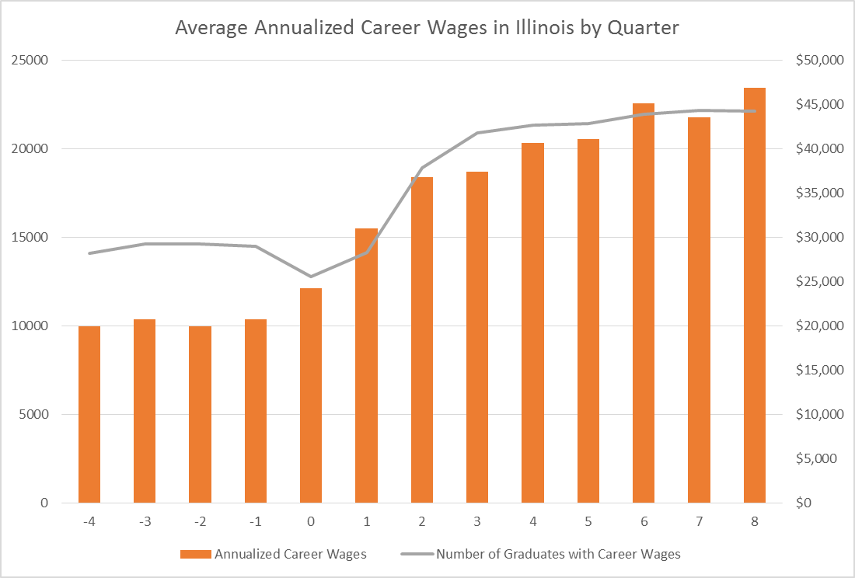
Career Wages over Time

Slide 139
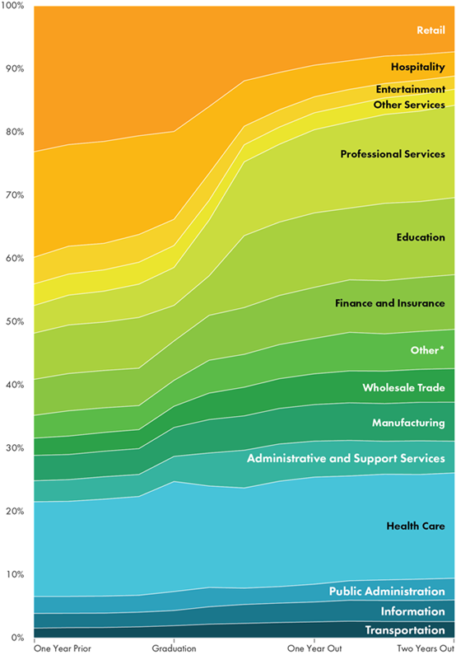
Job Share Distribution

Slide 140
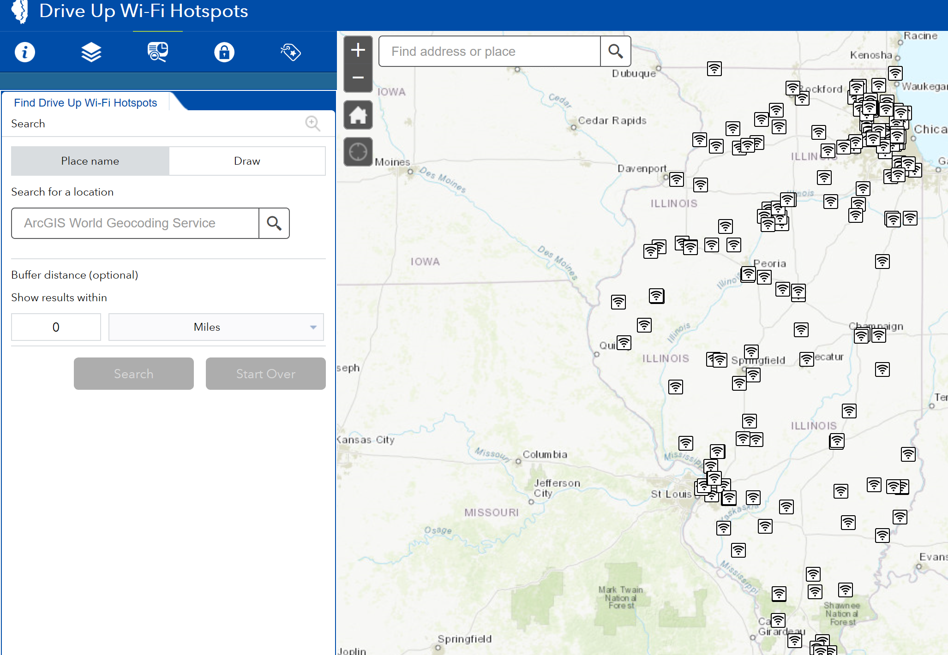
Drive-up WiFi Hotspots Tool
www.ildceo.net/wifi

Slide 141
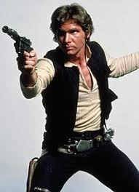
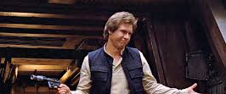
Be sure to wash your Hans! Hans!!!

Slide 142
Questions
Please type your questions for IBHE into the chat box. Preface questions with the agency or person they are directed to.

Slide 143
Q & A BEGINS
Afternoon Session Questions
Please type your questions into the chat box starting with agency or person they are directed to:
Marcus Brown, Illinois Community College Board
Jason Helfer, Illinois State Board of Education
Eric Lichtenberger, Illinois Board of Higher Education

Slide 144
Closing Thoughts & Setting the Stage for Friday
Wrapping it Up - Albert Wat
Looking to Friday: Joni Scritchlow

Slide 145


