Slide 1


Slide 2

WELCOME
Forum Agenda for Friday, April 17, 2020
10:00 AM Welcome Joni Scritchlow, Senior Program Director INCCRRA
Yesterday, Today, Tomorrow: Paint by Number
RFP Opportunities: Create YOUR Vision of Tomorrow
Dr. Stephanie Bernoteit
Illinois Board of Higher Education, Executive Deputy Director
Dr. Marcus Brown
Illinois Community College Board
Senior Director for Academic Affairs and Student Services
Keynote presentation by Dr. Theresa Hawley
Office of the Governor JB Pritzker
The Best State to Raise Young Children: What Will it Take from Higher Ed?
Wrap-Up/Closing Thoughts
1:00 PM Adjourn

Slide 3

Materials/Information
Gateways to Opportunity Forum Agenda
State Panel Bios
Entitled Institution Maps
Credentials and Competency Timeline
College Cohort Report
Faculty Fellows Report
FAQ: Modularization
Guidance Regarding Illinois Articulation Initiative document
Guidance on Applying Pass/Fail Grades document
Dual Credit Guidance link to document
Dual Credit FAQ link to document
COVID-19: Illinois’ Early Childhood Care and Education Response document

Slide 4


Paint by Number

Slide 5

Story by Numbers
Gateways to Opportunity:
Credentials
Registry
Great START
Scholarship
i-Learning

Slide 6
Gateways Credentials

Slide 7
Challenges: inconsistency

Slide 8
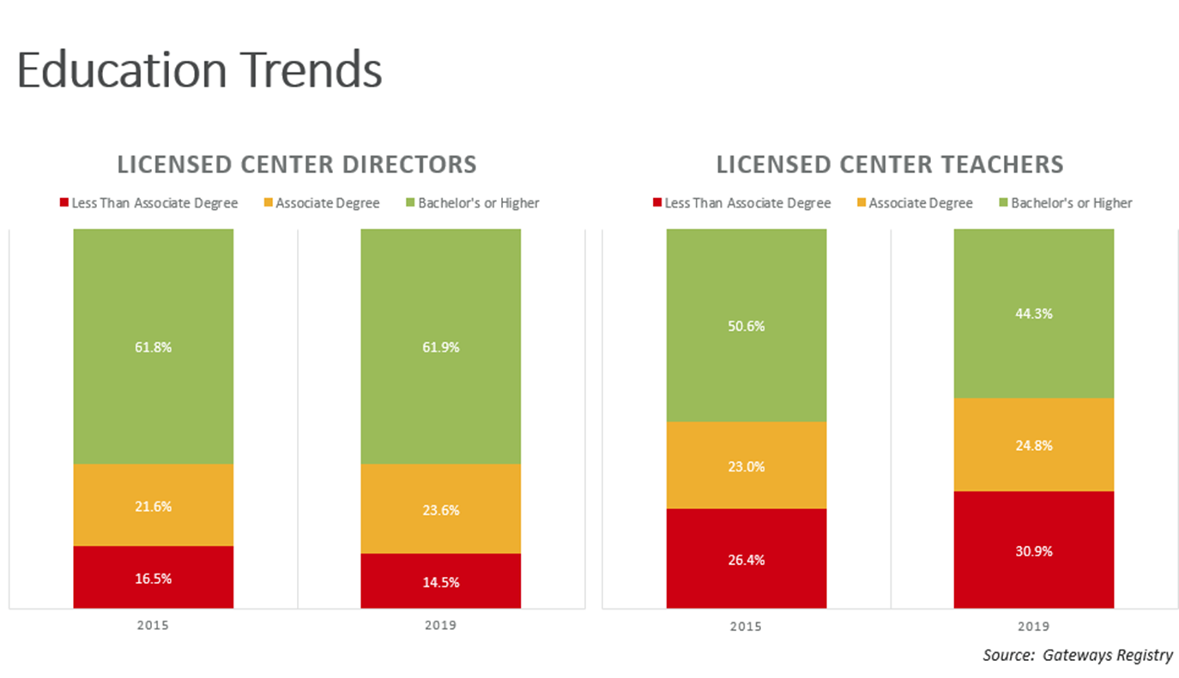
Education Trends

Slide 9
Licensed Center Teachers with degrees

Slide 10
Story by Numbers
Gateways to Opportunity:
Credentials
Registry
Great START
Scholarship
i-Learning

Slide 11
Story by Numbers
-
Scholarship Support

Slide 12
i-Learning Explosion

Slide 13
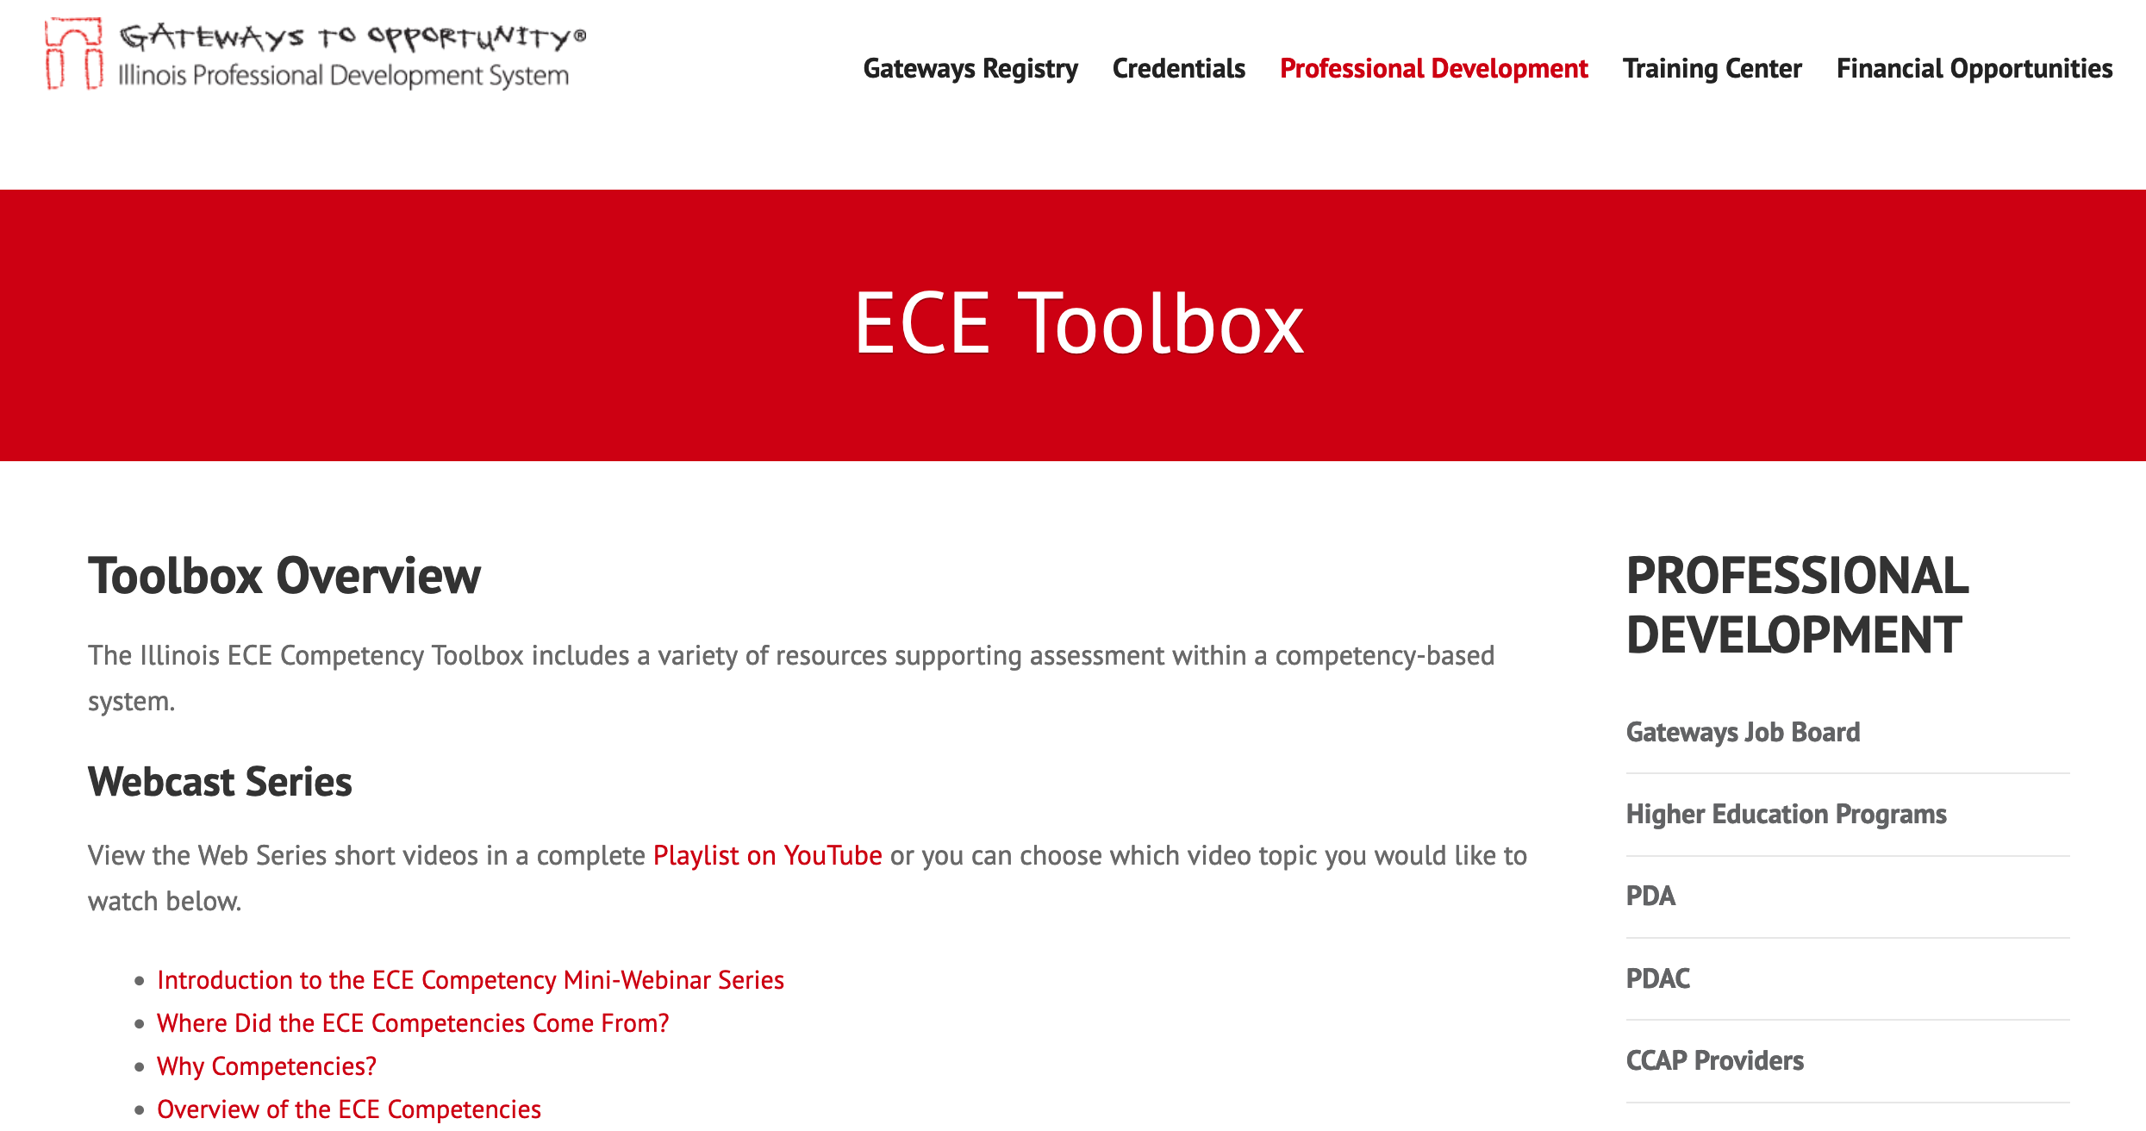
Over 17,000 HITS!

Slide 14
Building the Pipeline
Gateways
ECE Credential
Level 1 in
High Schools

Slide 15
Painting a Picture for
Early Childhood

Slide 16

Stephanie Bernoteit, Ed.D.| April 17, 2020

Slide 17
Illinois Community College Board Update
April 17, 2020
Dr. Marcus Brown
ICCB Senior Director for Academic Affairs and Student Services

Slide 18
There is a huge need and opportunity to give everyone a voice and to help transform society for the future. The scale of the technology and infrastructure that must be built is unprecedented, and… this is what we should focus on.
Mark Zuckerberg

Slide 19
Positioned for Future
Teacher Shortage
    Diverse Pipeline
      how can we maximize/support?
    Complex skills required
Early Childhood “in the moment”
  Recognized as Essential
  Appreciated as never before

Slide 20
Change is Underway
National Competency-Based Education Network
  Institutions Expanding Competency-Based Education nationally
  CBE meets student & workforce needs
  On-line not required/less reliance on seat time IS
ISBE movement to K-12 Teacher Preparation Competencies mirrors Early Childhood
NAEYC developed Early Childhood Competencies

Slide 21
Complex Times
COVID-19
What will change?
  Student appetite
  Faculty perspective
  Technology utilization
  How can we position institutions to maximize the opportunities change brings?

Slide 22
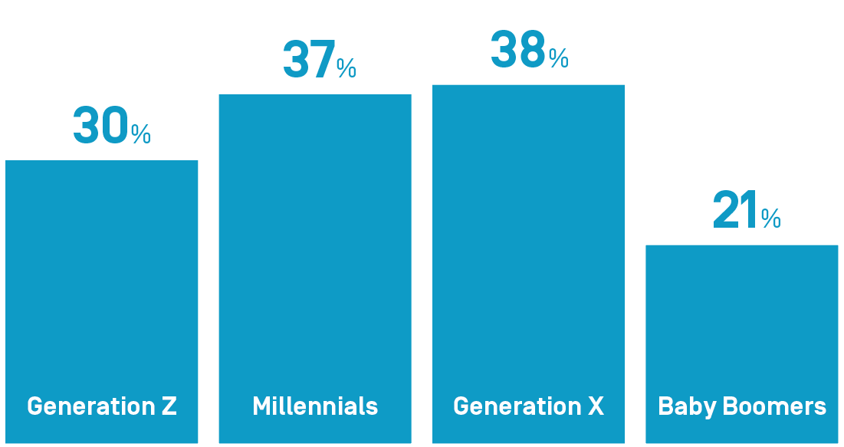
% who believe they would need more education to find a comparable job if they lose theirs - stradaeducation

Slide 23
State Competency Leadership Team
Faculty Fellows Project – Accomplished 2019
Grant from McCormick Foundation
Develop expanded repository of assessments of
Gateways Credential competencies - existing rubrics
  Faculty ARE USING the ECE Tool Box
Broaden knowledge & utilization of Gateways Credential assessment infrastructure and rubrics
Explore opportunities to use technology
in assessments, repository, database

Slide 24
State Competency Leadership Team
Faculty Fellows Project – Next Steps
Faculty Fellows did initial work to identify potential data collection points for a future assessment repository
Refinement needed and processes for reporting
Good news………………..

Slide 25
Early Educator Investment Collaborative
LOI was submitted by National Louis University with partnership opportunities for a range of Illinois higher education institutions.

Slide 26
Opportunities Ahead
RFP for Early Childhood Credential Completion Cohort (EC4) Grants
RFP for interested institutions to work
on Illinois Gateways ECE Credential competency modularization
RFP to expand or maximize ways to
utilize technology

Slide 27
RFP for Early Childhood Credential Completion Cohort (EC4) Grants
1.3M in funds from Illinois PDGB-5 Initiative
RFP planned release ~May 1, 2020
Applications likely due June 1, 2020
Work begins ~July 1, 2020
Opportunity for at least four grants for cohorts of 20-40
Eligibility:
  Illinois institutions of higher education
  Accredited by the Higher Learning Commission
  Entitled by Illinois Gateways

Slide 28
RFP: ECE Credential Competency Modularization
Funded through GOECD’s Illinois PDGB-5Federal Renewal Grant
RFP released May 1, 2020
Applications due June 1, 2020
Work beginning July 1, 2020
Opportunity for four to six Higher Education Institutions to be funded
Eligibility:
  Illinois institutions of higher education
  Accredited by the Higher Learning Commission
  Gateways to Opportunity Credential Entitled
  Institution via INCCRRA

Slide 29
Technology RFP Opportunity
More than ever, we see the impact technology can have on educating and training students
Build on the competency-based model
Enhance opportunities to ensure students are ready when they move out into the field.
Grant details forthcoming

Slide 30
Creating YOUR Vision for Tomorrow - Opportunities
The reward for work well done is the opportunity to do more.
Jonas Salk

Slide 31
The Best State to Raise Young Children
What Will it Take from Higher Ed?
Theresa Hawley, Ph.D.
First Assistant Deputy Governor, Education
April 17, 2020

Slide 32
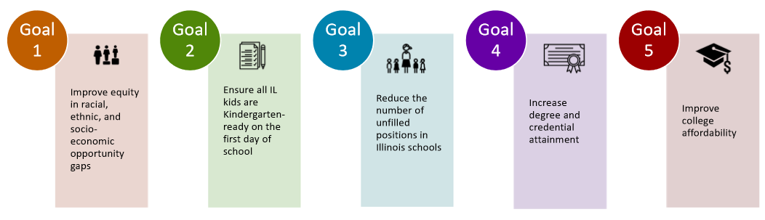
Education Goals for the administration

Slide 33
Early Childhood Goal from Governor
Prizker
Illinois will become the best state in the nation for families raising young children, with the nation’s best early childhood education and childcare.
“Our work won’t be complete until every child in this state enters kindergarten with the cognitive skills to think, learn, read, remember, pay attention, and solve problems, but also the social emotional skills to communicate, connect with others, resolve conflict, self-regulate, display kindness and cope with challenges. These are the skills that high-quality early learning programs help young children develop.“

Slide 34

Our Vision
We envision Illinois as a place where every young child—regardless of race, ethnicity, income, language, geography, ability, immigration status, or other circumstance—receives the strongest possible start in life so that they grow up safe, healthy, happy, ready to succeed, and eager to learn.

Slide 35

Prenatal to Three Agenda
Healthy Parents & Babies
  Comprehensive Perinatal Supports
  Strengthened Home Visiting System
High-Quality Early Learning
  Accessible Family & Center-Based Care and Learning
  Optimized Early Learning for Children with Delays/Disabilities
Economically Secure Families
  Family-Friendly Work Policies
  Income Supports for Families
Strong Infrastructure
  Strong State and Community Structures
  Cross-System Preparation, Professional Development & Supports

Slide 36
Strategic Plan
Access
Expanding Equitable Access to ECCE Services
Coordination
Enhancing Coordination and Collaboration Across Multiple Types of ECCE Services
Quality
Improving the Quality of ECCE Services
Workforce
Addressing Recruitment, Retention, Compensation, Equity, and Professional Development of the ECCE Workforce

Slide 37
Equitably supporting every child’s development
All children are identified prenatally or at hospitals—
All provided with some information/linkage to services (Universal Support)
Community Collaborations are supported in ensuring all families are linked to services,
and that children and families with the highest needs are prioritized for services
Birth to Three Years
Home Visiting (beginning prenatally where possible)
Gold Circle Center-Based Programs (full-day/full-year)
which include Family Support
Parenting information through pediatricians, etc.
Guidance on quality child care through QRIS
Licensed Family Child Care /
Family, Friend & Neighbor Care
“Neighborhood Supports” (Library groups, parks, etc.)
Preschool Years
Gold Circle
Preschool
(part-day or school-day) including Family Support
Gold Circle Center-Based Programs (full-day/full-year)
which include Family Support
Tuition-based/sliding scale part-day pre-K
Guidance on quality child care & pre-K through QRIS
Licensed Family Child Care /
Family, Friend & Neighbor Care
“Neighborhood Supports” (Library groups, parks, etc.)
Kindergarten and Beyond
High- Performing Schools
Strong community services
“21st Century Schools” with comprehensive community supports
Strong support for parent engagement
Key:
High Need Children receive 1 or more of these service combinations
All Children receive

Slide 38
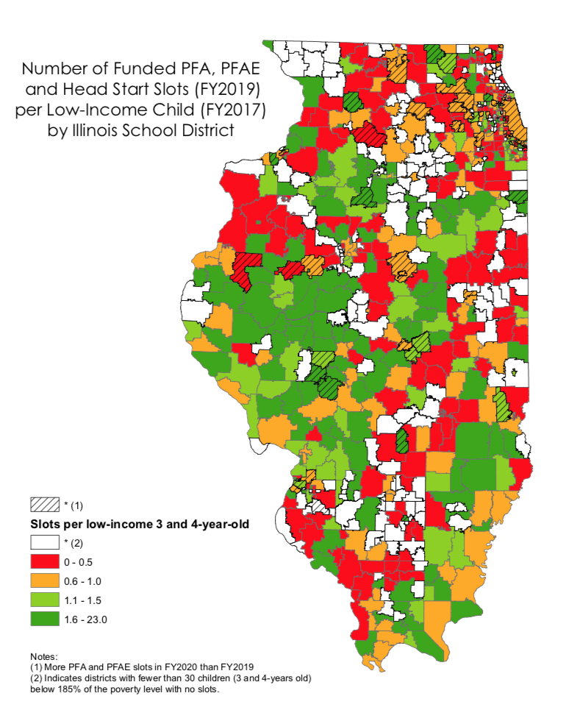
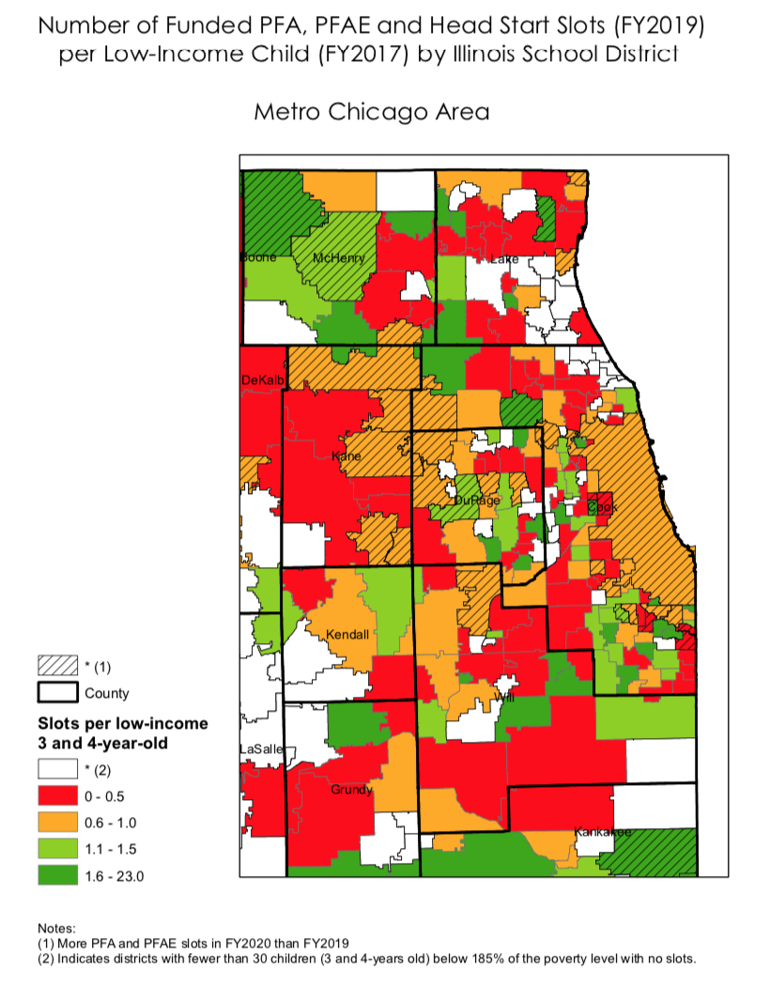
Program availability varies across the state and is inequitably distributed

Slide 39
Upper income families access center-based ECEC at higher rates than other families
Source: Chaudry, Morrissey, Weiland, and Yoshikawa (2017)

Slide 40
Lower income families are often not served in high quality settings
Rough Estimates of Current (FY19) Reach in Serving Low-Income 3 & 4 Year Olds Statewide
Goal is for 85% of low-income 3s & 4s to be served in high-quality (PFA/HS, Gold Circle)
We are falling far short of this goal!
Data notes: Estimates calculated from a combination of NIU report on unduplicated count, IECAM HS estimates, ISBE FY19 data on income levels of participating PFA/PFAE students, and IDHS data on child care participation by age and type of care

Slide 41
Illinois spends 85% less on ECCE for children
0-5 as on K-12 for school-aged children
7x higher spending

Slide 42
Fragmented funding means providers & families depend on multiple sources across many agencies

Slide 43
Commission on Equitable Early Childhood Education and Care Funding

Slide 44

Commission’s Charge
“The Commission shall study and make recommendations to establish funding goals and funding mechanisms to provide equitable access to high-quality early childhood education and care services for all children birth to age five and advise the Governor in planning and implementing these recommendations.”

Slide 45
Commission Deliverable
We need to know “the number”. There is not enough revenue in the system to support a sufficient, stable supply of providers of high-quality ECEC – how much do we need?
We need to assess all funding mechanisms and the management and oversight structures of ECEC.
  How should we distribute funds?
  Who should distribute and monitor the funds?
We need to determine how to implement our recommendations
  How will we reach our recommended end state, over what period of time?

Slide 46
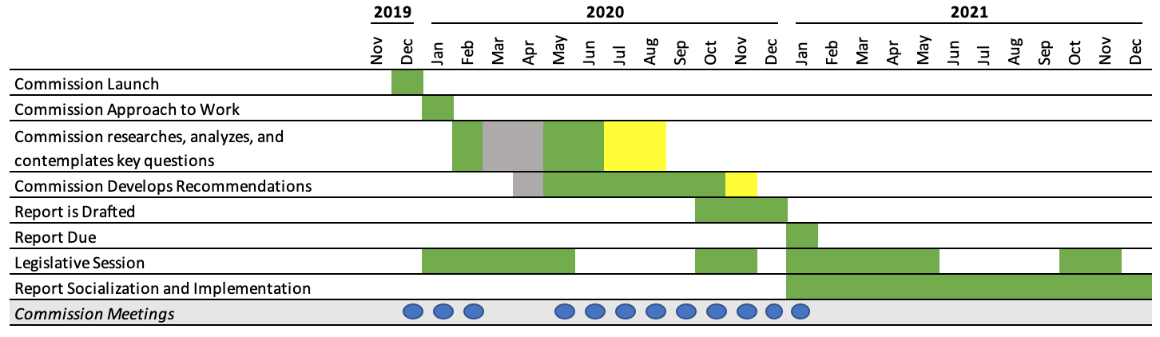
Commission Timeline - Revised
The Commission will deliver its report by January 2021 with consideration to the Governor’s budget address and legislative session timing.

Slide 47
Themes for Our ECEC Agenda
Restoring and Expanding Access to High-Quality ECEC
Refining and Re-designing Standards, Funding Streams, and Infrastructure Supports
Growing a Highly-Qualified ECEC Workforce

Slide 48
Restoring & Expanding Access
What we’ve already done
  Raised CCAP eligibility to entry under 200% FPL; exit at 225% FPL
  Lowered co-pays to no more than 9% of family income
  Expanded PFA, PFAE and PI by a total of over 6,000 children
  PDG B-5: Scaling up Home Visiting for DCFS-involved families

Slide 49
Restoring & Expanding Access
What we want to do
  Bring intensive Home Visiting to “saturation”
  Further lower co-pays to no more than 7% of family income
  Expand quality center-based infant-toddler care slots
  Fill-in PFA/PFAE/HS “deserts”
  Raise quality of preschool in child care centers, especially for low-income children, so that children of working parents have access to HQ preschool

Slide 50
Access Goals for ECEC for this term
Bring intensive home visiting to scale
  Add about 13,000 slots (compared to FY18); needs to be carefully targeted to avoid oversaturation
  Develop potential scalable funding model for universal newborn visits
Double the number of infants and toddlers in high quality child care
  Add about 5,000 slots of Prevention Initiative-Center Based, Early Head Start-Child care Partnership, or new initiative to create high quality slots
  Implement stronger supports for FFN and licensed Family Child Care
Ensure all low-income preschoolers have access to a high-quality preschool education
  Requires some expansion in schools, in some communities (targeted)
  Requires raising to Gold the quality of preschool education in many more child care centers
Support continued financial viability of child care providers

Slide 51
Refining & Redesigning
Goal is to create greater coherence and stability for the system, so that it has a solid foundation on which to scale up
What we’ve already done:
  Establish Equitable ECEC Funding Commission
  Re-established the Child Care Advisory Committee
  Substantially revised the ECBG RFPs to better target expansion
  Raised CCAP reimbursement rate, addressing disparities in rural counties
  Included support for Pyramid Model implementation, K transitions pilots, and I/ECMH training in PDG B-5 grant
  Begun planning for intentional engagement of families in ELC & system governance

Slide 52
Refining & Redesigning—To Do’s
Update ExceleRate Illinois
  Better support and recognize incremental quality improvement
  Support “ownership” of continuous quality improvement
  Facilitate funding for structural quality (the things that cost more)
Refine CCAP rate structure/contract approach
  Informed by cost modeling
  Emphasis on paying for quality
  Taking into account other funding streams as appropriate
Clarify program models/standards
  Clarify model(s) for incorporating PFA into FD/FY child care programs
  Clarify PI Center-Based model requirements

Slide 53
Refining & Redesigning—To Do’s, Cont.
Strengthen our approaches to supporting quality
  Pilot new approach to supporting quality improvement with contracts
  Bring I/ECMH consultation supports to scale
  Embed Pyramid Model approach throughout EC training infrastructure
  Design & implement expanded supports for FFN and FCC care
Design & establish stable funding for accountable local early childhood community systems
  Building on successes of AOK Networks, Innovation Zones, other community collaborations
  Focus on system-level planning, coordinated recruitment & enrollment, comprehensive supports

Slide 54
Refining & Redesigning—To Do’s, Cont.
Strengthen data systems to support planning and CQI
  Longitudinal Data System 2.0: Better approach for combining existing data to facilitate meaningful data analysis
  “What if?” Design: Explore possibilities for new types of data collection systems (e.g., cross-system attendance database?)

Slide 55
Growing a Highly-Qualified ECEC Workforce
Areas of emphasis:
  Increasing compensation
  Strengthening workforce development pathways
What we’ve already done:
  Increase minimum wage
  ECGB RFPs, City RFPs require more equitable wages
  Pilot child care contracts with emphasis on compensation
  Included funding for cohort models in PDG B-5
  Included funding for modularization of coursework in PDG B-5

Slide 56
Workforce, Cont.
What we’d like to do:
  Build stronger pathways for moving from entry all the way to BA/PEL
  Explore innovations for potential to scale
    Credit-bearing CDAs
    Credit for prior learning
  Strengthen support for job-embedded professional development
  Develop and implement strategies for recruiting people to the field
Goal: Produce 6,000 new early childhood teachers
  Including current staff who get higher level credentials

Slide 57
Higher Education’s Role in Accomplishing the Vision

Slide 58
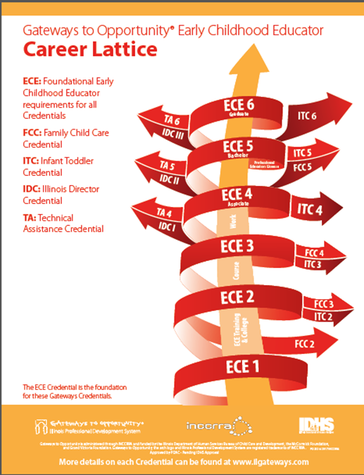

Slide 59
Reflecting on Where We Are Now
The need for teachers with degrees, and more importantly, with strong skills in early childhood education, has never been higher
Unfortunately, we are moving in the other direction—the number of new degrees in early childhood has been declining
The largest share of EC workforce (including Asst. Teachers) still does not have a degree

Slide 60
Degree completions are declining
-20%
-19%
-36%
Illinois Board of Higher Education. (2018). The college enrollment and completion patters of Gateways Credential holders. Springfield, IL: Author.

Slide 61
Reflecting on Skills in Workforce
Fewer degrees might be okay if we had evidence that teachers in the field nonetheless had the skills to support children’s learning and development
Unfortunately, we have a lot of data that shows that the level of Instructional Support that is provided by MOST early childhood teachers—across sectors—is not high enough to realize the potential of early education to improve children’s developmental trajectories
Head Start National CLASS Scores 2019
Domain | Lowest 10% | Median | Highest 10%
Emotional Support | 5.69 | 6.08 | 6.38
Classroom Organization | 5.32 | 5.82 | 6.17
Instructional Support | 2.33 | 2.92 | 3.45

Slide 62

The Challenge of “WYSIATI”
All of us are overwhelmingly biased to pay attention to what we see most often, and to believe that represents the norm
For faculty, that means that it is likely that you pay most attention to the experience of students who successfully move through your formal programs—these are the students you see most often
But what about the rest of the workforce?

Slide 63

Strategies for Combatting WYSIATI
Data!!
  What are the patterns of course completion and degree completion at your institution?
  Are there stumbling blocks to degree completion that seem common?
  Where else are your students taking courses?
Collaborate with other IHEs in your region, as well as local early childhood collaborations and school districts, to understand the workforce needs
  Analyze regional data together (INCCRA can probably help with this)
Pay as much attention to those who are NOT enrolling in your programs as to those who are
  Understand what keeps them from enrolling or persisting

Slide 64

We Must Do This Together
If each institution of higher education focuses only on meeting the needs of their own students and developing programs for the students they see, we will never move the needle on professionalizing the field and dramatically growing a highly qualified workforce
IHEs, particularly community colleges and public 4 year universities, must JOINTLY take responsibility for producing DRAMATICALLY more degrees and credentials in early childhood education

Slide 65

Innovation is Crucial
Follow the Early Childhood mantra of letting the students be our guide to how to teach them
  They are asking for online learning opportunities
  They need classes that fit into their daily and weekly routines
The majority of our future higher ed students are already working in early childhood classrooms today
  How do we make our programs more job-embedded?
  What partnerships can we form to support success?

Slide 66

Taking Effective Strategies to Scale
Grant-funded cohort models may be great, but they cannot solve our workforce development crisis!
How do we make the supports that these programs provide the NORM, rather than the special project?
We need to center our strategies on producing HUNDREDS of teachers, not dozens
  Even if, of course, we have to do the actual work dozens at a time

Slide 67

It’s Up to All of Us
Illinois can only be the best state in which to raise a young family if it is also a great place to be an early childhood professional
Working together, we can make that happen!

Slide 68

Closing
Thoughts

Slide 69


