Slide 1


Slide 2

Teresa Ramos, Illinois Department of Early Childhood
Michelle Wood, Illinois Department of Human Services – Division of Early Childhood
Joyce Gronewold, Illinois State Board of Education
Christi Chadwick, Early Childhood Access Consortium for Equity – Illinois Board of Higher Education
Marcus Brown, Illinois Community College Board
Facilitator - Kate Connor, Truman College City Colleges of Chicago

Slide 3
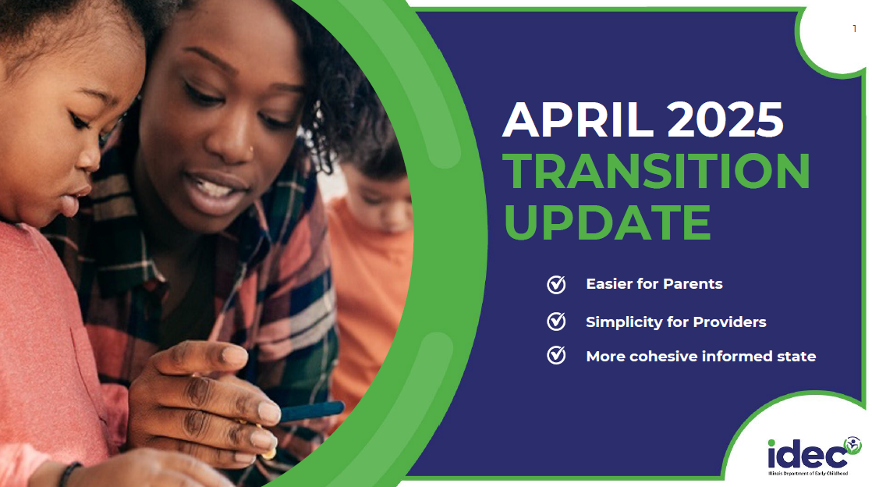

Slide 4
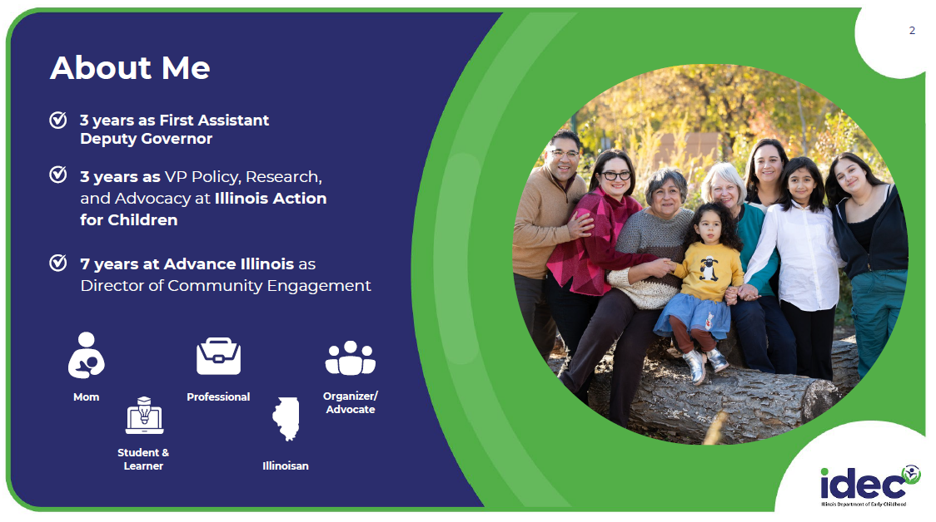

Slide 5
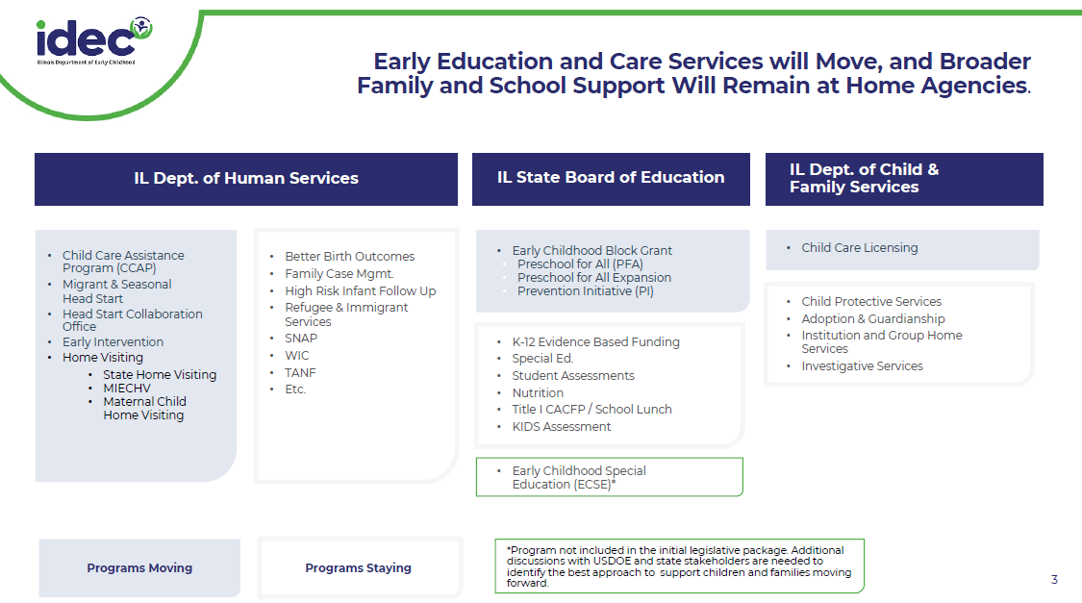

Slide 6
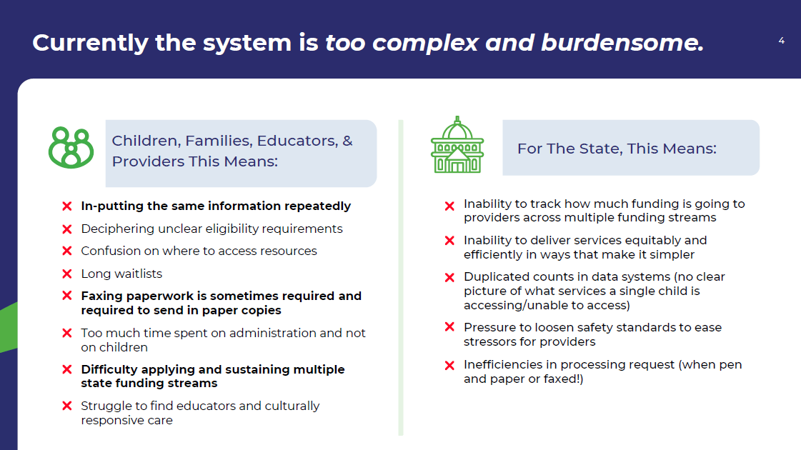

Slide 7
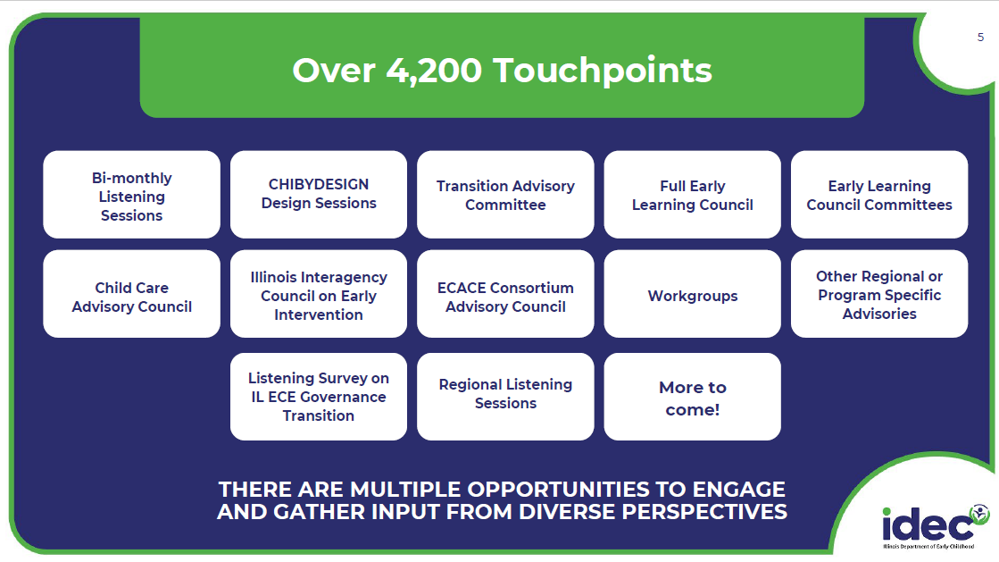

Slide 8
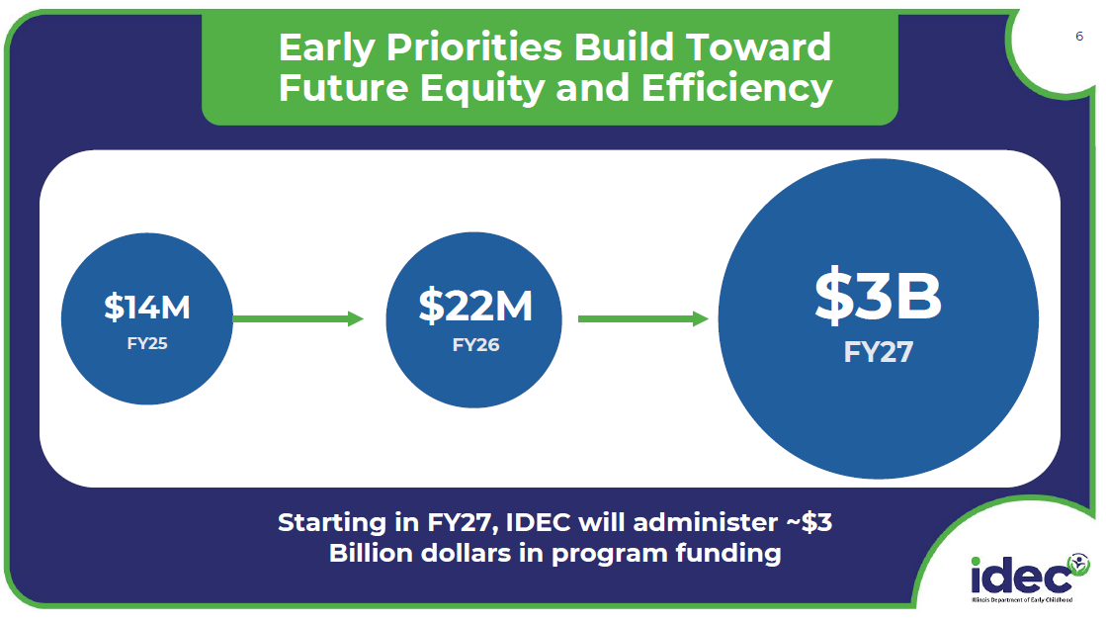

Slide 9
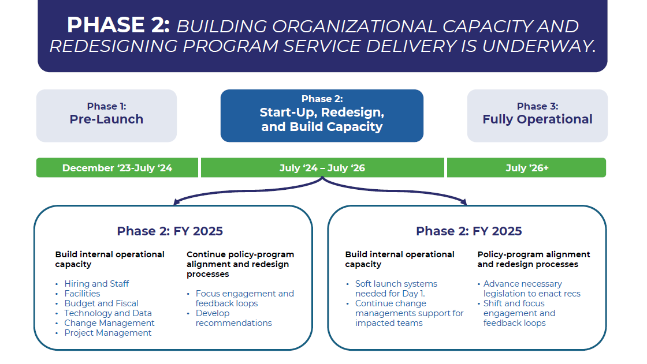

Slide 10
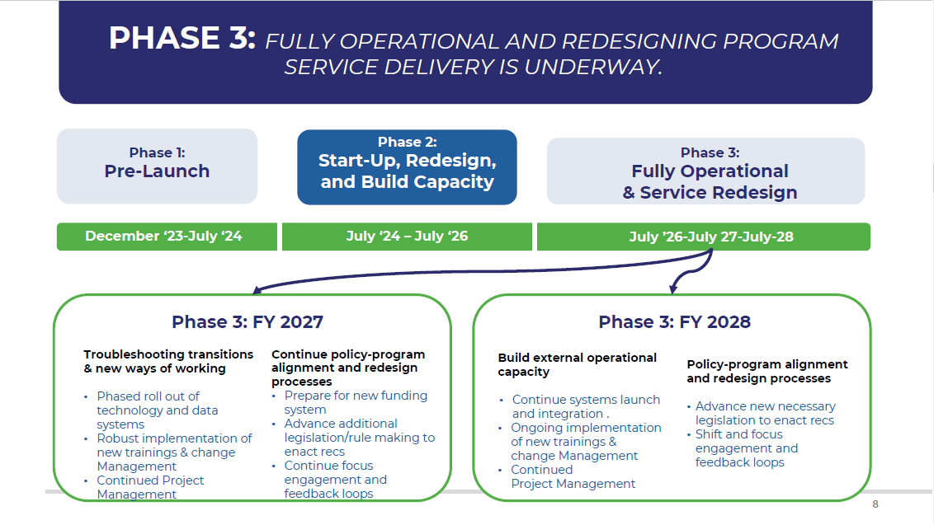

Slide 11
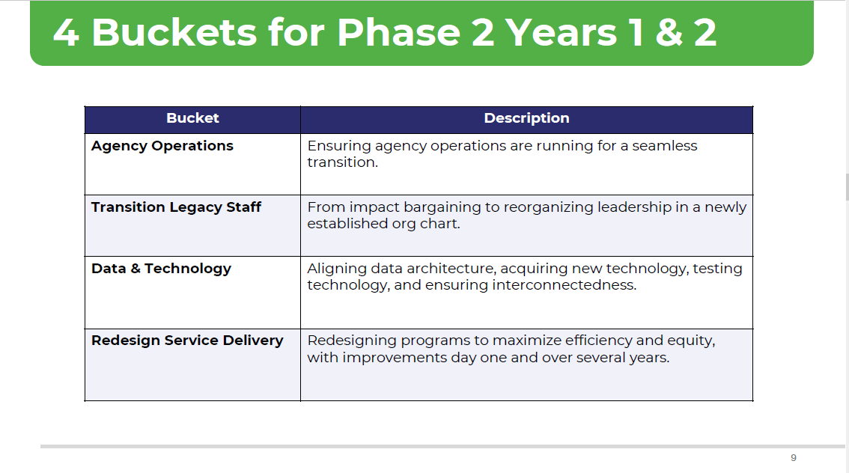

Slide 12
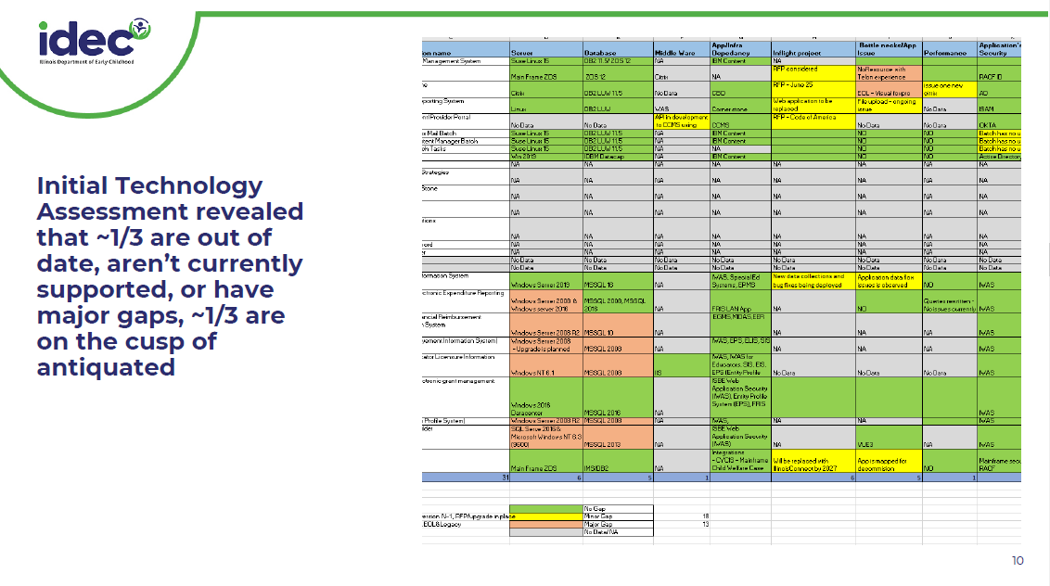

Slide 13
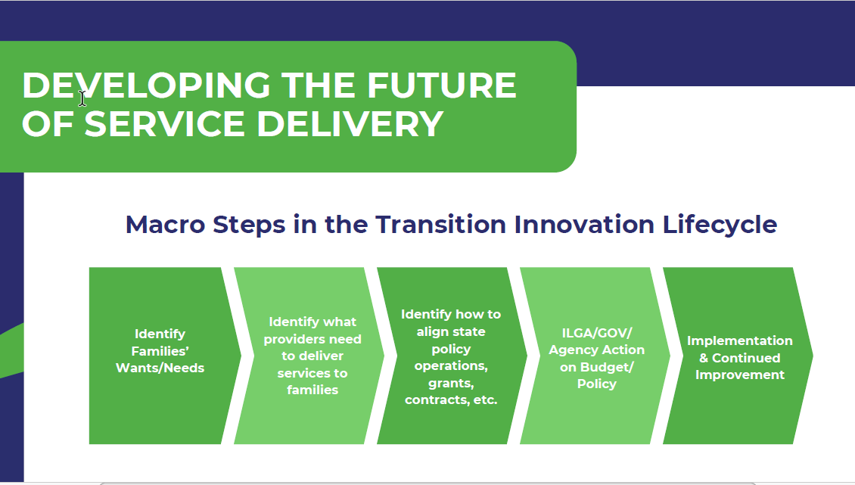

Slide 14
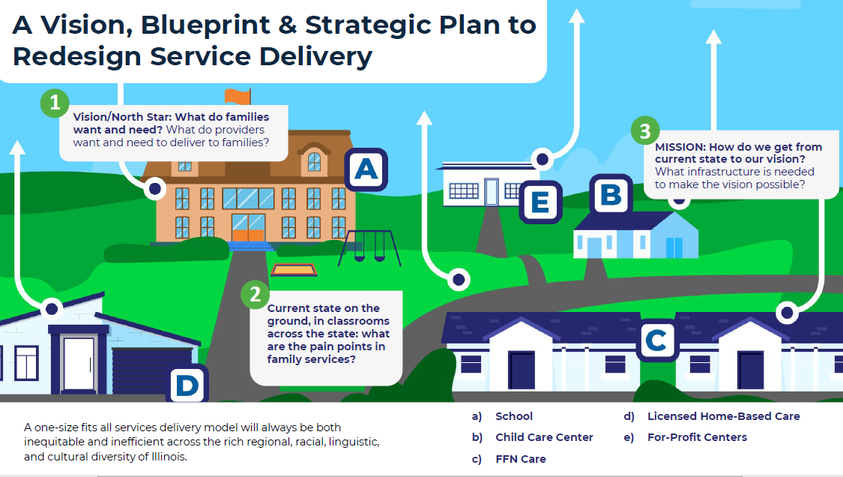

Slide 15
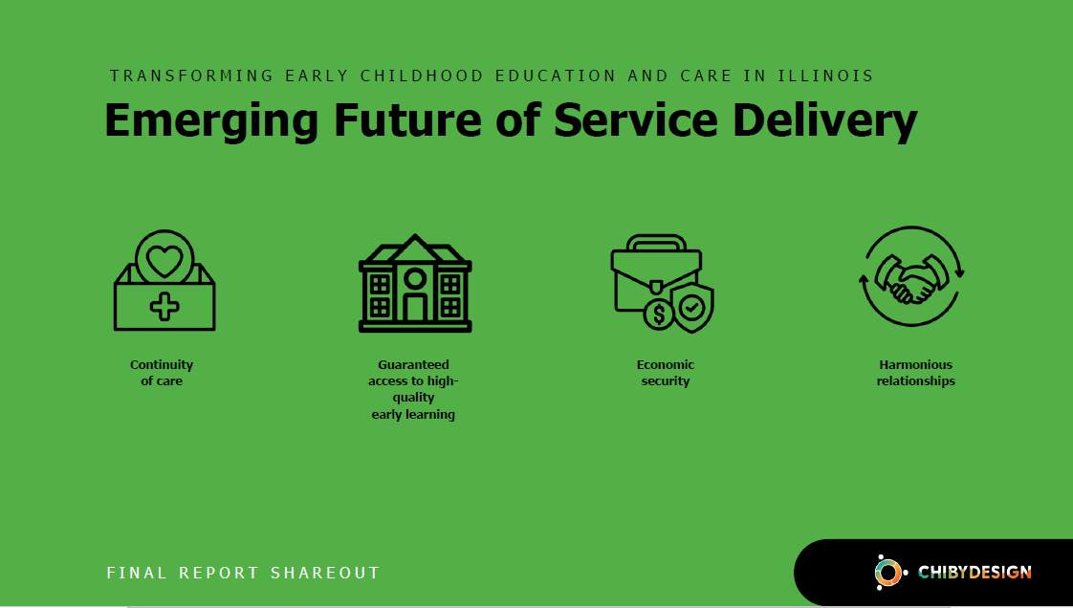

Slide 16
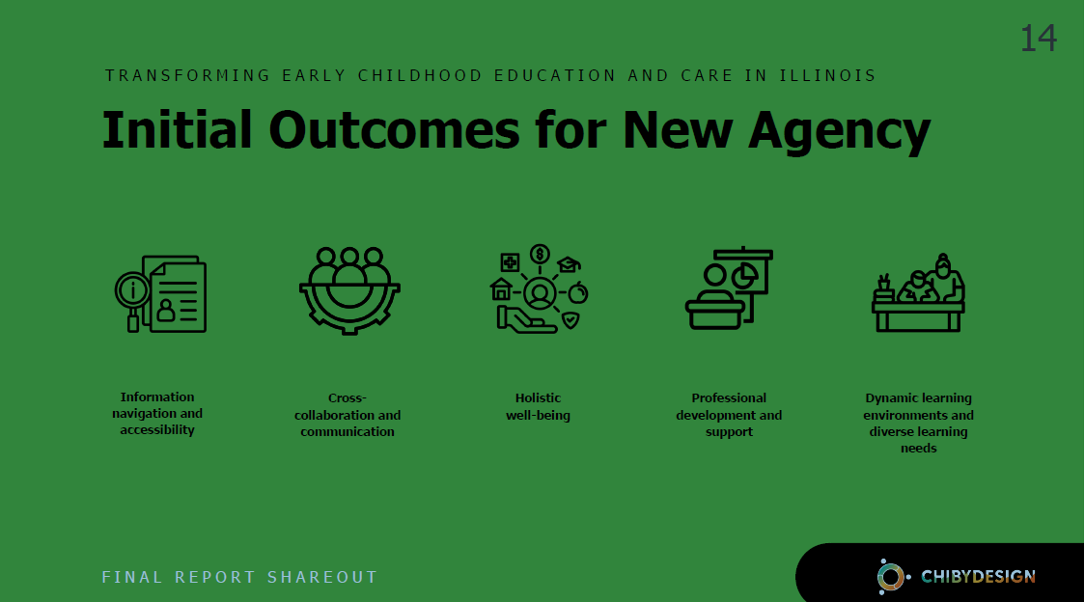

Slide 17
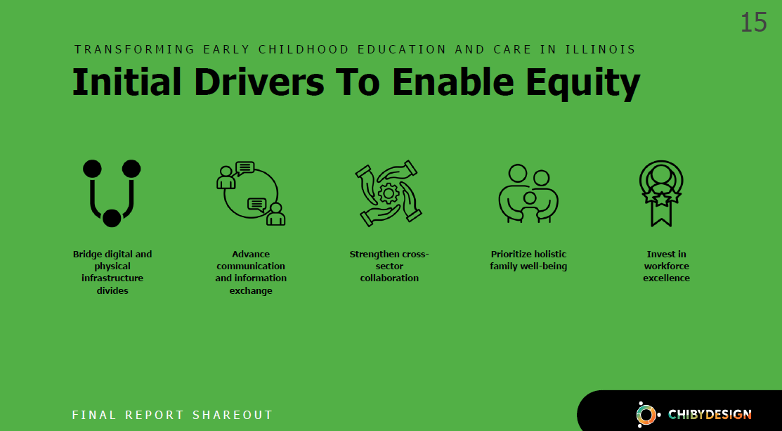

Slide 18
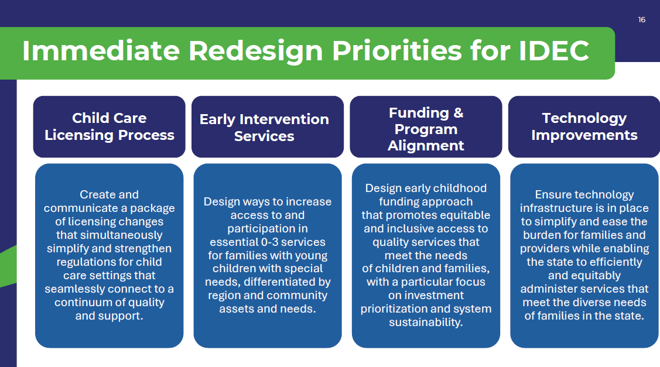

Slide 19
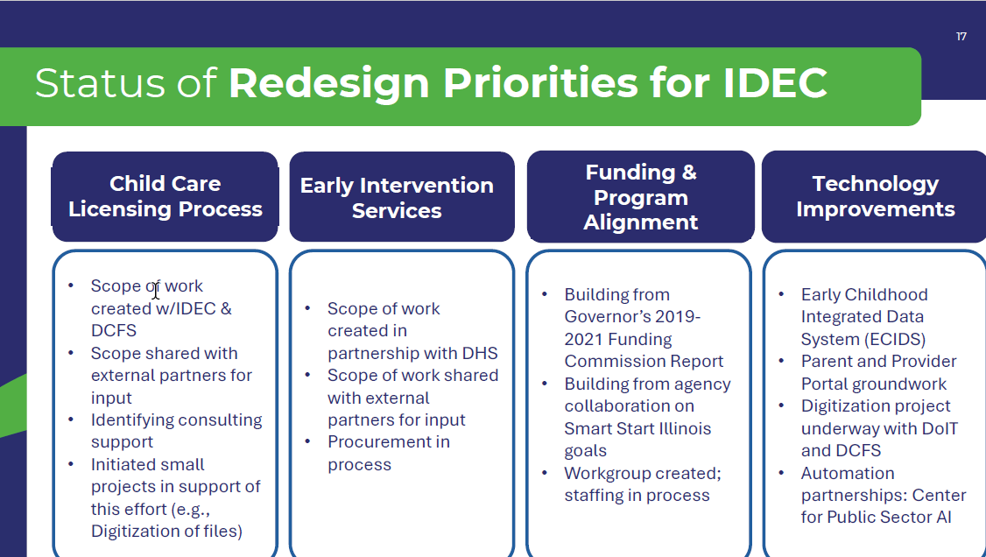

Slide 20
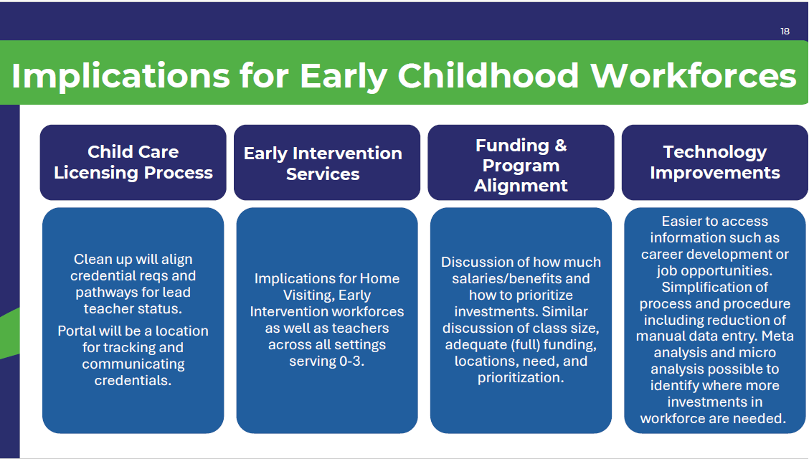

Slide 21
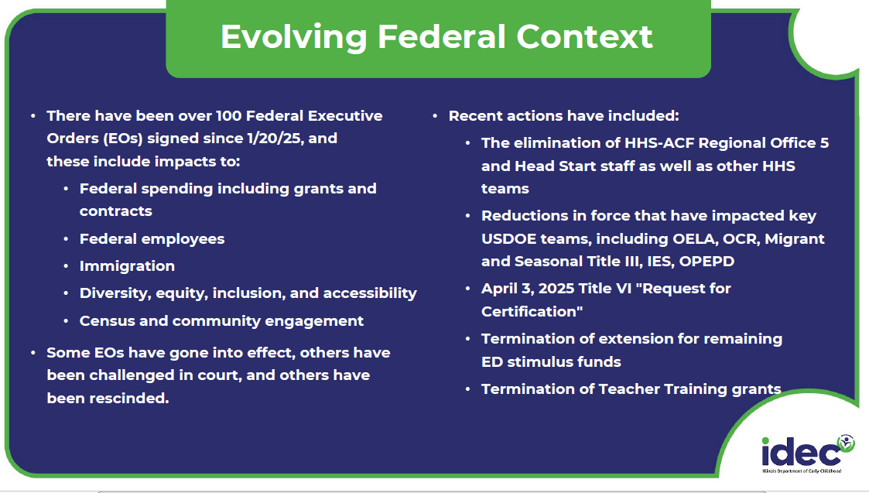

Slide 22
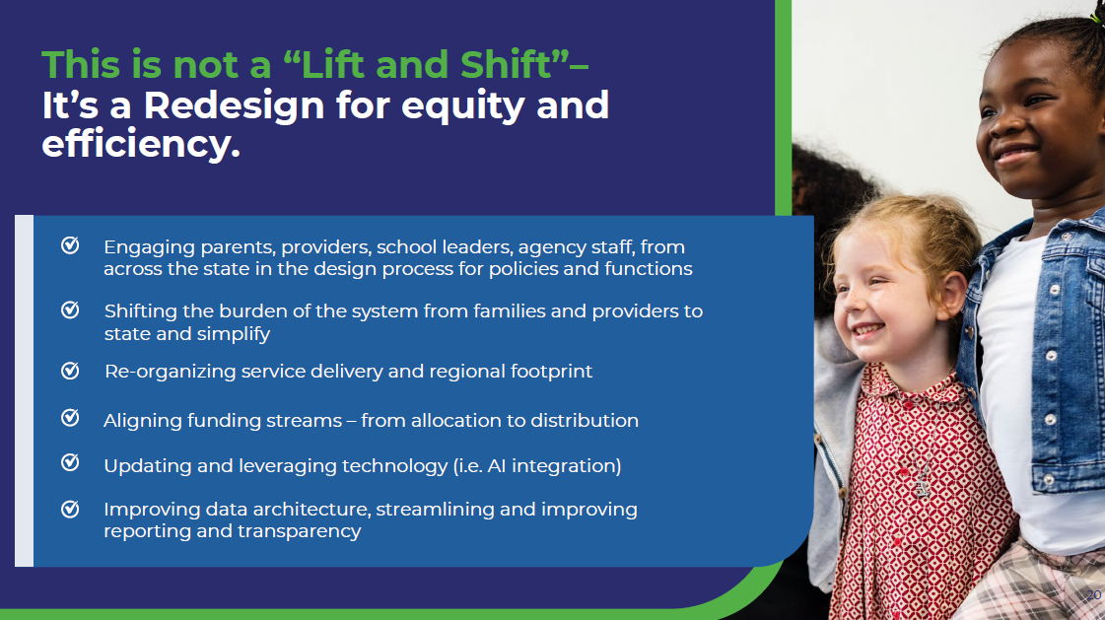

Slide 23
Smart Start
Child Care Update
Michelle Wood, IDHS-DEC

Slide 24
FY 26 Budget Proposal – Smart Start Child Care
The proposal includes $212 million for Smart Start Child Care, a $90 million General Revenue Fund increase from FY25.
Smart Start Workforce Grants
Smart Start Quality Support
Smart Start Apprenticeships
$200 million GRF (level funding, shift in funding source)
$10 million GRF (level funding, no change in funding source)
$2 million GRF (level funding, no change in funding source)
All proposed funding levels are subject to appropriation from the Illinois General Assembly.
Notes:
Governor Pritzker’s budget includes $212 million in General Revenue Fund (GRF) for Smart Start Child Care, and again I will emphasize that this is a $90 million General Revenue Fund increase from SFY 25.
Last year, some remaining American Rescue Plan Act dollars helped to fund Smart Start Workforce Grants, so in order to maintain this level of funding to sustain current grantees, the state needed to invest $200 million of State General Revenue Fund dollars for Fiscal Year 26 as those federal funds have been used and are no longer available.
Because of this change in funding source, even though it is a significant increase, the overall funding levels for all Smart Start Child Care programs will be the same as last fiscal year. (If approved by the Illinois General Assembly).
You can see here what that means for the total budget for each of the three Smart Start Child Care components.
$200 million total for Smart Start Workforce Grants
$10 million total for Smart Start Quality Support
$2 million total for Smart Start Apprenticeships

Slide 25
Smart Start Workforce Grants
IDHS Updates
Notes:
For those of you who are not familiar with SSWG, the Illinois Department of Human Services’ Division of Early Childhood (IDHS-DEC) launched Smart Start Workforce Grants in 2024, a nation-leading effort to raise wages while continuing the child care stabilization efforts that have helped Illinois avoid the child care cliff that has afflicted so much of the country.
These grants will allow providers to cover higher staff wages through consistent funding, helping to offset the unpredictable nature and fluctuation of private pay tuition and Child Care Assistance Program (CCAP) subsidy payments, considering the true cost of services, and paying in advance rather than in arrears.
With the help of Smart Start Workforce Grant funding, providers receiving the grant through IDHS will be required to meet or exceed a wage floor for teachers and assistant teachers, helping them to attract more staff and meet parents’ need for child care at a rate they can afford.
The ultimate goal of these efforts is to raise wages for staff to support staff recruitment and retention, so that child care providers can expand supply and serve more children and families without raising tuition.

Slide 26
Smart Start Workforce Grants - Round 3 funding highlights
After a peak in Round 2 – due to auto-renewal of all Round 1 grantees – 3,743 programs were authorized for funding in Round 3.
Notes:
Technical delays in the Gateways portal impacted the timing of applications in Round 2, so all Round 1 grantees were automatically renewed in Round 2. In Round 3 and going forward, programs must proactively indicate that they would like to continue, and typically we expect small amount of attrition between the rounds (generally countered by new applicants entering for the first time).
Round 1: 3,604
Round 2: 3,880
Round 3: 3,743

Slide 27
Smart Start Workforce Grants – Round 3 funding highlights
Spending for Smart Start Workforce Grants continues to be on target with budget projections, with $47.04 million distributed in Round 3.
Notes:
Round 1: $44.37 million
Round 2: $47.74 million
Round 3: $47.04 million

Slide 28
Smart Start Workforce Grants – SFY26
Looking ahead to SFY26 (July 2025-June 2026)
Round 1 of new fiscal year: Applications open April 1, funds will be issued in June and July 2025
As of the most recent round, all eligible applicants can be funded within budget
  FY 25 Round 3 (current round): $47 million issued
Budget for FY26: $200 million total
  Includes administrative support (application processing, accountability, T/TA, etc.)
  Approximately $48 million per round available for grants

Slide 29
Smart Start Quality Support
IDHS Updates
Notes:
The Smart Start Quality Support Program is an Illinois Department of Human Services (IDHS) program targeting support for quality improvement at center-based child care facilities. The program assists participating centers cover staffing costs associated with higher quality and guide staff in their quality improvement work. Currently, a limited number of licensed child care centers serving 40% Child Care Assistance Program (CCAP) children are participating. This program derives from the ExceleRate Illinois Child Care Center Pilot.

Slide 30
Smart Start Quality Support Overview
Staff wages
Improved staffing pattern
Centers are paid fixed rates designed to support additional costs they may incur to meet this requirement.
The rates are earned based on the highest credential held by each member of the teaching staff.
If staff gained higher credentials, their wage was immediately increased. The SSQS program pays the higher rate.
Baseline reports of center staffing collected prior to pilot launch showed that centers could only afford the staff necessary to meet licensing standards.
The SSQS program allows centers to use funding to secure additional staff.

Slide 31
Smart Start Quality Support Overview
Smart Start Quality Support Pilot programs engage in activities to test continuous quality improvement.
Commit to improving/maintaining ExceleRate Circle of Quality
Use ERS data to drive decision making and improvement efforts.
Use the Plan-Do-Act study model.
Encourage and support staff to earn higher credentials.
Mentoring and communities of practice from NLU.
Implementation of individualized Leadership Development Plans for directors.
Professional development opportunities

Slide 32
FY 26 Smart Start Quality Support Wage Scale
FY 26 Employer share: Directors: $17/hour, Lead Teachers and Assistant Teachers: $15/hour
​ Director​ ​ ​ | IDC III​ | $24.90 ​
 | IDC II​ | $23.90 ​
 | IDC I ​ | $22.90 ​
 | DCFS Director Qualified (no credential)​ | $21.90 ​
​ ​ ​ Lead Teachers ​ ​ ​ ​ ​ ​ | ITC 5 & 6, ECE 5 & 6 ​ | $21.25 ​
 | ITC 4, SAYD 5 ​ | $20.75 ​
 | ECE 4 ​ | $20.25 ​
 | ITC 3 ​ | $19.75 ​
 | ITC 2, ECE 3, SAYD 4​ | $19.25 ​
 | ECE 2, SAYD 3 ​ | $19.00 ​
 | SAYD 2​ | $18.75 ​
 | ECE 1 and SAYD 1​ ​ | $18.50 ​
 | DCFS Qualified Teacher (no credential)​ | $18.25 ​
​ Assistant Teachers​ ​ ​ | ECE 2, SAYD 3 ​ | $17.75 ​
 | SAYD 2​ | $17.50 ​
 | ECE 1 and SAYD 1​ ​ | $17.25 ​
 | DCFS Qualified Teacher Assistant (no credential)​ | $17.00 ​

Slide 33
Smart Start Illinois Apprenticeship Pilot
IDHS Updates

Slide 34

Smart Start Illinois Apprenticeship Pilot – Partnerships
Scholarships + Intermediary Support + Site-based Agreements
Institutions of Higher Education (IHEs)
Institutions of Higher Education (IHEs) provide coursework leading to Gateways to Opportunity Early Childhood Credentials and degrees
Apprenticeship Intermediary (UIC)
Workforce intermediary supports partnerships between IHEs and child care programs and provides support to site-based mentors, convenes advisory council, and serves as liaison to DOL
Child Care Programs
IDHS/INCCRRA provides beneficiary agreements to participating child care programs to fund wage scale tied to credentials and degrees and conditions that support professional learning in the workplace
Notes:
How:
To meaningfully address the well documented and systemic early childhood education (ECE) workforce crisis, Illinois must implement a full complement of coordinated strategies to confront the specific challenges faced by the field. Based on the challenges currently faced by the field and existing initiatives, the Illinois Department of Human Services (IDHS) Division of Early Childhood (DEC) would like to roll-out:
An apprenticeship model to bridge and connect scholarship programs leading to credentials and degrees with on the job/real world training and mentorship tailored to the context of the specific communities where apprentices work; and
Couple those with the expansion of child care program contracts, specifically targeted to support funding for increased compensation directly connected with increased qualifications.
This complements and supports the compensation side of ECACE and other scholarship opportunities and provides the missing employer supports to get providers on board with sending their staff back to school as well as bringing a new generation of caregivers and teachers into the workforce.

Slide 35
Smart Start Illinois Apprenticeship Pilot – Participants
Early Childhood Providers/Employers:
Carole Robertson Center for Learning, Chicago
Heartland Child Development Lab, Bloomington
It Takes a Village, Chicago
SAL Family Services, Milan, Moline, Rock Island
Roles and Responsibilities
Promote workplace conditions that support professional learning
Sponsor at least two Apprentices
Sign on to customizable “Standards of Apprenticeship”
Identify mentor(s) to provide regular 1-on-1 mentoring to Apprentice, and support them to receive training
Support weekly mentor/Apprentice meetings
Implement wage growth steps aligned with worker competency development and the ECE Career Pathway
2- and 4-year Institutions of Higher Education:
City Colleges of Chicago
Blackhawk College
Heartland College
National Louis University
Western Illinois University
University of Illinois Chicago
Roles and Responsibilities
Prepare Apprentices for admission to ECE program of study
Assist Apprentices in accessing existing scholarship opportunities (Early Childhood Access Consortium for Equity (ECACE) Scholarship, Gateways to Opportunity Scholarship Program (GSP), Chicago Early Learning Scholarship (CELS))
Administer Credential and Degree coursework including award of credit for OJT competencies
Provide academic advising, tutoring as necessary
Contextualize curriculum as needed
Coordinate between faculty and on-site mentors
Award Credentials and Degrees in Early Childhood Education

Slide 36
Contact Information
Thank You!
Michelle Wood, Bureau Chief, Quality Initiatives
Michelle.Wood3@illinois.gov

Slide 37
2025 Gateways Higher Education
Faculty Forum
Innovation in Action: Reaching the Workforce
Joyce Gronewold
Executive Director of Specialized Instruction

Slide 38
Early Childhood &
Educator Effectiveness Updates
April 11, 2025

Slide 39
Licensure
  Early Childhood Content Test
  Test Development
  Right Start Preparation
Individualized Pathways
Credential Options
Illinois Educator Preparation Profiles
Teacher Recruitment
Retention

Slide 40
Licensure

Slide 41
Early Childhood Content Exam (206)
Targeted Redesign
ISBE Board Approved New Cutscores
Newly Approved Cutscore Operational for all test takers
All Cutscores Converted to a 100-300 Scale
Notes:
The current early childhood education content test (206) just went through a targeted redesign to identify and remove any potential bias and ensure the test was aligned to the most recent standards. ISBE just approved a new, lower, cutscore for this test at it’s February board meeting. Since then, Pearson has made the newly approved cutscore operational for all test takers. Please note, all cutscores are converted to a 100-300 scale, using the formula in Part 25.760.

Slide 42
Phase 1 Test Development & Redesign
Early Childhood FLEX Option
Alternate assessment designed around specific test objective
Applicable for candidates who were unsuccessful in previous traditional test attempts
Early Childhood Testlet Model
Set of subtests
Candidates can take subtests separately
Each subtest score can be added towards overall passing score
Option to retake subtest individually

Slide 43
New Provisions
Free Practice Tests for all fields including Early Childhood Education
Right Start Preparation Course
Diagnostic assessment
Free Retake Policy
Notes:
ISBE also launched a Right Start preparation course for early childhood education. This course begins with a diagnostic assessment that allows candidate to target their preparation in their weakest areas. You can learn more about Right Start at this webpage. The final update is our new free retake policy. Any candidate who had two unsuccessful attempts after January 28, 2025, and scored with one standard error of measurement of passing, is automatically eligible for free unencumbered retakes. This will automatically be applied to eligible candidate’s accounts with no voucher code needed. You can read more about the free retake policy at this webpage under “retake policy”.
Free Retakes
For registrations on or after January 28, 2025, candidates who have taken the same ILTS test with the same test code twice and have not yet passed but have achieved a test-specific scaled score as indicated below on at least one of those attempts will be able to reregister for the same test at no cost.*
Please note the following:
Any test registration or administration prior to January 28, 2025, will not count toward a free retake.
You do not need to use a voucher or any special code; the system will automatically allow eligible candidates to reregister for free.
You may register for free up to 12 months after the release of your most recent score report for the test
If you are absent from your test appointment, the absence will not count toward one of the two attempts.

Slide 44
Individualized Pathways
IHEs can honor Prior Learning Assessments (PLAs) or other alternative means in place of coursework as part of a licensure program.
  Experiences in teaching
  Certifications
  Content Knowledge Assessments
Use form 83-85 on an individual basis; submit a program change form if the option is available program-wide.
Shorten licensure timelines
Lower education costs
Increase persistence in programs

Slide 45
Credential Options
Short Term Emergency – Early Childhood Special Education
Short Term Approval – Content Knowledge Pathway
Short Term Approval on a PEL
Subsequent Endorsements – 18 SH Content
  Coursework + Content Test
  Includes Early Childhood and Elementary Endorsements
Short Term Approval – Paraprofessional
Notes:
Reminders on current options in place

Slide 46
Illinois Educator
Preparation Profiles (IEPP)

Slide 47
Supporting Educators: IEPP
Available online at ISBE
Data from 2022-2023 school year and covers 2019-2023
Includes Illinois Department of Employment Security Data
Highlights
6% increase in diverse candidate enrollment
86%placement rate
Teacher retention above state target

Slide 48
Recruitment
Early Childhood Access Consortium for Equity Scholarship Program
  The 2025-26 application is now available:
    https://www.isac.org/ECACEscholarship
    Priority consideration date is May 19, 2025
Gateways Scholarship Program
  Pays a portion of tuition for eligible professionals working in early care and education or school age programs who want to earn college credit, credentials,or degrees.

Slide 49
Recruitment
CTE Education Career Pathway Program
Become at Teacher
  www.becomeateacher.com
Notes:
CTE Education Career Pathway Program- In September, ISBE announced $7.4 Million in state funding towards CTE Education Career Pathway Grants to 18 entities serving 39 school districts. FY26 No updates at this time.

Slide 50
Retention

Slide 51
Retention
Teacher Coaching and Mentoring
Affinity Groups
  Teach Plus: https://teachplus.org/il/
Teacher Vacancy Grant
Notes:
Teacher Coaching and Mentoring- FY 25 is last cycle through Appropriation funding. At this time, no updates available
Affinity groups- Teach Plus Illinois – information available not only on ISBE Learning Renewal webpage as well as teachplus.org/Illinois
Teacher Vacancy grant part of a pilot program aimed at addressing chronic shortages by providing the state's most understaffed districts with resources to attract, hire, support, and retain teachers. Districts in Evidence-Based Funding Tiers 1, 2, 3 (as calculated for fiscal year 2023) have been identified for eligibility. Districts in Tier 4 are ineligible for this program as are the 352 districts that reported having no unfilled teaching positions at the beginning of the 2022-23 school year. One hundred seventy districts have been identified as eligible to receive awards based on the highest counts of unfilled teaching (not administrative or school support) positions and to ensure that 60% (102) of awards go to rural districts and 40% (68) of awards go to urban districts.
Districts in Evidence-Based Funding Tiers 1, 2, 3 (as calculated for fiscal year 2023) have been identified for eligibility. Districts in Tier 4 are ineligible for this program as are the 352 districts that reported having no unfilled teaching positions at the beginning of the 2022-23 school year. One hundred seventy districts have been identified as eligible to receive awards based on the highest counts of unfilled teaching (not administrative or school support) positions and to ensure that 60% (102) of awards go to rural districts and 40% (68) of awards go to urban districts.

Slide 53

ECACE & Other Higher Education Work Underway

Slide 54

ECACE Scholarship
Eligibility and Prioritization for AY2026
This Photo by Unknown Author is licensed under CC BY-ND
Notes:
Christi

Slide 55
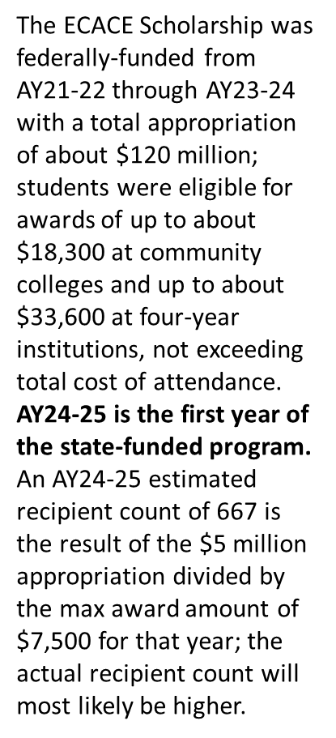
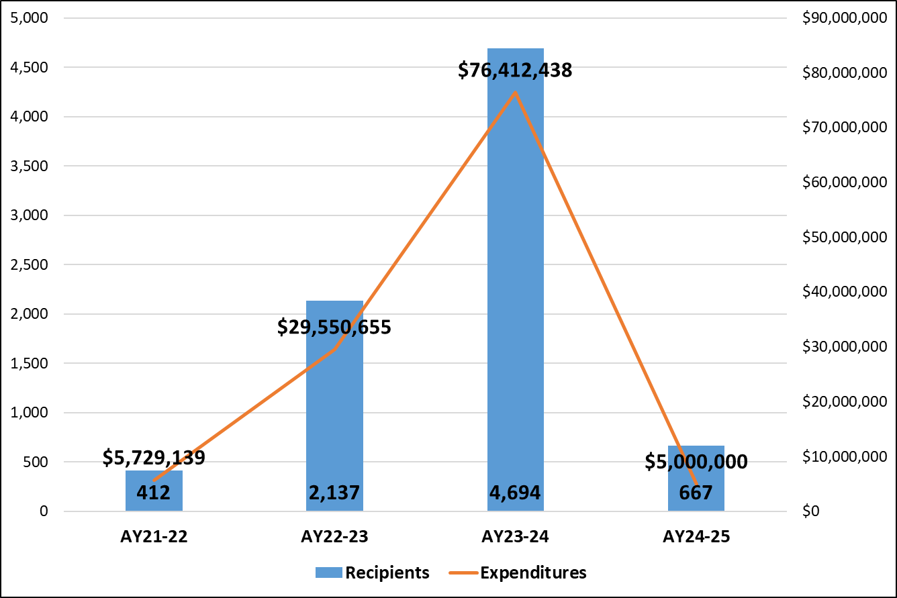
ECACE Scholarship Program Expenditures and Recipients
AY21-22 (Year 1) – Estimated AY24-25 (Year 4)
Notes:
– This is just to remind folks what the scholarship looked like over the last few years and to emphasize the reduction in resources.

Slide 56
Prioritizing Students for the ECACE Scholarship
Many students were awarded scholarships in AY2024
As resources have declined, how do we prioritize students for the scholarship?
Governor’s Office asked state agencies to determine what it would take to prioritize those “close to completion” for FY2026 to address workforce demands
For AY 2026:
Prioritize FIRST current (AY25) recipients that return (Maybe 450 out of 666)
NEXT: Prioritize those students from AY2024 who have 30 Credit Hours or Less Remaining
Beyond AY2026:
Short-term Priority: A focus on those ‘close to completion’ should be a short-term initiative, potentially 3 – 4 years. Get a few cohorts of students “over the finish line” then adjust to ensure we are focusing on the needs of the Consortium and field from entry to completion.
Notes:
Christi

Slide 57
Timeline
March 31 | Application opened Institutions and navigators contact former recipients
May 29 | Priority Deadline for applicants
End of May/ First of June | Eligible students’ info sent institutions to verify eligibility and note whether they are “close to completion” (30 hours or less)
June & July | Institutions verify student eligibility and credit hours
Beginning of August | Make awards
Notes:
Christi

Slide 58

AAS Transfer Study
Consortium universities have implemented transfer pathways for students with an AAS in early childhood, as required by legislation.
ECACE is partnering with Community College Research Center (CCRC) at Columbia University to better understand how institutions made this happen.
Opportunity to document efforts of Consortium institutions and share lessons learned about developing pathways from historically terminal degrees into baccalaureate programs.

Slide 59
Research Phases and Timeline
Institutional Survey
April 2025
Focus Groups
April - May 2025
Consortium Work Group Meetings (2)
All 62 institutions will complete a brief survey on the development of ECE AAS transfer pathways and associated supports
Small team discussions to gain insights into promising practices, innovations, and any challenges
April: Receive input on study design and methods
Late Summer: Refine draft findings and recommendations
Notes:
Research Phases and Timeline
Year One (2025)
Institutional Survey (March 2025): All 62 Consortium institutions will complete a brief survey focused on the development and implementation of their ECE AAS transfer pathways and associated supports.
Focus Groups (April-May 2025): Follow-up discussions with small teams from 6 selected institutions to gain deeper insights into promising practices, innovations, and challenges.
Consortium Work Group Meetings (Twice in 2025):
The working group will include a representative from 8-10 Consortium institutions.
Early 2025 (Feb/March): Solicit input on study design, research questions, and data collection instruments.
Late Summer 2025: Review and refine draft findings & recommendations.
Process to complete the survey:
Email and link will be sent to institutional provosts and chief academic officers
Leadership will organize a team / bring together institutional teams to discuss the questions in the survey and document responses
Teams need to include those familiar with the implementation of this work. Examples:
Deans
Chairs
Faculty
Registrars
Advisors

Slide 60
2nd Annual Report
Highlights from the First Full Year of the Consortium

Slide 61
Early Childhood Student Enrollment: AY19-20 to AY22-23
+11.4%
ECACE Goals and progress are based on a comparison to a “baseline” year – AY2019 – 20.
Since baseline, early childhood programs experienced a 11.4% increase.
In the first full year of the Consortium, enrollment increased by 10.6%
+10.6%
All institutions were sent their institutional level data.
Notes:
Ay 2023 data – lagging b/c of intensive matching project. Match data w/ICCB, ISAC, and INCCRRA to get the incumbency marker.

Slide 62
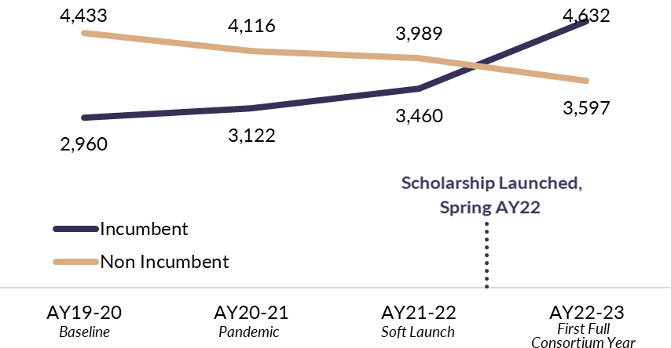
Incumbent vs Nonincumbent Enrollment
Incumbent
+33.9%
Enrollment (AY22-23)
  4,632 incumbent workforce enrolled
  56.5.% increase from baseline
  33.9% increase within a year
Persistence Rates (AY22-23)
  72.9% incumbent workforce EITHER
    completed in AY21-22 OR
    persisted and continued into AY22-23
Incumbent and Non-incumbent Worker Enrollment
in All Consortium Early Childhood Programs,
AY19-20 to AY22-23
Notes:
Ay 2023 data – lagging b/c of intensive matching project. Match data w/ICCB, ISAC, and INCCRRA to get the incumbency marker.
19% DECREASE for non-incumbent and 10% since AY22

Slide 63
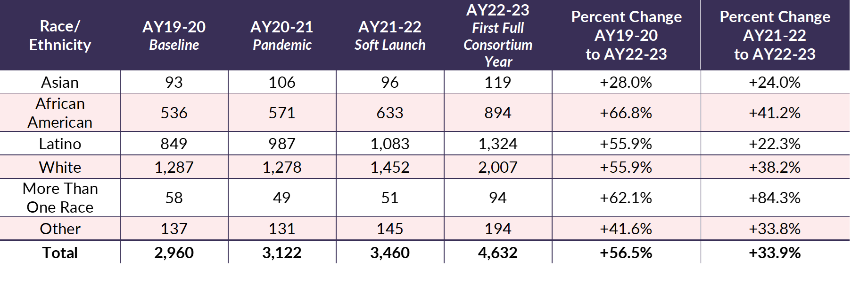
Enrollment Increased Across Races, with Highest Rates for African American Students
The Enrollment of Incumbent Early Childhood Workforce by Race/Ethnicity, AY19-20 to AY22-23
Notes:
the greatest increase: 41.2% African American (633→894)
the greatest increase: 66.8% African American (536→894)

Slide 64
ECACE Report Highlights (Cont.)
Time Frame:
18 months
(July 2022 – December 2023)
Debt Relief: 1,205 students' debt removed
Transfer Pathways: 2,053 students transferred into four-year Early Childhood programs, 31.7% held an AAS degree
Program Design and Modality: More accessible
Student Supports: Mentors, coaches, and tutors met students over 50,000 times
Outreach and Engagement with Employers:
2,137 outreach events
40,253 incumbent workforce participants
11,382 reported employer connections
Notes:
Next Report
Time Frame:
AY23-24 (July 2023 – June 2024)
Expected Time:
Late summer/Fall, 2025
THIRD ANNUAL REPORT -- Working on this now
Estimated publish date: end of summer
Plan to include more information on transfer patterns AND Completion rates

Slide 65
Governor Pritzker’s Proposed Budget
$46m (3%) increase in general funds for public universities and community colleges
$3m to expand the Common App and simplify it’s use
$10m increase for Monetary Award Program (MAP)
Flat Funding:
  $5m ECACE
  $10.75 for Golden Apply Scholars and $5m for Golden Apple Accelerators
  $8m Minority Teachers of Illinois (MTI)
$200m to support Early Childhood Workforce Compensation Contracts
$85m in crease in Child Care Assistance Program
$10m increase for compensation increases for Early Intervention providers
65

Slide 66
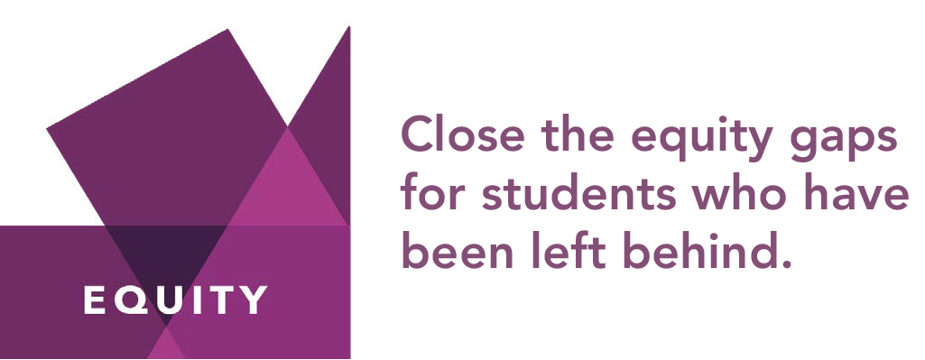


Strategies for a Thriving Illinois
Notes:
The strategies outlined in this plan are designed to close equity gaps, build stronger financial futures, and increase talent and innovation to drive economic growth.
We outlined 25 strategies in the full plan. And work is underway on the majority of the strategies, including meeting student basic needs, through ECACE, benefits navigators, HOUSE liaisons, grants for basic needs, mental health early action on campus, and the Technical Assistance Center; implementation of equity plans; work on equitable and adequate funding for institutions; on-going investments in MAP; among others.
What we will highlight today are efforts to keep high school students in Illinois for college and specific efforts to implement direct admissions.

Slide 67


Common App has led to dramatic increases in applications, including for students from low-income families and students of color
67
Notes:
The Common App is an online portal that allows prospective students to apply to multiple colleges with the same basic application. In 2021, all public universities began using the Common App. Illinois was only the second state in the country to have all public universities on the Common App.
With the Common App students can see the array of great Illinois options for college, part of our effort to keep high school graduates in Illinois for college.
And from an application side, it is working. As you can see, we have more applications coming into public universities through the Common App in 2022 than we received total applications in 2020. And we’ve seen an increase in the number of applicants from Illinois residents, as well as an increase in applicants of color.
Of the 190,778 applications inside the CA, 62% (119,286) of them were applications that went to in-state institutions. That number represents a 9% increase in in-state applicants over this time period last year.
While the number of fee-waiver eligible students has grown over the last four years (from 25,920 to 41,425), the percentage of overall applicants qualifying for fee waivers each year hovers around 32%. (This is a proxy for applicants from low-income families)
In the last four years, the number of students of color applicants has risen by 9 – 12% points, with the largest growth seen from this time last year to this year. The number of black or African American applicants grew by 12% (11,587 to 13,473) and the number of Latinx grew by 10% (19,097 to 21,234).
In February 2024, we received a grant from the Lumina Foundation as part of their Great Admission Redesign to implement at scale a direct admissions program for high school students and for community college transfer students.
Our plan is to expand what we are doing with Common App as the foundation of this new program.
NOTE: Includes all applications to Illinois public universities including from out of state.

Slide 68

One Click College Admit:
High School Program Overview
One Click College Admit is Illinois’ free, quick, and stress-free direct admissions program into the state’s participating universities. With only their GPA, graduating high school students are directly admitted to one or more Illinois public universities!
One Click College Admit
  Removes application fees, essays, and letters of recommendation
  Expedites the admission process
  Ensures students, who meet eligibility criteria, a spot at an Illinois university
  Reminds students of open enrollment at their local Community College
68
Notes:
Called One Click College Admit, the new direct admissions program is a partnership among the IBHE, ICCB, ISAC, and Common App. ISBE is also a partner. We are implementing direct admissions in two phases. The first phase launched in January of this year. The second phase is dependent on legislation going through the general assembly now. As you likely heard in the Governor’s Budget Address, Direct Admissions is one of his major education priorities.
In this first phase, we are partnering with Common App. (highlights of program on slide)
To receive One Click College Admit offers, students:
Create a Common App account (or have an existing account)
Indicate their permanent home address in IL
Enter their GPA and GPA scale (One Click College Admit guide provides step by step directions)
That’s it – at this point there is no need to complete the full application inside Common App
Eligibility match process will run weekly
Institutions verify with transcripts before enrollment
More on how the program operates.
Students get both an email notification of the universities they are matched to and how to find their local community college and they can find more detail about the institutions through their Common App portal.
The key difference between the current program and what we will be able to do once the legislation passes: today, students have to enter their GPA, so the participants are students who choose to open a Common App account and enter their GPA. Under the full program, we will be able to do this more universally.
All public universities participating except ISU and the U of I schools.

Slide 69

Work Underway to Include Transfer Students in One Click
Learn from Current Universities
Build ICCB/IBHE/ ISAC Data Match
Comms and Outreach Campaign
Launch OneClick
69
Notes:
We want to implement a similar program for community college students who wish to transfer to be One Click admitted to public universities.
Criteria for OneClick transfer refined (for legislation)
ICCB works with community colleges to collect data to determine eligible students (timely GPA, course completion data needed). ISAC matches then provides to Common App (we hope)..
Work with stakeholders to ensure successful participation
Goal: Implement for Fall 2027 semester
Public University Direct Program Act (HB3522 and SB2448)
Implementation Timeline: Fall 2027 Enrollment
Fall 2025
August 2025 School districts begin collecting opt-in forms during registration for high school juniors; community colleges begin collecting opt-in forms for transfer students.
Spring 2026
Beginning March 1, 2026 (Annually after) Public universities submit GPA admission standards; UIC/UIUC submit out-reach and access criteria.
Summer 2026
By July 1, 2026, High schools begin providing junior/rising senior student data to ISAC for admission determinations. Community colleges will begin to provide transfer student data to ISAC for admission determinations.
Fall 2026
September 2026 First direct admission offers, and pre-selection notifications issued for enrollment in Fall 2027.
August 1, 2029
Program report submitted to the Governor and General Assembly.

Slide 70

Contact:
Christi Chadwick
Chadwick@ibhe.org

