Slide 1


Slide 2
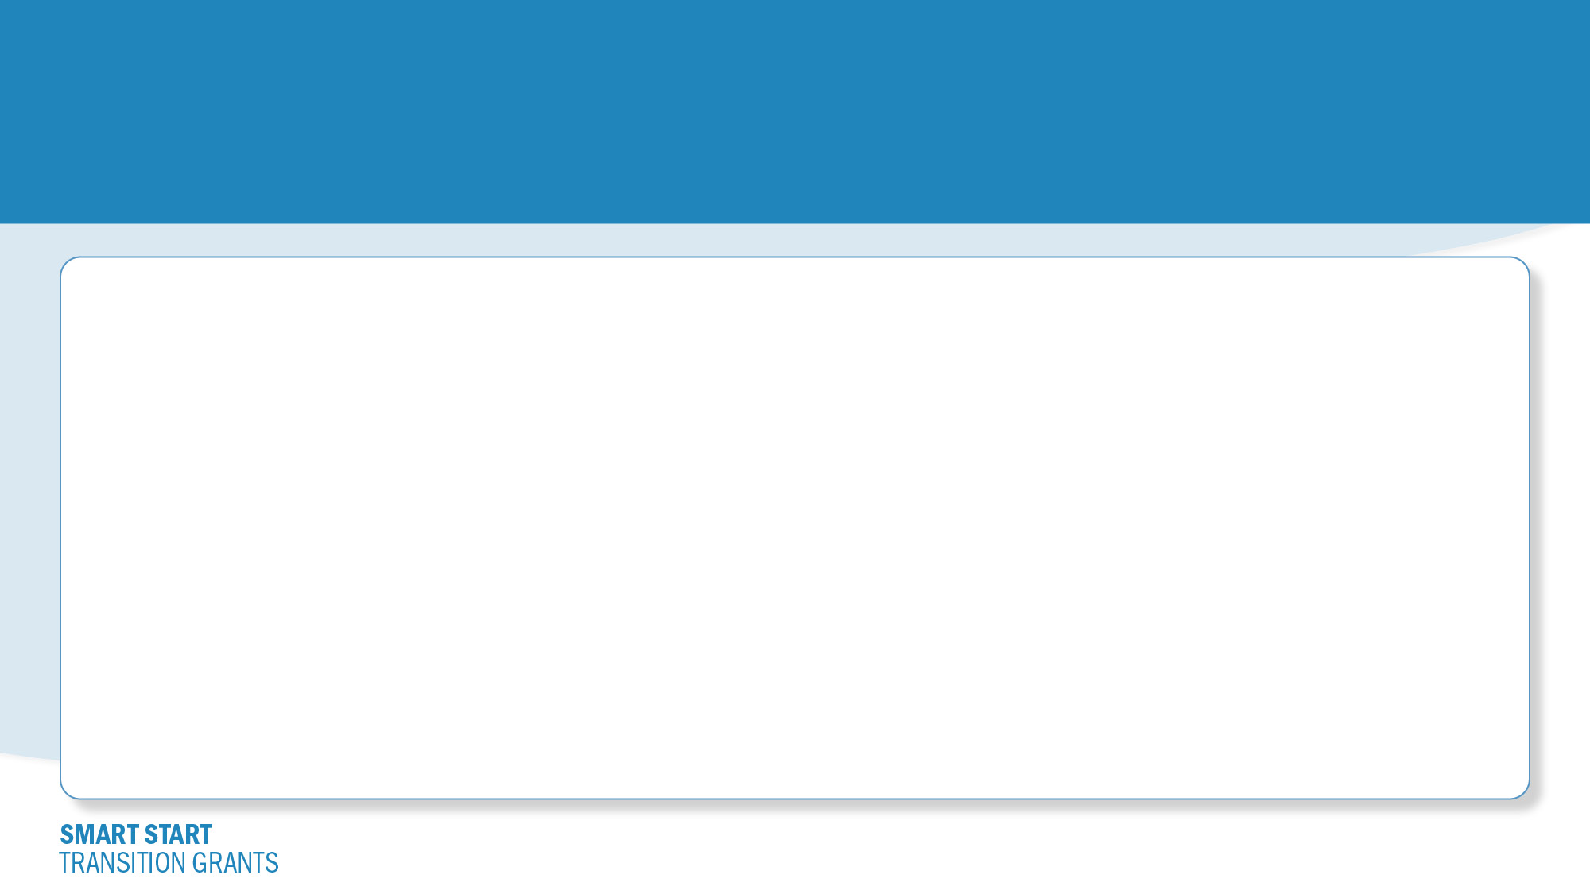
Smart Start Transition Grants
Transition Grants application will open on Monday July 10, 2023
Smart Start Transition Grant Schedule
Transition Grants Round 1: October 2023 – December 2023 (Applications available July 10, 2023 – August 10, 2023)
Transition Grants Round 2: January 2024 – March 2024 (Applications available October 2, 2023 – October 31, 2023)
Transition Grants Round 3: April 2024 – June 2024 (Applications available January 2, 2024 – January 31, 2024)
Transition Grants Round 4: July 2024 –September 2024 (Applications available April 1, 2024 – April 30, 2024)

Slide 3
The Smart Start Transition Grants are available to all programs who:
are licensed as a child care center, child care home, or group child care home
were in operation as of June 1, 2023, and continue to care for children today
operate full-day and full-year, defined as a program that is open and offering at least eight consecutive hours of care per day, five days a week, 47 weeks a year
at least 10% of program’s current licensed capacity (at time of application) enrolled and funded by CCAP in any one month between January 2022 to date of application
less than 75% of total revenues from other public funding streams (e.g., Head Start, Preschool for All)

Slide 4

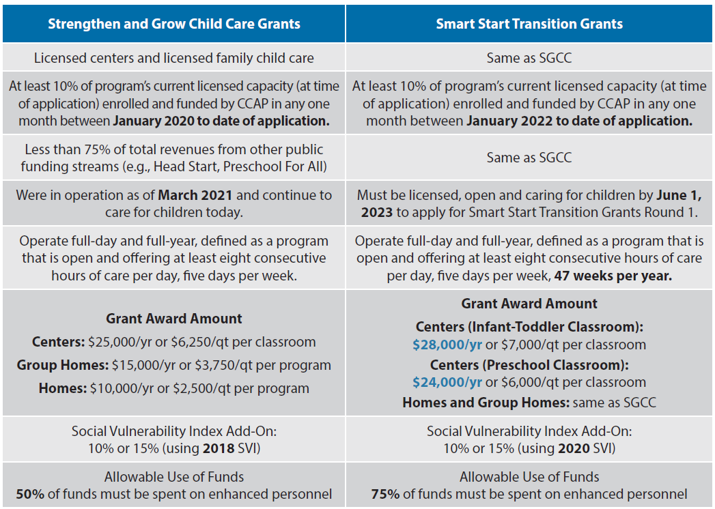
What is the difference between SGCC vs. Transition Grants?

Slide 5
Getting Ready to Apply
Your Gateways Registry membership must be current
You must have access to your program’s Director Portal
Gather your W-9 form
Have you Unique Entity Identifier (UEI) ready, or request a free UEI
Get your certificate of good standing from the Secretary of State*
Review the tip sheets on the Gateways website:
https://www.ilgateways.com/smart-start/smart-start-transition-grants
* Required unless you file your taxes and W-9 as a “sole-proprietor” with the Internal Revenue Service (IRS)

Slide 6
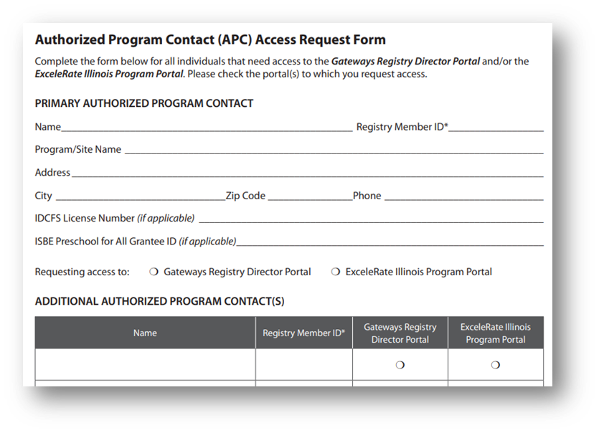
Director Portal Access
If you need access, complete an Authorized Program Contact request form
https://registry.ilgateways.com
Be A Member > Director Portal
Scan/email to onlinehelp@inccrra.org
You will receive an email confirming access in 2-4 business days

Slide 7
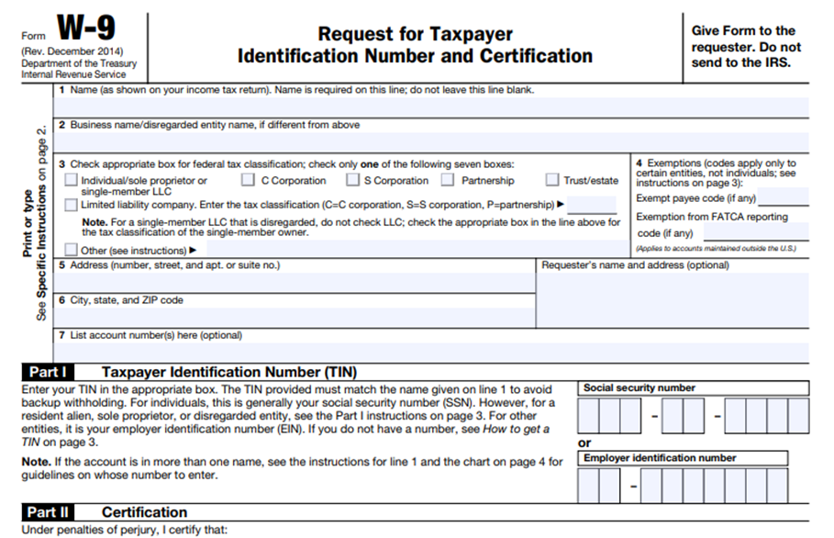

W-9 Form
Complete a W-9 Form for your program
Forms can be downloaded from the IRS website
Make sure the form is complete. An incomplete W-9 will cause a delay in processing your application.
Line 1 must match the check payable to in the application.

Slide 8
Unique Entity Identifier (UEI)
Unique 12 character ID to identify your business for federal funds
FREE to get a UEI
Tip sheet is available on Gateways website under the Smart Start menu

Slide 9

Certificate of Good Standing
Required unless you file your taxes and W-9 as a “sole-proprietor” with the Internal Revenue Service (IRS)
See Line 3 on the W-9
www.ilsos.gov/corporatellc/

Slide 10

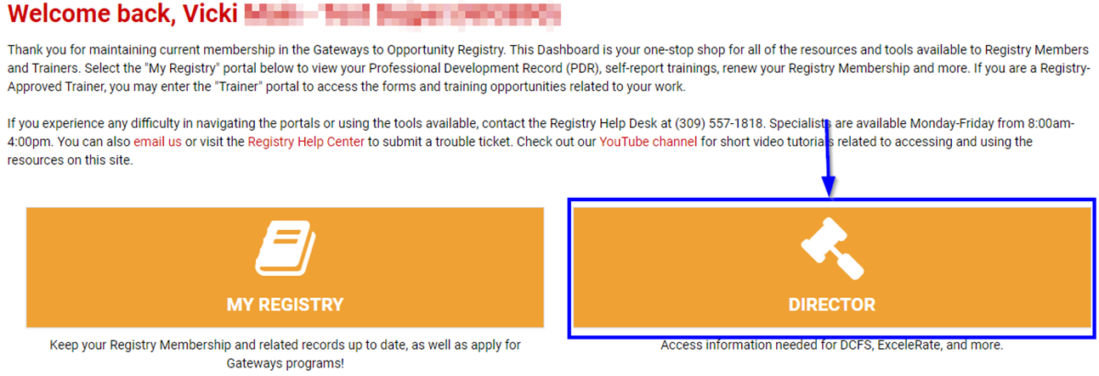
Step 1 – Log in to Director Portal
Go to https://registry.ilgateways.com
Click on “Dashboard Login”
If you do not see the DIRECTOR card, you must request/renew access

Slide 11
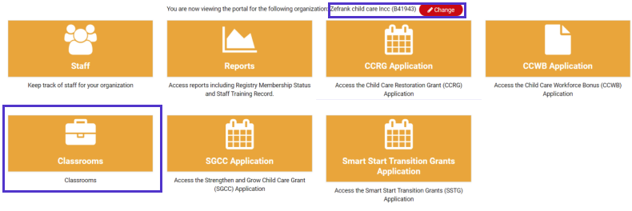
Step 2 – Add Classrooms (Licensed Centers only)
Click the “Director” card
Check that the program listed is correct
If you are the contact for several programs, click the Change button and select the appropriate program from the drop-down listing
Click the “Classrooms” card

Slide 12

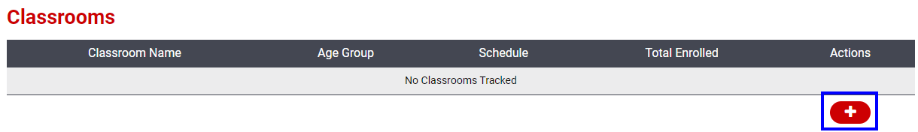
Adding Classrooms
Add all classrooms that are currently open and operating full-day and full-year
Click the “+” to add a new classroom

Slide 13
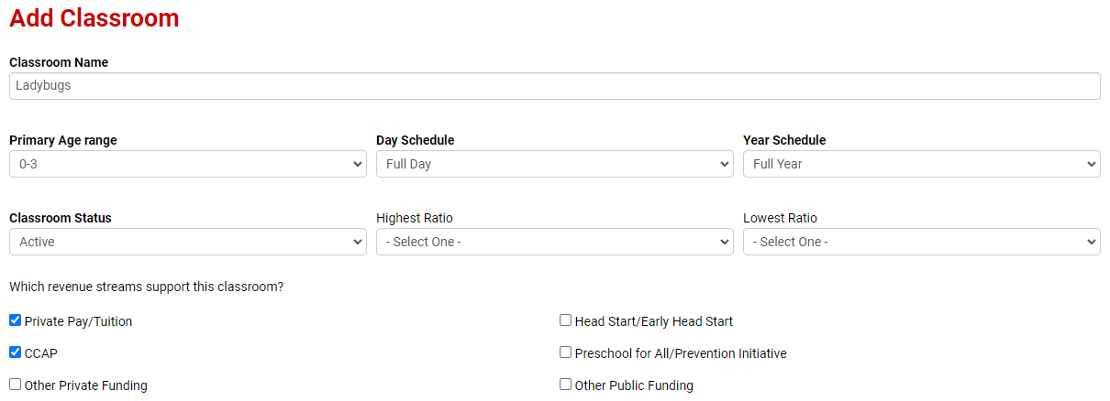
Complete the main classroom information

Slide 14
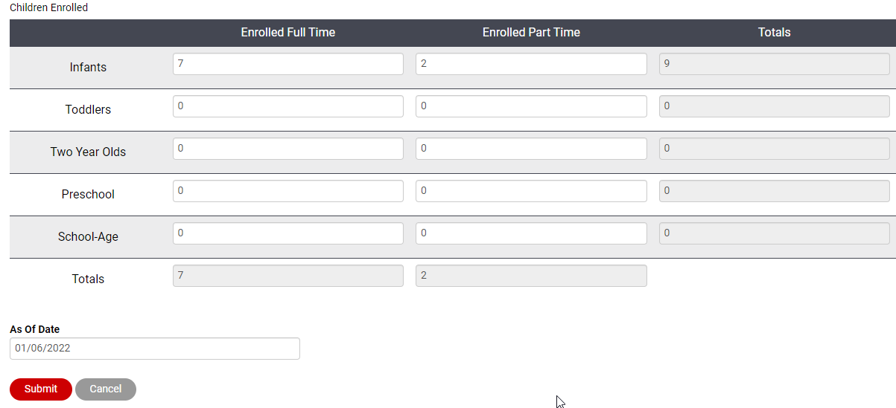
Enter current enrollment and “as-of date”

Slide 15
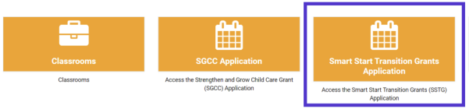
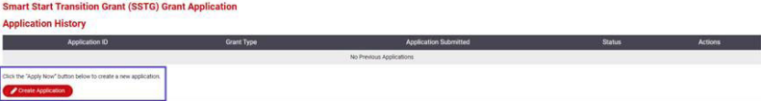
Step 3 – Complete the Application
Go back to the Director Portal
Click the “Smart Start Transition Grants Application” card
Click the “Create Application” button

Slide 16
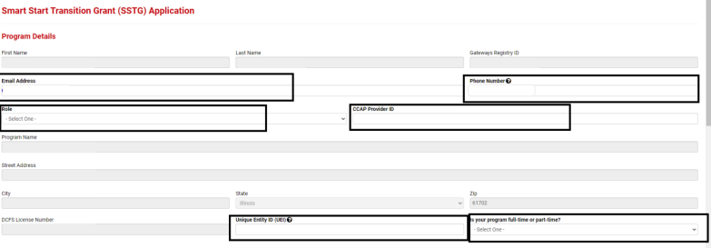
Program Details
Check the Program Name and Address to be sure you are applying under the correct program
Enter the requested information:
Email address
Phone number
Role
CCAP Provider ID
Unique Entity ID
Full-Time / Part-Time

Slide 17
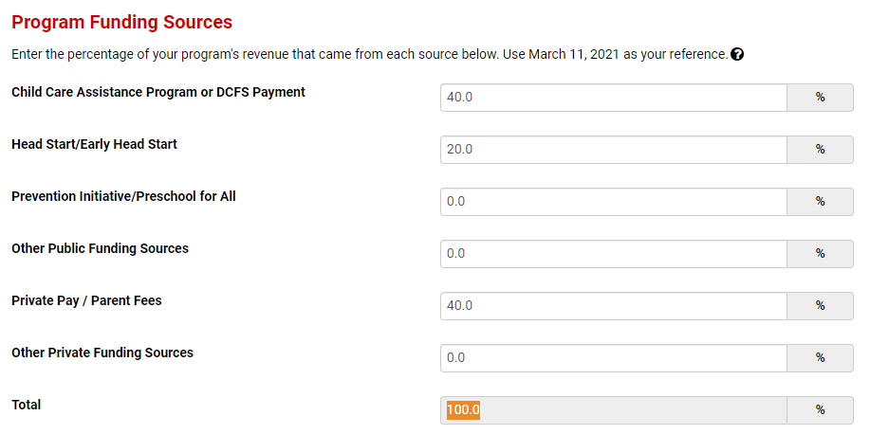
Program Funding Sources
Enter the percentage of your program’s revenue that comes from each of the sources listed – the total must add to 100%

Slide 18
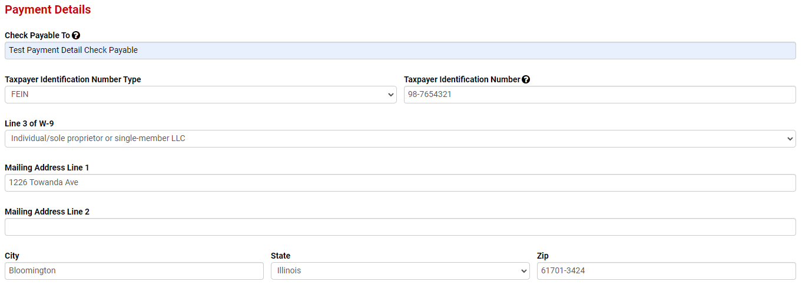
Payment Details
Enter the required information in this section.
It is very important that the first 4 items match what is listed on your W-9!
Enter the mailing address – this is where the check will be sent

Slide 19
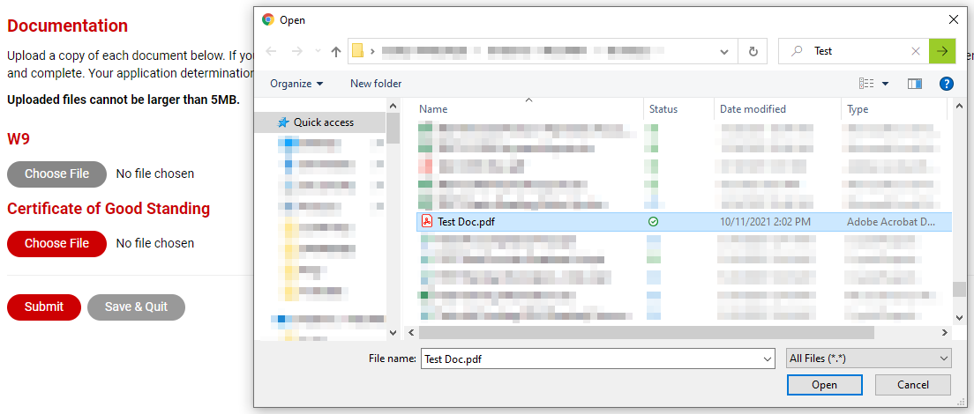
Documentation
Click the “Choose File” button and find where you saved the document or picture on your computer
Double click on the file to add it to the application.
If you need to do more work, click “Save & Quit” to come back later; otherwise, click the “Submit” button
Note: You will only be asked for a Certificate of Good Standing if required based on your tax filing status

Slide 20

Don’t forget the next step…
PLEASE TAKE NOTE!
There is an additional step you must take after submitting your application
Click the link in the confirmation message to move to the next step and submit a budget request
You can also submit a budget request by clicking the calculator icon next to your application

Slide 21
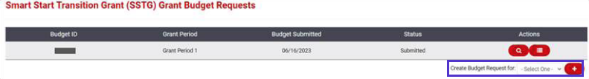
Step 4 – Submit Budget Request
Select the grant period you are submitting your request for and click the “+”
Note: If you are first applying in Grant Period 2, then create your budget request for Grant Period 2, etc. We cannot accept budget requests for grant periods that have already closed.

Slide 22
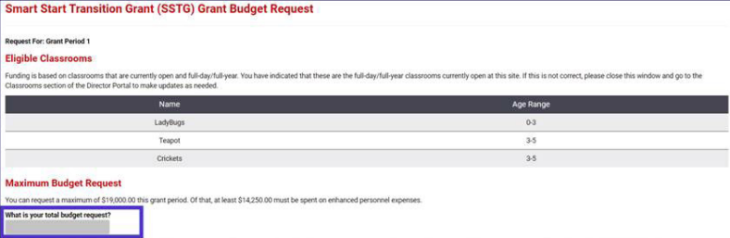
Enter Total Budget Request (Centers)
Review the classrooms listed. If incorrect, go back to Classroom card and revise.
Review the maximum dollar amount listed. You may request the full amount listed, or a lesser amount.
Enter the amount of your request for this grant period.

Slide 23
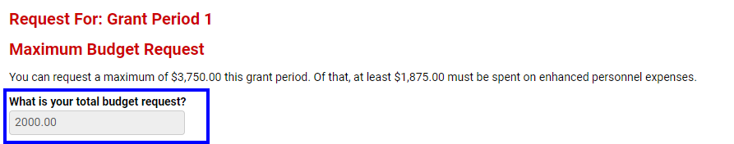
Enter Total Budget Request (Homes)
Review the maximum dollar amount listed. You may request the full amount listed, or a lesser amount.
Enter the amount of your request for this grant period.

Slide 24
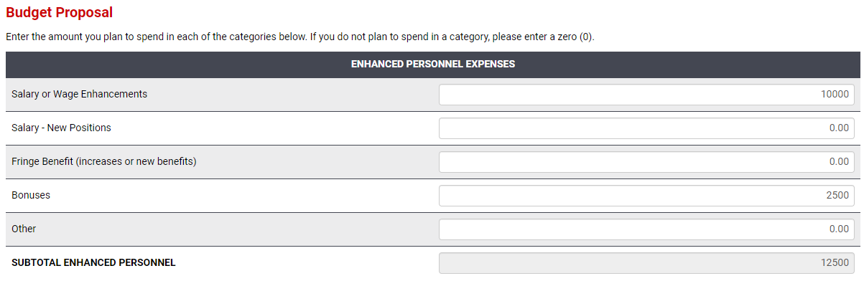
Enter Budget Proposal – Enhanced Personnel
Enter the dollar amount you plan to spend in each of the categories listed.
Review the subtotal to ensure this is at least 75% of your total budget request.

Slide 25
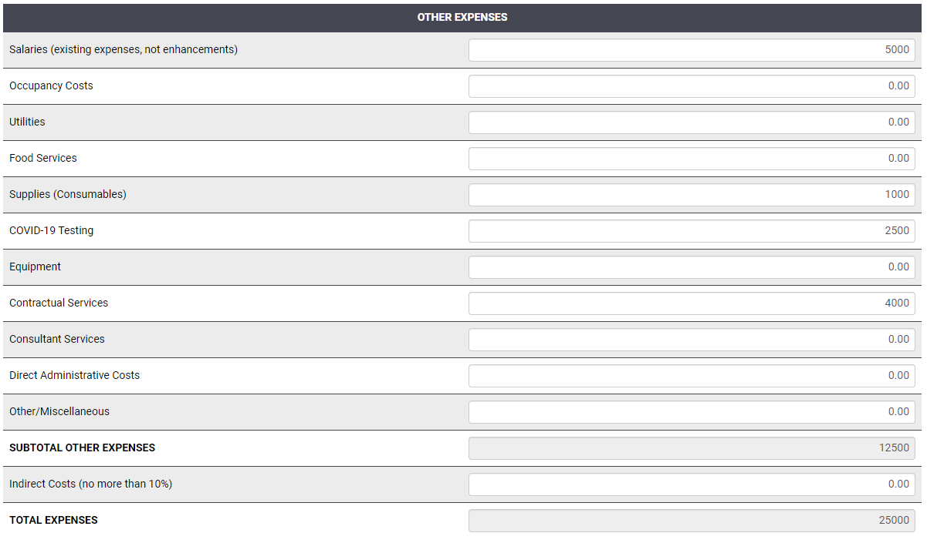
Enter Budget Proposal – Other Expenses
Enter the dollar amount you plan to spend in each of the categories listed.
(Indirect Costs will appear for centers only.)
Review the total expenses to ensure it is equal to your total budget request.

Slide 26
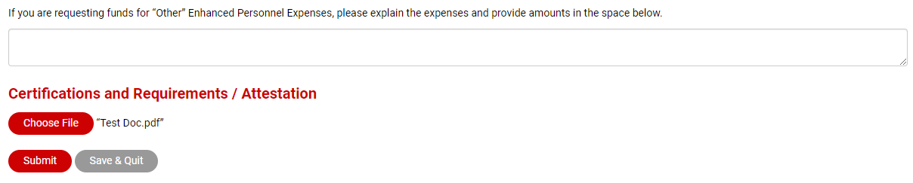
Documentation
Provide explanation if you are requesting funds for “Other” Enhanced Personnel Expenses.
Upload your signed attestation document for this grant period.

Slide 27
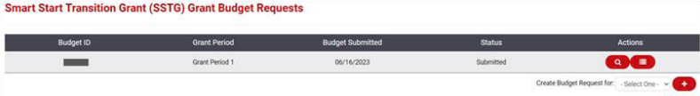
Viewing Budget Request
Once your budget request has been submitted, it cannot be edited. If you would like to review your request in read-only mode, click the magnifying glass icon.

Slide 28
What to Expect Next
Applications will be reviewed
INCCRRA will email you to let you know:
If your application is incomplete or clearer documentation needs to be uploaded.
If you need to submit clearer documentation, you will be allowed time to submit additional documentation.
If your application has been found eligible or ineligible.
When your grant payment check has been mailed.
Grant reports will be due by the 15th of the month following the funding period
Example: Round 1 funding is October-December 2023, so reporting will be due Jan. 15th, 2024

Slide 29
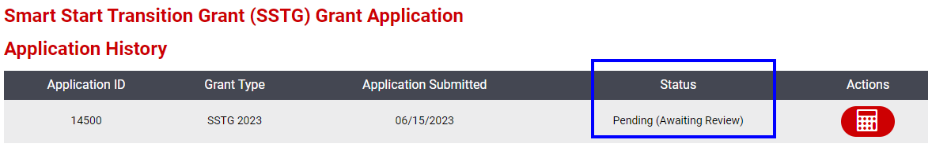
Checking Your Application’s Status

Slide 30
Application Status Meanings
Pending (Online Submission) - You’ve saved your application but still need to finish it and click “Submit”
Pending (Awaiting Review) - You’ve submitted your application and it is in the queue to be reviewed
Pending (Information Required) - Your application is being reviewed and requires some information from you (please check your email for details)
Eligible - Your application is approved, and you will receive payment
Ineligible - Your program does not meet eligibility guidelines (e.g., not a full-time program, has 100% of funding from Head Start, does not meet CCAP requriement) or did not submit required information within the deadline

Slide 31
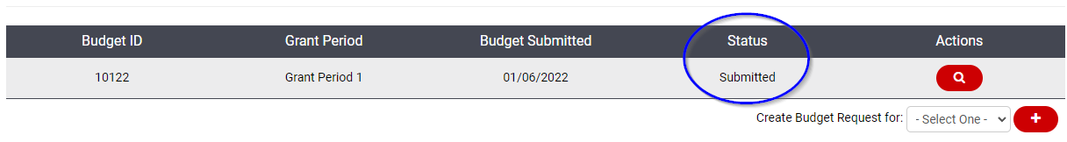
Budget Status Meanings
Draft - You’ve saved your budget request but still need to finish it and click “Submit”
Submitted – The request has been submitted for review
Approved - Your budget request has been approved

Slide 32
Getting Help
Our Help Desk team is available M-F, 8:00am – 4:00pm
Email us at grants@inccrra.org – this is the fastest way to get a response to your question
We receive many requests when grant rounds open and will work to get you an answer to your question as quickly as possible!

