Slide 1
Welcome to:
Apprenticeship Pilot Advisory Committee Meeting
March 18, 2026
1-2 pm

Slide 2


Agenda
Carole Robertson Center for Learning
IDHS Update
  IDEC
INCCRRA Update
UIC Update
  Conference/Forum Attendance
  Apprenticeship Updates
  National Apprenticeship Week

Slide 3


Carole Robertson Center’s Apprenticeship Journey
1

Slide 4
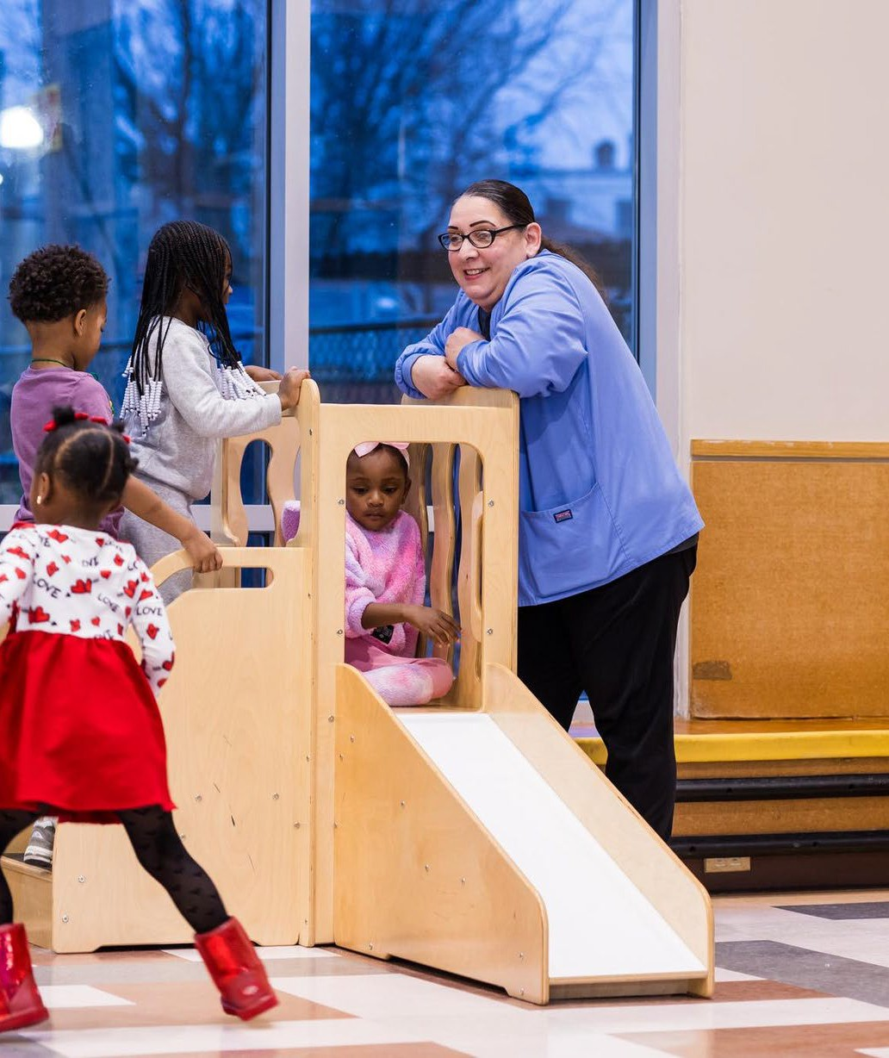
Participant Numbers
28 Total Apprentices
  14 currently in process of getting registered
8 Total Mentors
With expansion into Home Visitor Apprentices coming soon!

Slide 5
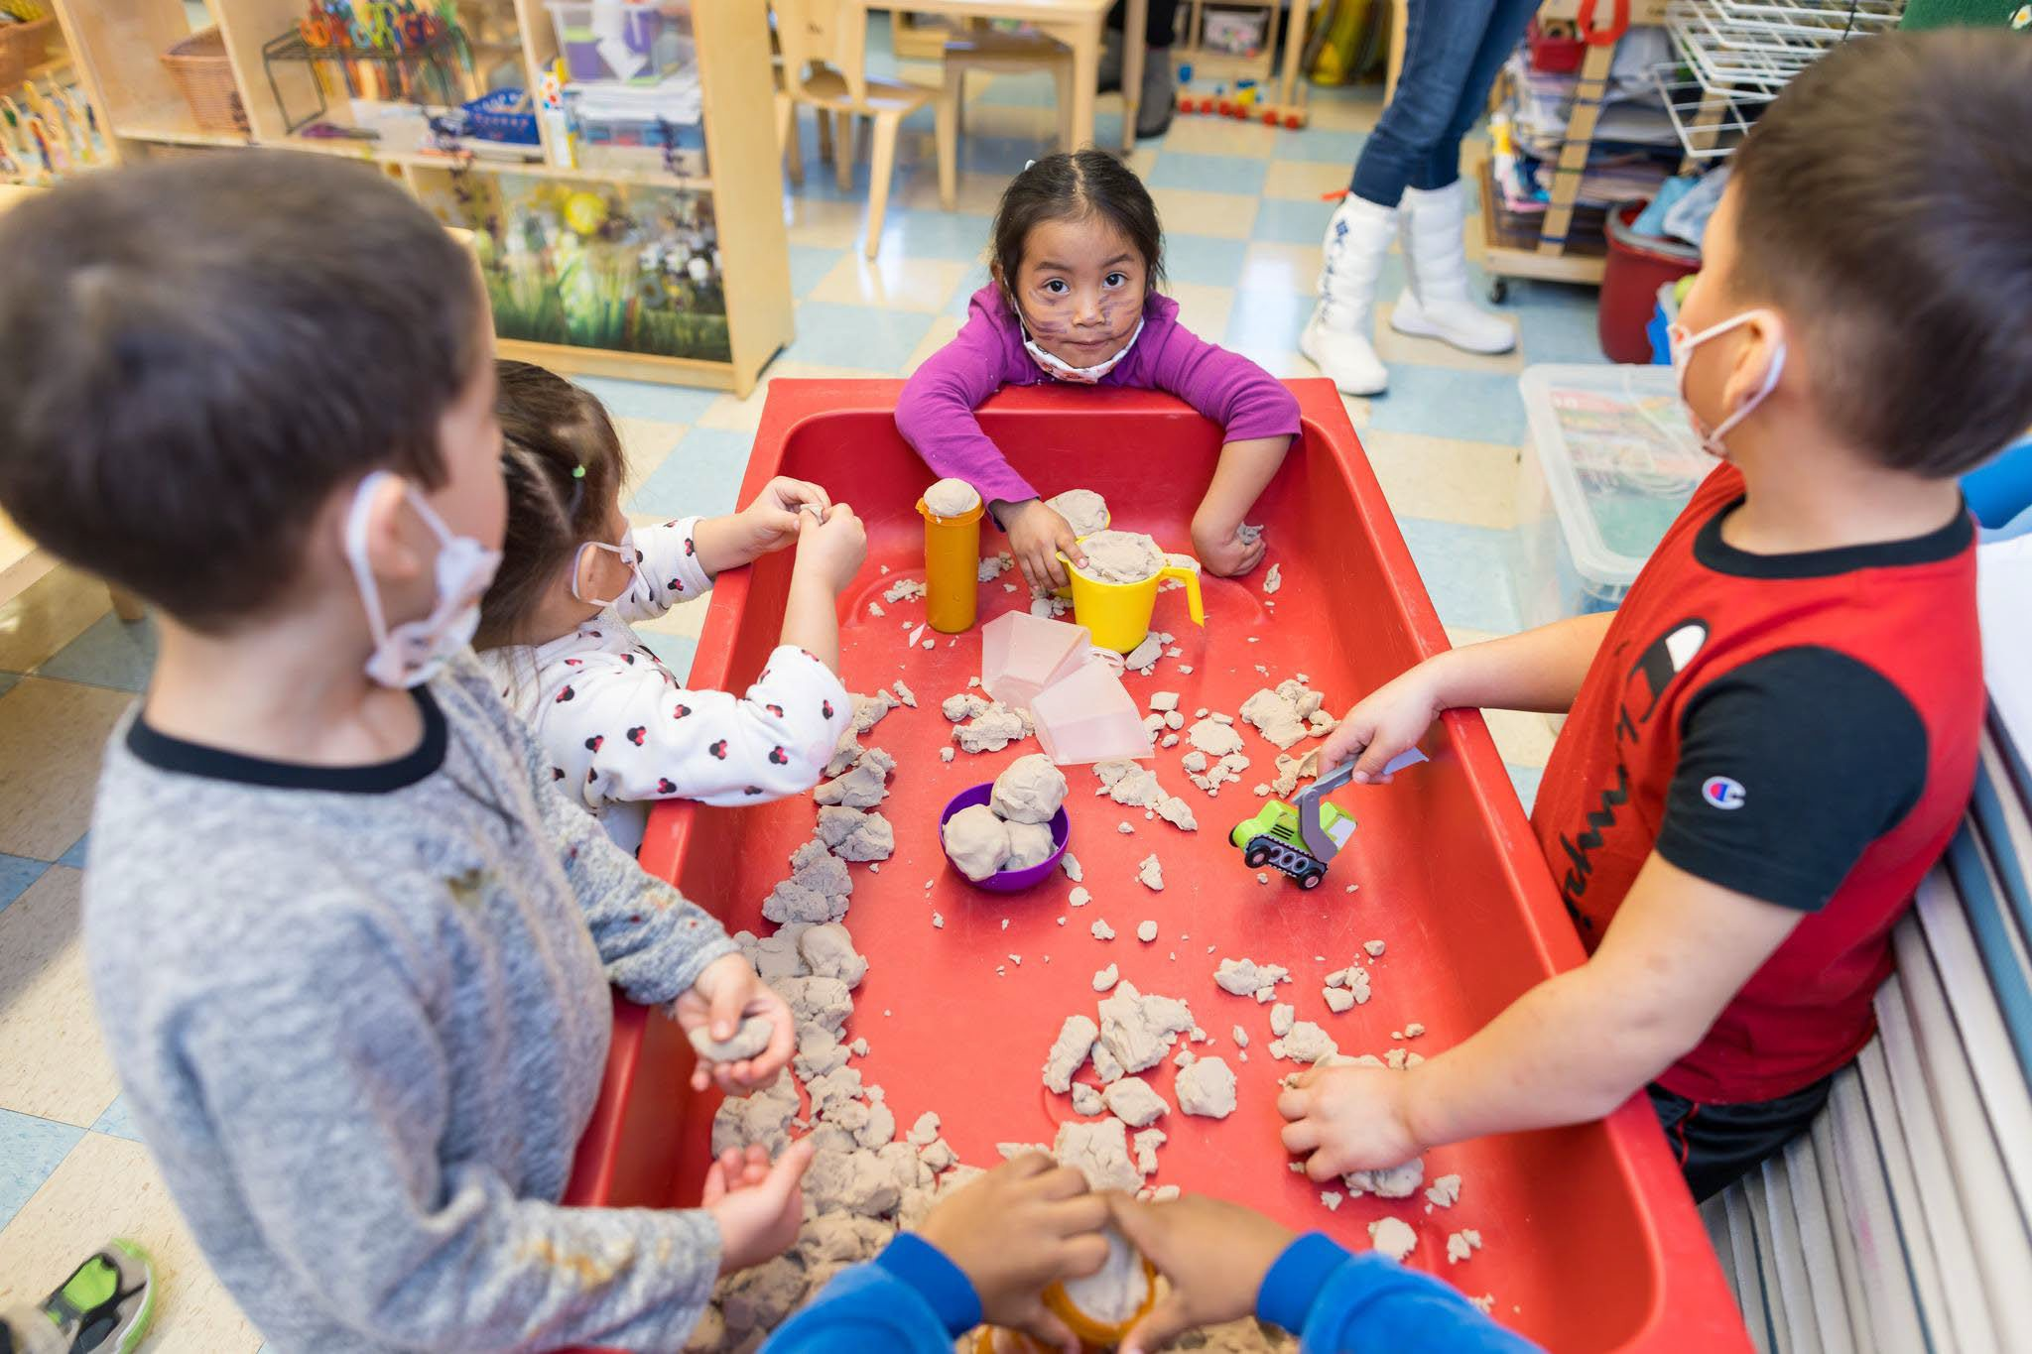

Strides and Bright Spots
Pipeline Program Mode From entry level TransformED apprentice to AA/BA program beginning to operationalize
Cohort Partnerships
Oakton partnership launched in February
Coaching
A model grounded in high touch support

Slide 6
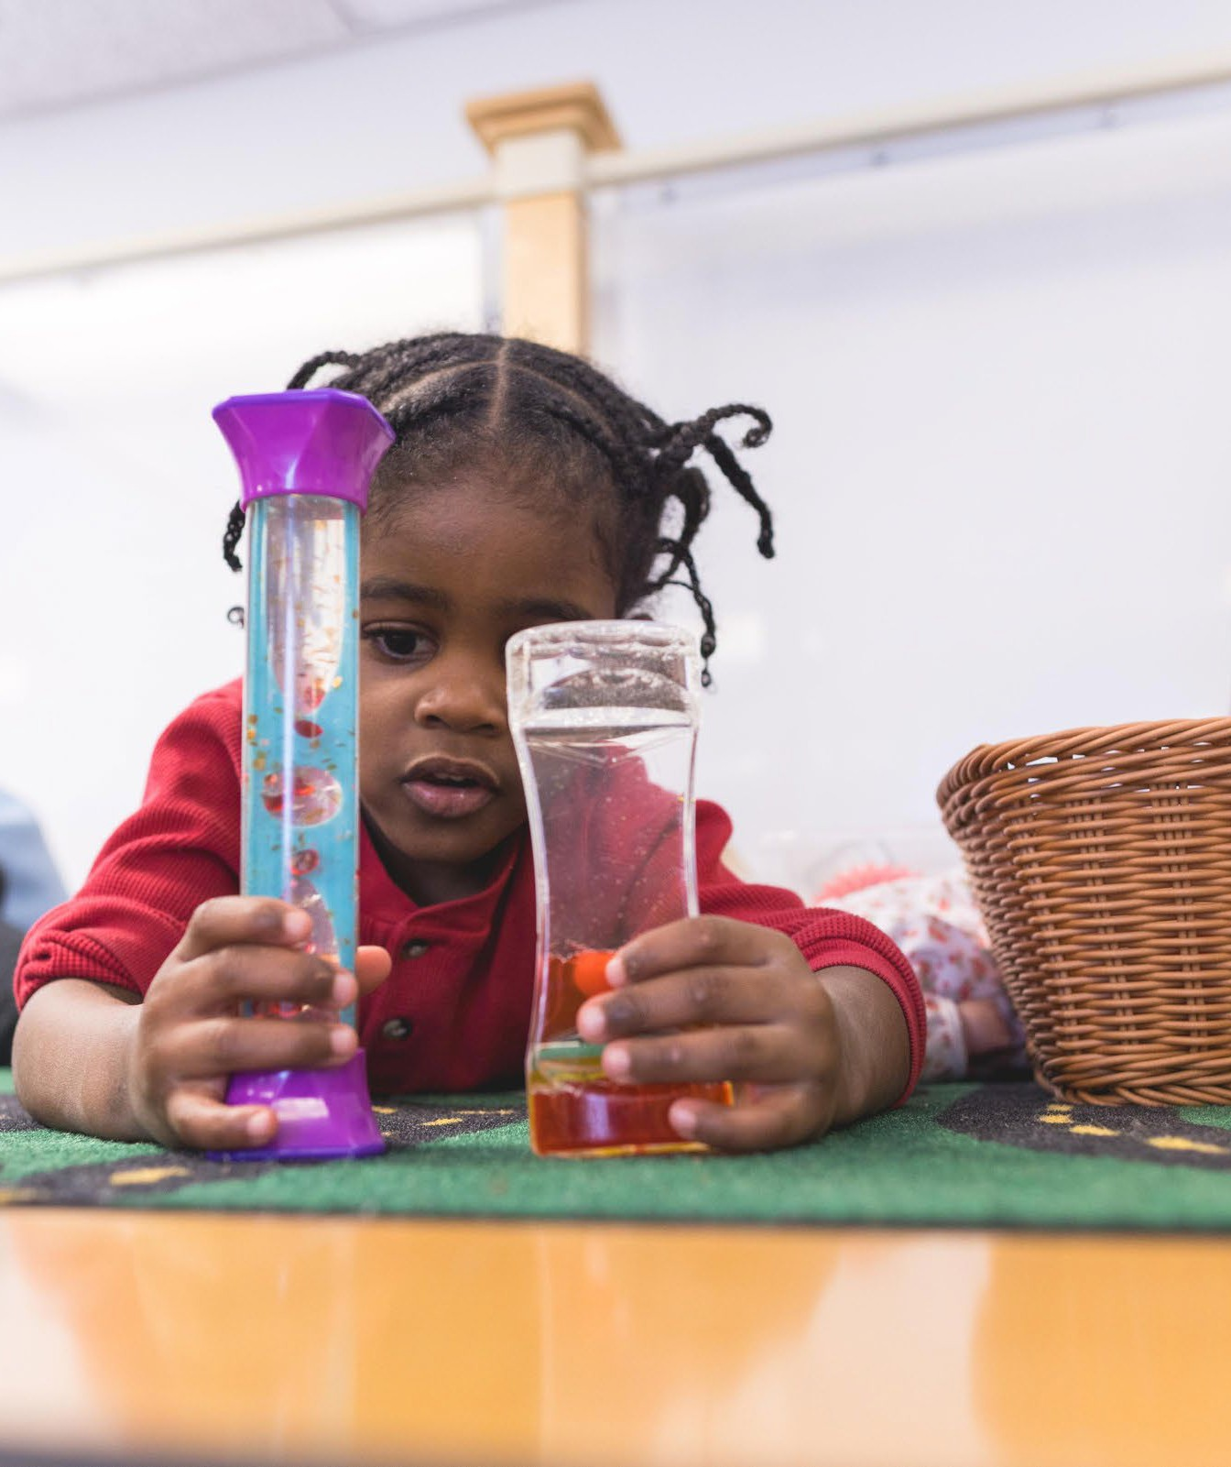
Challenges
Moving from interest to application to registration. (navigators not enough)
Administrative supports increase beyond capacity as the number of apprentice participants increase.

Slide 7
Lessons Learned
Mentorship becomes before apprenticeship, not after
Navigating the system still takes administrator advocacy
Access to bilingual higher education programs boost participation

Slide 8

THANK YOU!
24

Slide 9
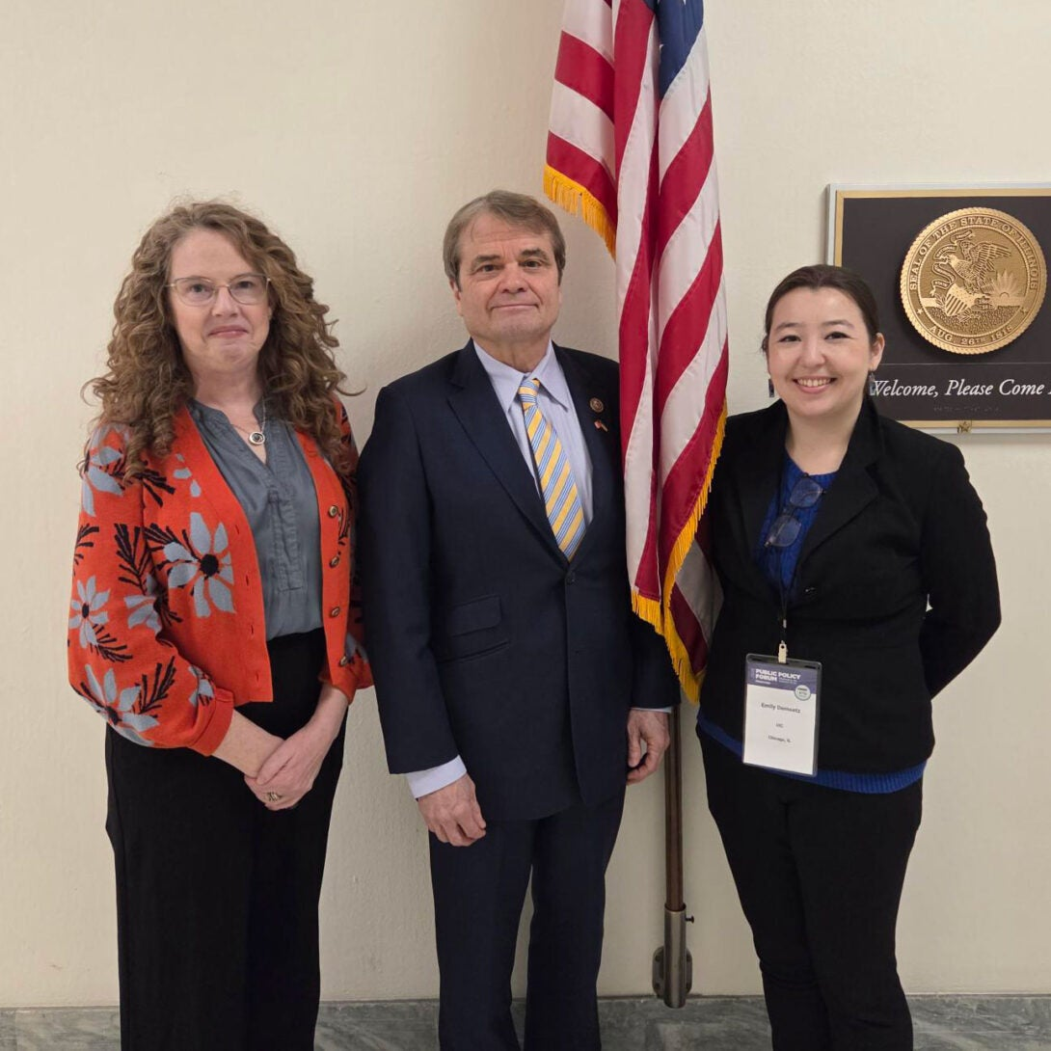
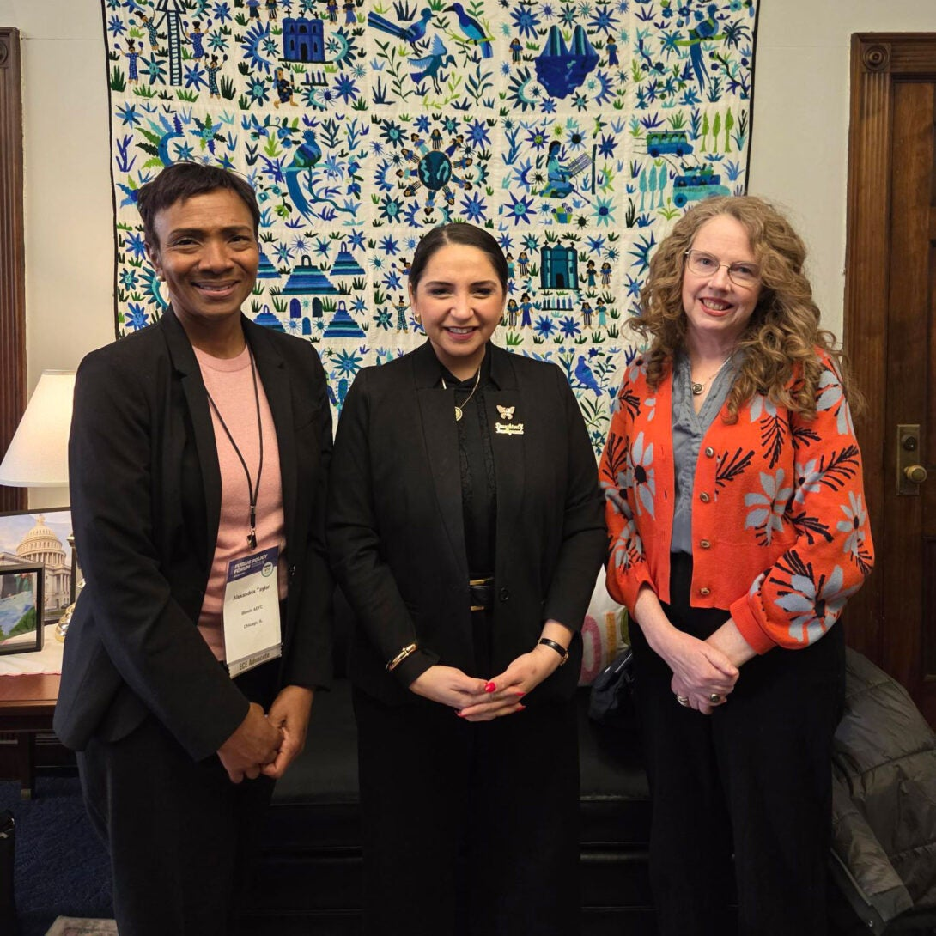
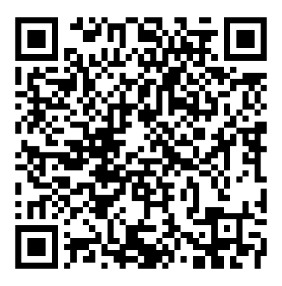
UIC – Updates
Conference and forum attendance
  NAEYC Public Policy Forum – Washington, D.C. – see pictures at left
  ECEPTS National Conference – San Diego, CA
Apprenticeship updates – now reaching 60+ apprentices as interest grows both within and beyond Smart Start programs
  Number of participating programs has more than doubled with addition of new sites, non-Smart Start, in green
  UIC Children’s Center
  Gads Hill Center
  Little Folks Daycare
  Onward Neighborhood House
  Carole Robertson Center for Learning
  Heartland Child Development Lab
  It Takes A Village
  SAL Community Services
  Marillac St. Vincent
National Apprenticeship Week coming up: April 26-May 2, 2026
  One of our Smart Start apprentices will be on “Ask An Apprentice” webinar with ECWC and Midwest Urban Strategies on April 29th, 2026
  Opportunities to participate – proclamations
National Apprenticeship Week – Event & Proclamation Resources

Slide 10
Thank you!

