Slide 1


Illinois Early Childhood Apprenticeship Project (IECAP) Pilot
Apprentice Kick-Off Meeting

Slide 2
Apprenticeship Pilot Program Team
Michelle Wood, Lori Harrison (Illinois Department of Human Services – Early
Childhood Division)
Toni Porter, Annie Connell, Courtney Kirk (Illinois Network of Child Care
Resource and Referral Agencies, INCCRRA)
Karen Yarbrough, Cathy Main, Karee Clarke, Nikole Powell (University of Illinois
Chicago, UIC)
Kate Connor (City Colleges of Chicago, CCC)

Slide 3
Apprenticeship Pilot Program: Participating
Apprentices, Mentors and Site Leaders
Carole Robertson Center for Learning - Chicago
Heartland Community College Child Development Lab - Normal
It Takes A Village Family of Schools - Chicago
Skip-A-Long Childhood Centers - Moline

Slide 4


EC Workforce: Critical Ingredient of High-Quality Programs
A workforce that is knowledgeable, skilled and consistent—and reflective of the diversity of the children they serve—is the most important predictor of high-quality early learning environments that lay the foundation for success in school and beyond.
Your commitment to the Apprenticeship Program will make a difference for Illinois' youngest children and yourself!
Notes:
Key Message:
The workforce members are the most important part of the work

Slide 5





Five Key Components of
Registered Apprenticeship
Industry Recognized Credentials, Degrees, and Licenses
Apprentices obtain Gateways to Opportunity Credentials, degrees and Professional Educator Licenses (PEL)
Classroom-based Instruction
Participating Gateways entitled 2- and 4-year institutions provide instruction leading to degrees and credentials funded through existing scholarship programs.
Structured On-the-Job Learning
Designed by participating IHEs, supervised by mentors trained and supported by IHEs/Intermediary.
Financial Rewards for Credentials and Degrees
Beneficiary agreement with employer detailing funding for wage increases based on Gateways Credentials and Degrees.
Employer Involvement
Employer signs on to Apprenticeship Agreement, identifies site based mentors, promotes workplace conditions that support professional learning.
Notes:
How:
To meaningfully address the well documented and systemic early childhood education (ECE) workforce crisis, Illinois must implement a full complement of coordinated strategies to confront the specific challenges faced by the field. Based on the challenges currently faced by the field and existing initiatives, the Illinois Department of Human Services (IDHS) Division of Early Childhood (DEC) would like to roll-out:
An apprenticeship model to bridge and connect scholarship programs leading to credentials and degrees with on the job/real world training and mentorship tailored to the context of the specific communities where apprentices work; and
Couple those with the expansion of child care program contracts, specifically targeted to support funding for increased compensation directly connected with increased qualifications.
This complements and supports the compensation side of ECACE and other scholarship opportunities and provides the missing employer supports to get providers on board with sending their staff back to school as well as bringing a new generation of caregivers and teachers into the workforce.

Slide 6
Equity Statement
Our Illinois Early Childhood Apprenticeship Pilot (ICEP) programming as well as our general approach to innovative reforms for early childhood systems build on the equity principles developed for UIC’s Alternative Licensure Program. These include:
• Explicitly stating that our childcare workforce crisis is rooted in historic racism and sexism and, as such, our workforce has had limited access and opportunity to advance their education and as frontline workers have borne the burden of a broken early childhood system;
• Inverting the deficit models of professional development and instead focus on strengths and
assets, particularly the community cultural wealth of our incumbent workforce;
• Intensive support at the place of employment. This includes careful consideration of the
workplace conditions that support the professional development of the workforce; and
• Inclusion of a developmental and longitudinal evaluation that includes surveys, focus groups and individual interviews to elevate their voices, expertise, and needs.
Illinois State Board of Education (Equity Standards) - https://www.isbe.net/Pages/Culturally-Responsive-Teaching-Leading-Standards.aspx
Illinois Early Learning Council - https://oecd.illinois.gov/early-childhood-racial-equity.html#:~:text=As%20part%20of%20the%20Council's,the%20development%20of%20young%20children.

Slide 7
IHE Commitment
Prepare Apprentices for admission to ECE program of study
Assist Apprentices in accessing existing scholarship opportunities (Early Childhood Access Consortium for Equity (ECACE) Scholarship, Gateways to Opportunity Scholarship Program (GSP), Chicago Early Learning Scholarship (CELS))
Administer Credential and Degree coursework including award of credit for Prior Learning Experiences
Provide academic advising, tutoring as necessary
Contextualize curriculum as needed
Coordinate between faculty and on-site mentors
Award Credentials and Degrees in Early Childhood Education
2- and 4-year Institutions of Higher Education:
City Colleges of Chicago
Blackhawk College
Heartland College
National Louis University
Western Illinois University
University of Illinois Chicago
Notes:
Participating programs have agreed to

Slide 8
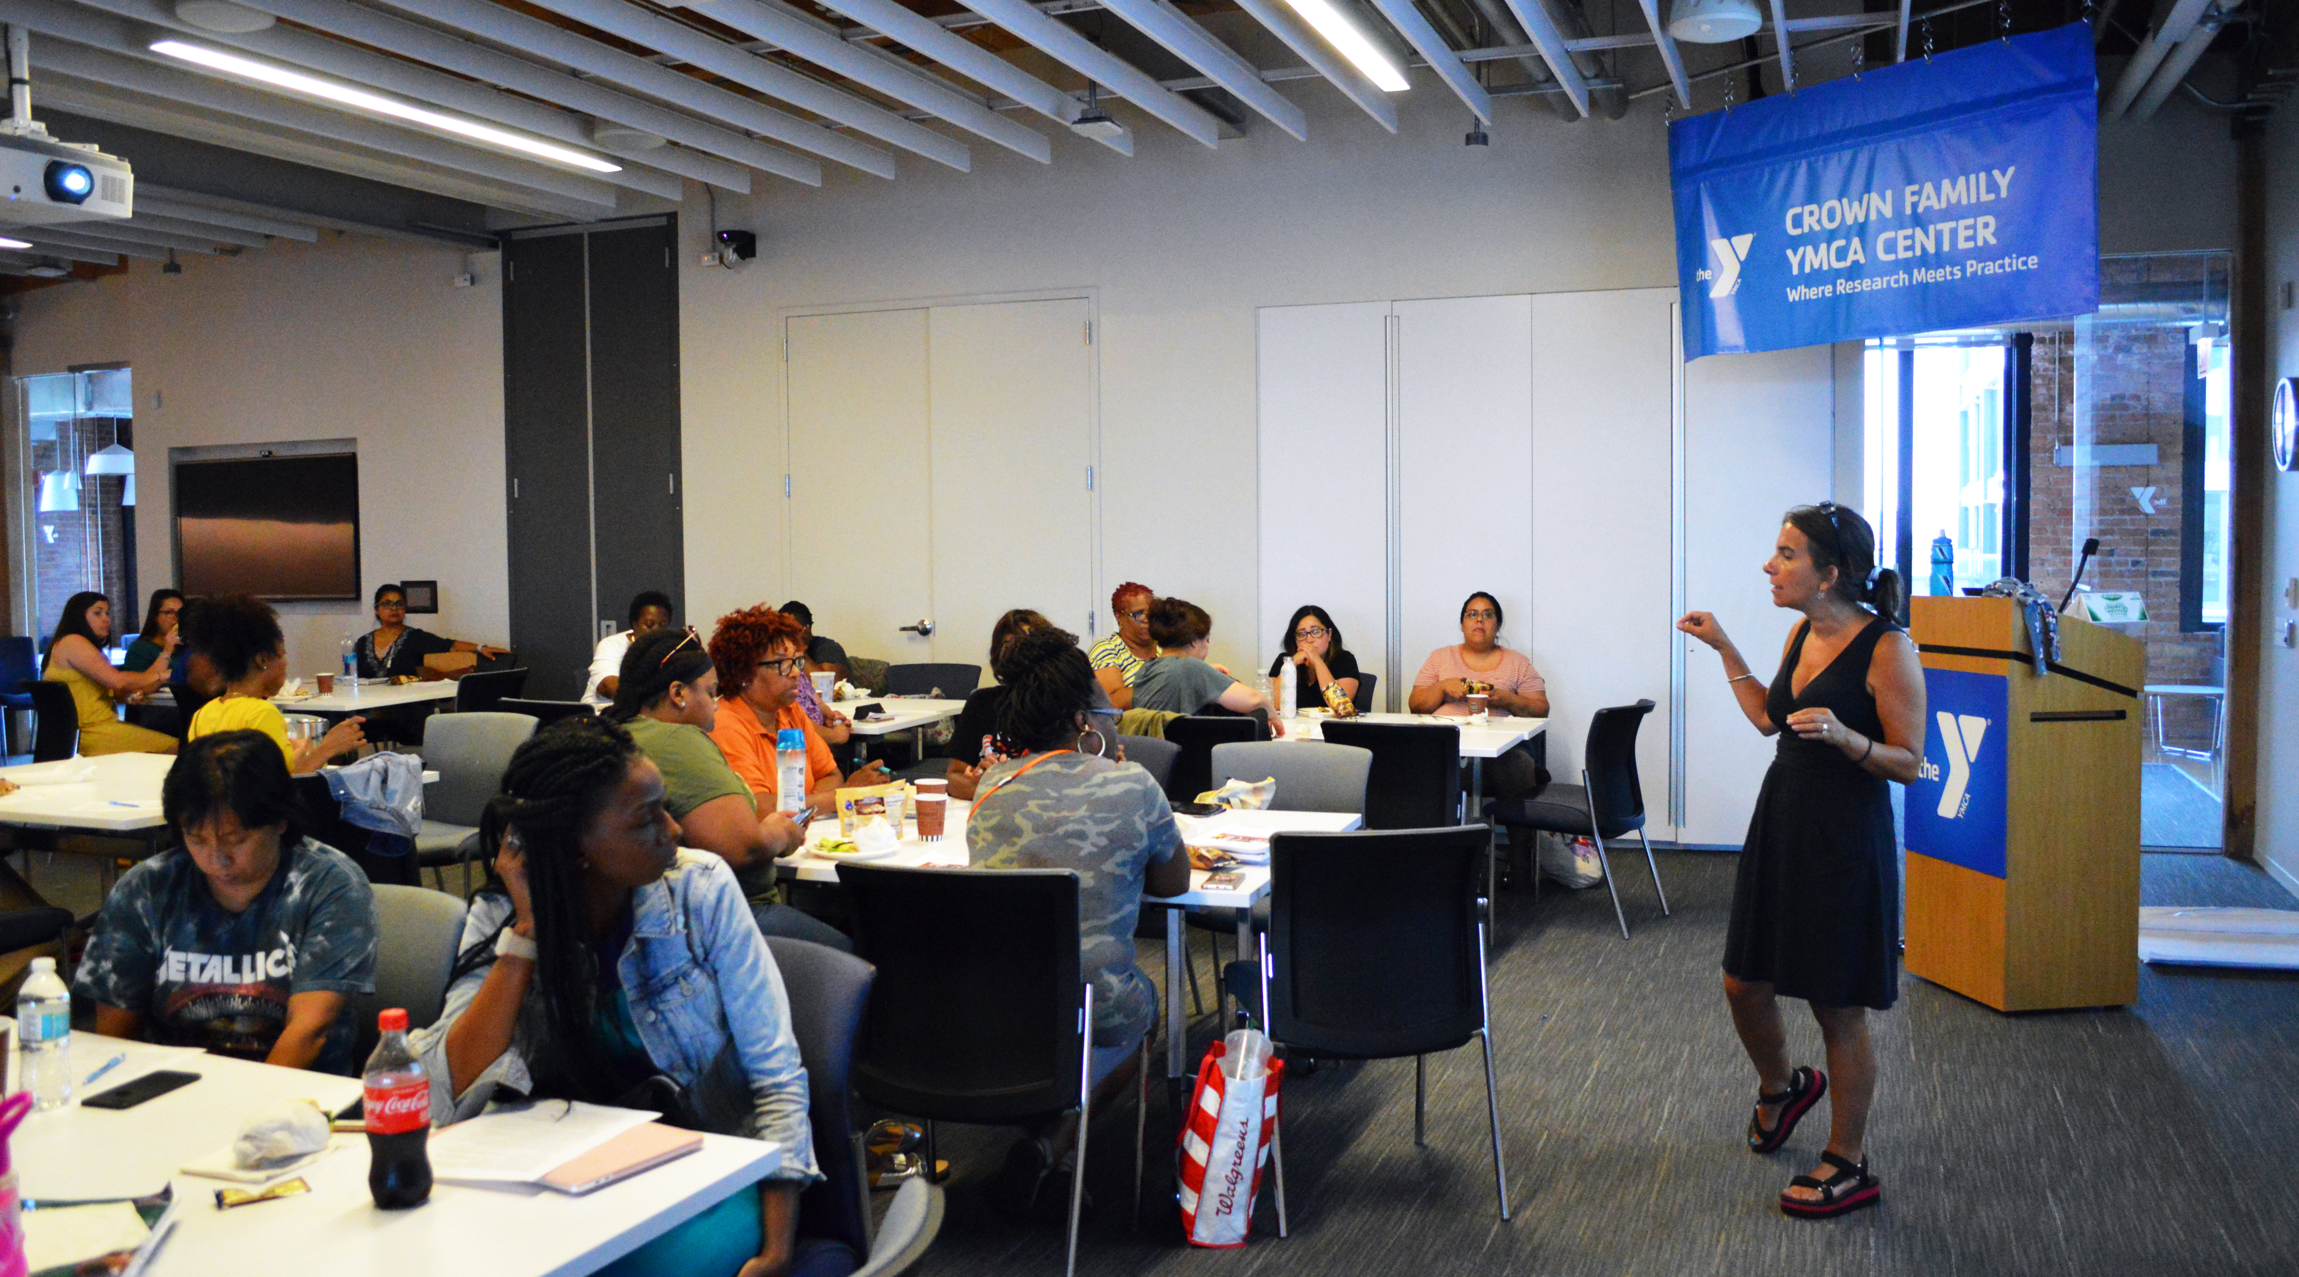
Role of Mentors
Site-based Mentors will:
  Participate in UIC credit bearing course to support development of competencies needed to be a mentor teacher ​
  Provide reflective supervision to apprentice(s) ​
  Provide other needed support to apprentice and make connections to other resources to support persistence and success of apprentices.

Slide 9
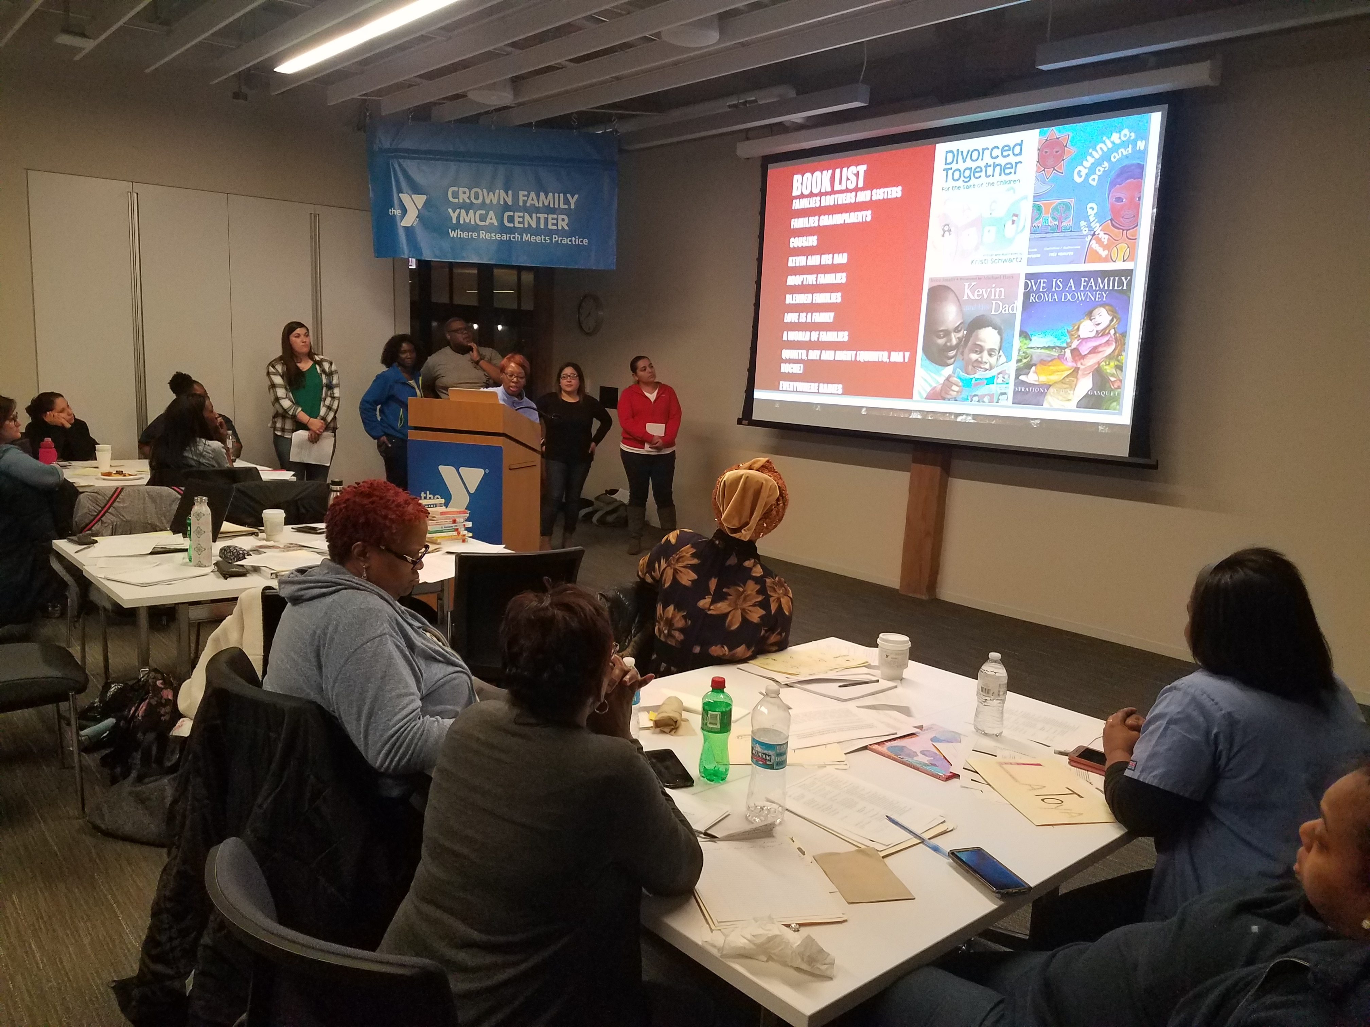
Shared Commitment to Learning
A commitment to documenting, collecting, and sharing data and information on the apprenticeship pilot and engaging in collaborative planning with apprenticeship intermediary (UIC)
Participating in Communities of Practice for Program Leaderships and Faculty from Institutions of Higher Education
Participating in the SEQUAL (Supportive Environmental Quality Underlying Adult Learning) survey, developed by the Center for Study of Child Care Employment (CSCCE) to examine early educators’ perspectives on their own work environments. ​
Notes:
Need info

Slide 10
Website, Contacts
https://www.ilgateways.com/smart-start/illinois-early-childhood-apprenticeship-pilot
General pilot information, Advisory Committee information, links to participating pilot programs and higher education partners
Questions can be directed to:
apprenticeship@inccrra.org
If you are an Apprentice who is interested in taking coursework for the pilot, please contact us for more information about a special opportunity available through the Gateways Scholarship Program.
Notes:
This slide will talk about the website and list who to contact for various situations.

Slide 11
Questions????

