Slide 1

FY27 Information and Updates

Slide 2

Agenda
Introductions
IDHS/IDEC updates
FY27 information and updates
Reporting reminders
Gateways Scholarship Program information
Updates from employer programs
Questions

Slide 3

Introductions
Name, position, program

Slide 4
IDHS/IDEC Updates

Slide 5

FY27 Information and Updates
Program Name
Beginning July 1, 2026, the program will be called the Smart Start Illinois Early Childhood Apprenticeship program.
Reporting Deadline​
All monthly reporting will now be due on the 10th of each month.
Credential Awards
Pay rates should be adjusted in the first full pay period following the award of a Gateways Credential.
Salary Scale
The new scale now includes a column that notes the fixed add-on rate.

Slide 6
FY27 Information and Updates
Travel
If you have approved travel dollars in your budget, all out of state travel must have approval prior to the expense being incurred.
Quarterly Budget Meetings
Just like FY26, we are planning to touch base quarterly about budgets.
Late Reporting/Corrections
Late submission of reporting or corrections will result in a delay of payment.
Contact Sheet
We will send a contact sheet template via email. Please use this to confirm contacts and email addresses, and to provide phone numbers for staff working on reporting for the Apprenticeship Program.

Slide 7

Reporting Reminders
Pay Rates
Differing pay rates should be reported on separate lines. Overtime pay can be reimbursed at the regular pay rate, so does not need a separate line.
Approved Spreadsheets
Please be sure to review approved spreadsheets along with monthly snapshots. The notes in the spreadsheet highlight items that likely need to be corrected for the next month’s reporting (ie: awarded Credentials, updated degrees, etc.)
Expenditure Rationales
The rationales provided on the expenditures tab should be specific. Lines like Supplies should provide details regarding how the expenditure supports Apprentices in their work as Apprentices and furthers the overall mission of the Apprenticeship program within your site(s).

Slide 8


Slide 9
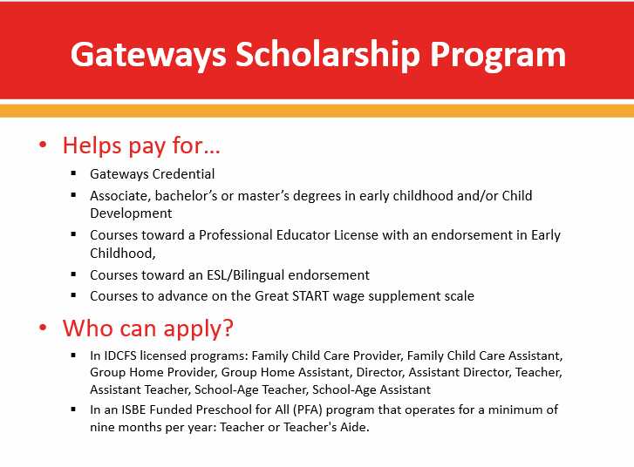

Slide 10
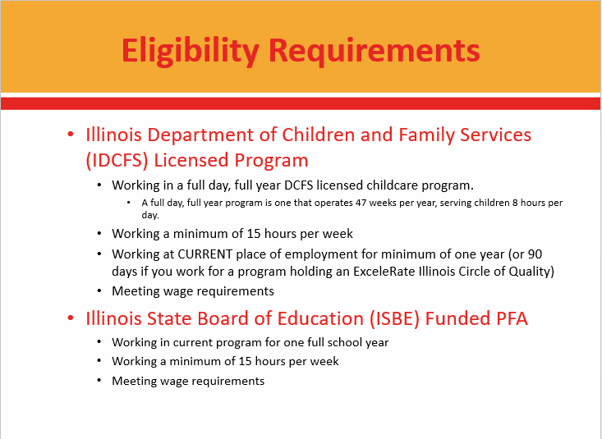

Slide 11
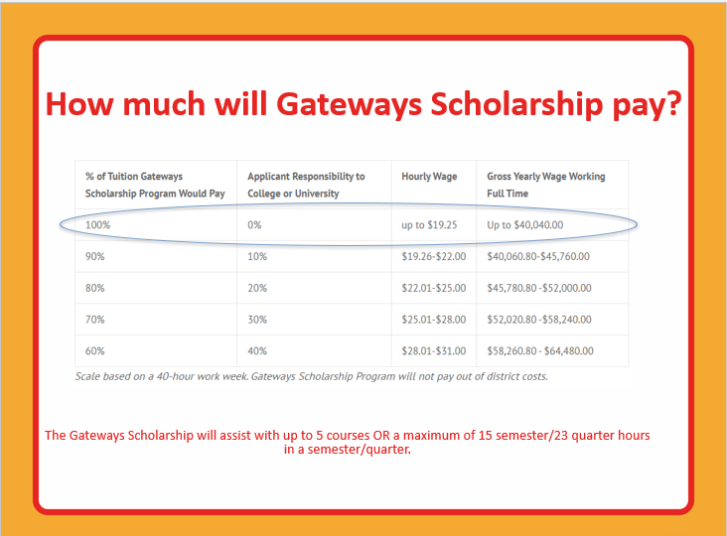

Slide 12
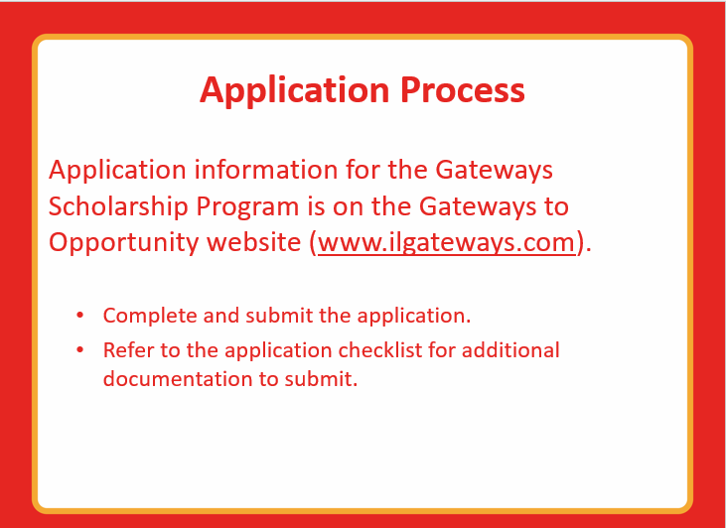

Slide 13
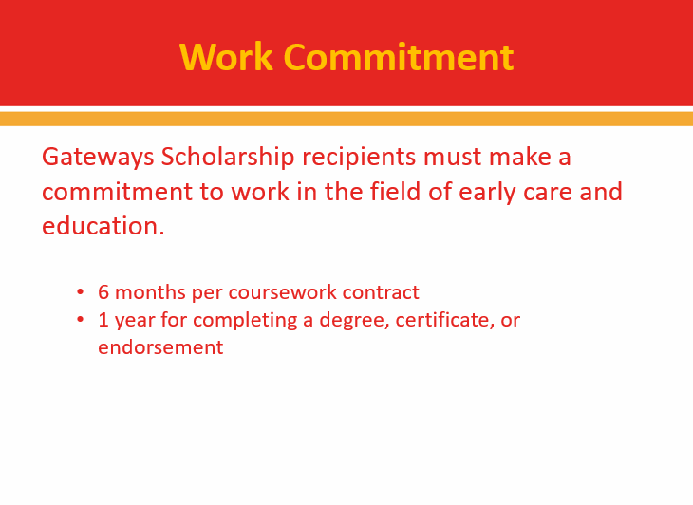

Slide 14
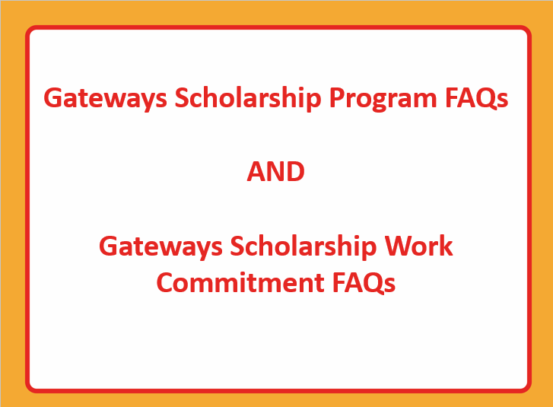

Slide 15
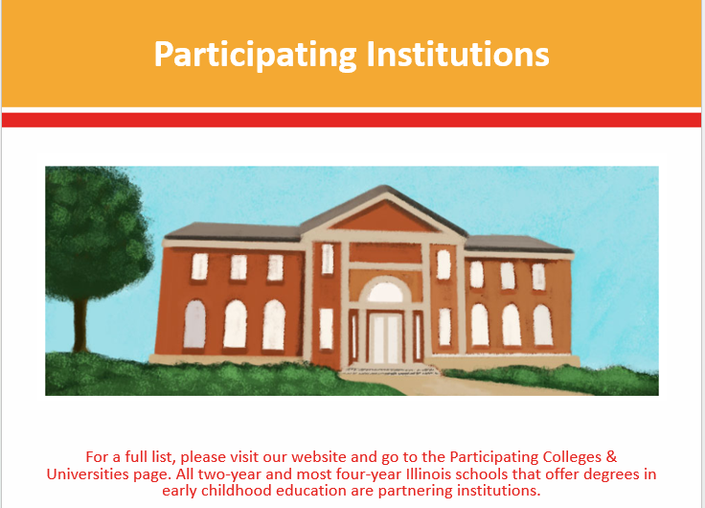

Slide 16


Slide 17
Program Sharing

Slide 18
Questions?

Slide 19


